Slide 1
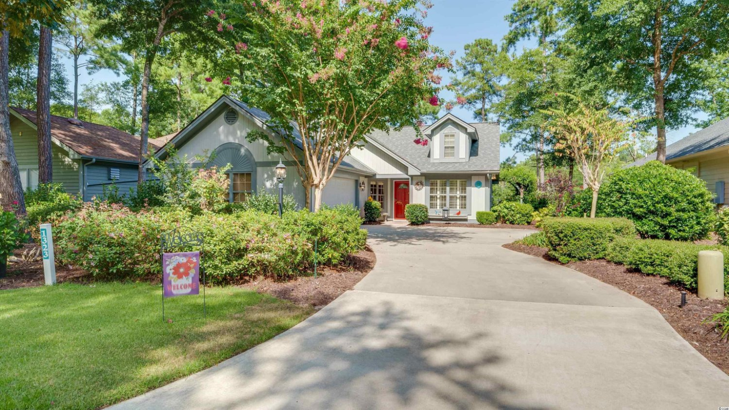
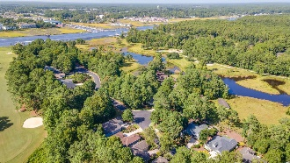
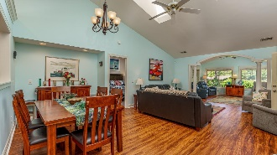
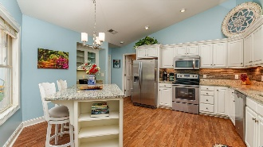
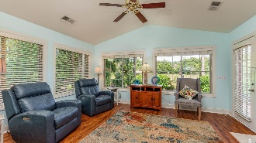
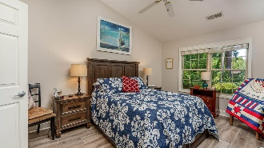
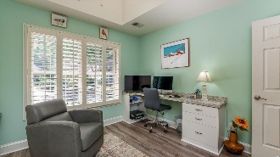
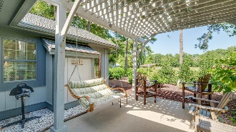
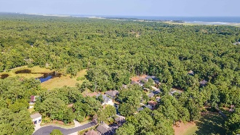
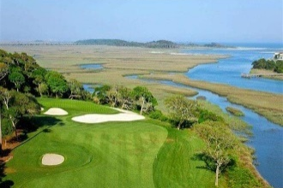
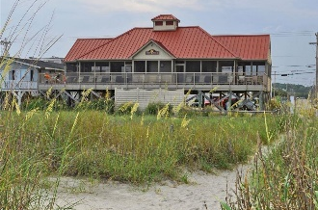



COMPELLING PRICE!
Take a tour today!
1323 Clipper Rd
Tidewater Plantation | North Myrtle Beach SC 29582
MLS# 2119310 | $389,900
With low HOAs & taxes, a homestead exemption when qualified and rich amenities, this home is an excellent investment as well as being highly desirable for a vacation or permanent home. Owners have access to the guest and owners' pools on the Plantation side near the fitness and amenity centers and the tennis courts. NOT IN A FLOOD ZONE. The home has much curb appeal with its pretty cottage exterior and is perfectly located on an impressive lot with much mature landscaping in a park-like setting of mature shrubs, trees and gorgeous flowering plants. The HOA maintains the grass in the front of the house. The home is sold unfurnished; however, there are two really wonderful decorative and functional Murphy beds set up in the second and third bedrooms, one queen and one twin set that will convey, along with all window coverings, major appliances, including washer and dryer, and the Westinghouse generator. The two bedrooms are also set up for studies or offices. Everything is newer, and the roof is 2021. Tidewater HOA documents and more are in Associated Docs. This 3/2 ranch lives large! In addition to the big great room/dining area, there is a Carolina room with gas fireplace; a perfect, cozy enclosed porch; and an irresistable patio featuring a white jasmine-coverd pergola in a private enclave with inviting porch swing...oozes charm...This is a traditional luxury home with lots of upgrades and a flex floorplan for easy, fun living and great for entertaining. The home is immaculately maintained inside and out and a pleasure to show! It is open and incredabily spacious. Noted features include roomy, light and airy master bedroom with en suite, vanity, walk-in shower and large walk-in closet. Closets are plentiful and throughout, including entry and linen closets. The kitchen, morning room, is amazing, too, and completely rennovated. You just have to see it! Notice the beautiful cabinetry, desk, convenient and versatile breakfast bar and pantry. New floors and granite and solid-surface countertops throughout, too! Lots of soaring vaulted ceilings and sky lights add much light and more perceived roominess. There is a separate utility room off the garage and kitchen, making a convenient entry into the home and then through the kitchen into the large, welcoming foyer with red door, opening up encompassing views of the dining area, great and Carolina rooms in the heart of the home and on past to the big rear windows into the tranquil and lovely backyard. Cardinals and bluebirds abound! Much can be said about the contiguous indoor/outdoor living space. Call today for your personal tour, COMPELLING price, also! But see it all for yourself soon. Virtual and real-time video walk-throughs offered of the home & of Tidewater which enjoys many upscale amenities, including owners' beach cabana on the Cherry Grove Beach named the 11th best in the nation, pools & spas, clay- & hard-surface tennis courts, pickle ball, bocce, horseshoes, amenities center, fitness center, driving range and putting green, 24-hour gated & manned security and clubhouse with bar & restaurants. There is even a complimentary gated storage yard for boats, campers, recreational vehicles and the like. The convenient HOA building has rooms for business and other meetings and events and a lending library. Tidewater itself is on a tree-lined road to oceanfront Anne Tilghman Boyce Coastal Reserve, a nature conservancy. It is minutes to the beach, shopping, dining, entertainment, medical services, outstanding schools & parks & access to highways. It represents a lifestyle, to do as much as you desire or to just relax in the pristine surroundings. The jewel in the crown of the development is that private owners' beach cabana on the wide, white sand of Cherry Grove Beach in popular, safe North Myrtle Beach, a top-5 beach town in the U.S. The jewel in the crown of the Plantation of Tidewater is its affordable traditional beauty.
Virtual Tour: https://my.matterport.com/show/?m=bBRLTUvGD21
Video Tour: https://youtu.be/A5ztbIIC674
Connie Ross-Karl
702-306-2643
conniesross@aol.com
Ronnie Nichols
Realtor
Broker in Charge
NEW WAY PROPERTIES MYRTLE BEACH

