Slide 1
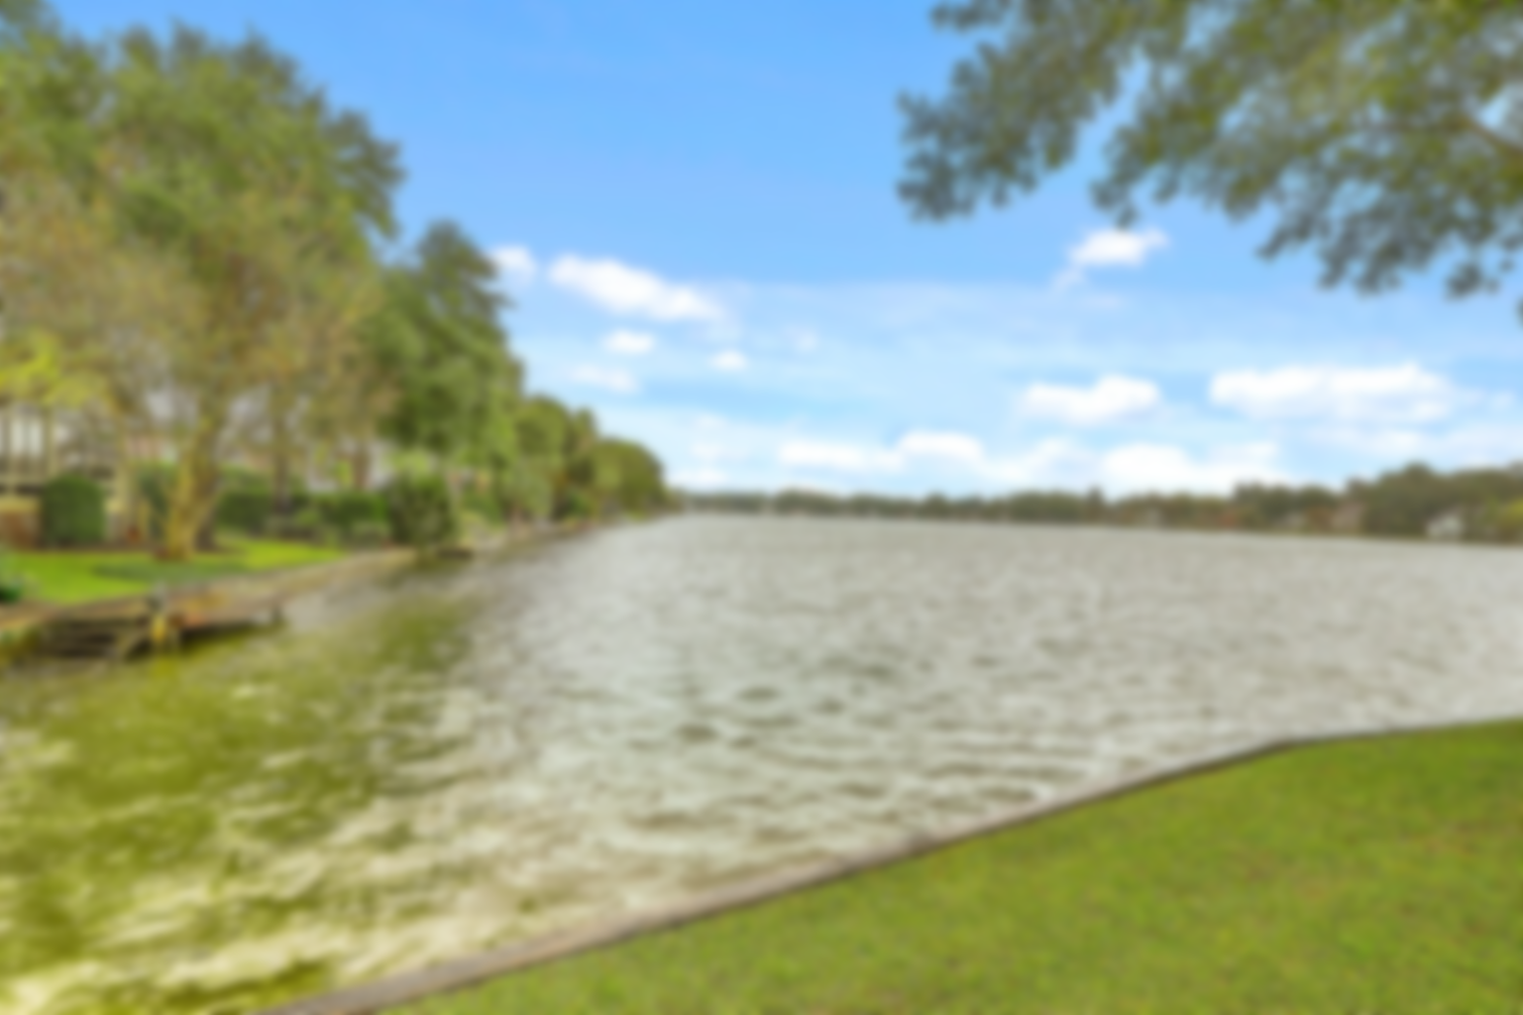
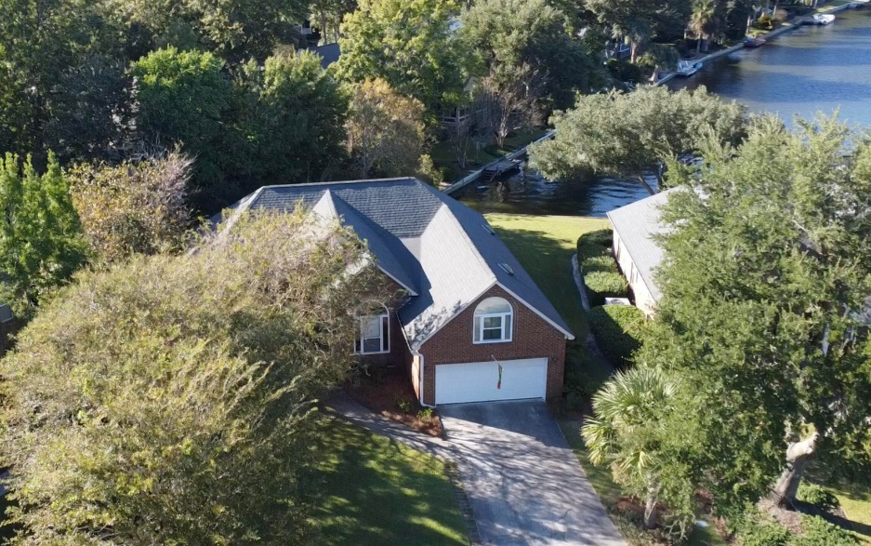
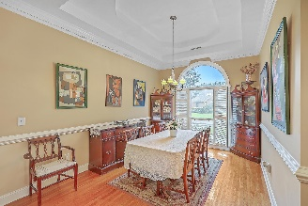
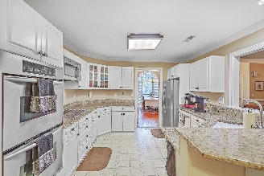
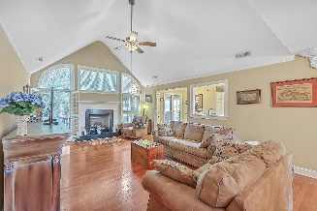
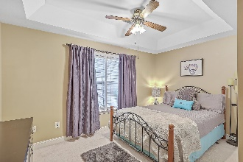
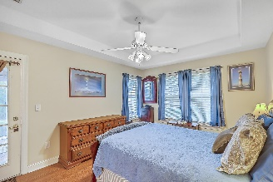
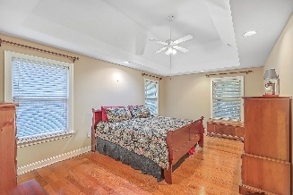
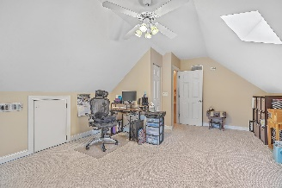
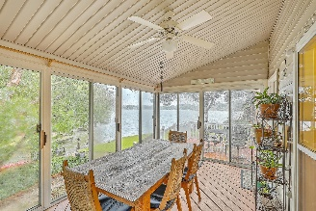
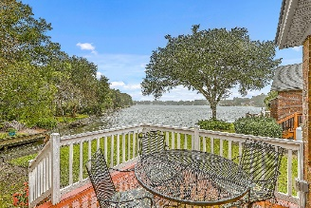
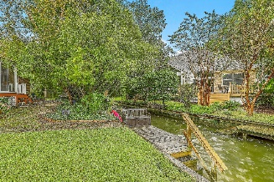

Waterfront Open House Friday 4-6pm!
1323 Deep Water Drive
Lakeshore
Mount Pleasant, SC 29464
MLS# 23023438
$950,000
4 Bed | 2 Bath | 2,275 SF
Waterfront homes in Lakeshore don't come on the market very often! This ranch-style brick veneer home features 3 bedrooms and two full bathrooms on the main living level, plus an awesome FROG/4th bedroom. The floor plan boasts an open concept, with the eat-in kitchen open to the large living room, and the formal dining room nearby. Out back, you'll find a fantastic multi-season covered porch and deck overlooking the water. This home is situated on an incredible lot which touches both a canal and Hidden Lakes' big lake! Launch your kayak, paddleboard, electric boat, etc. right from you own dock! Lakeshore offers a wonderful location in central Mount Pleasant, close to shopping, restaurants, and beaches. A community pool and dock also await owners in this great neighborhood.

