Slide 1
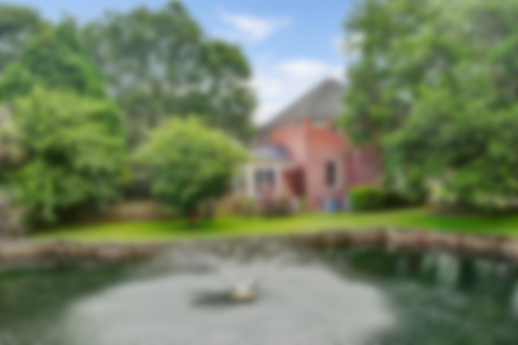
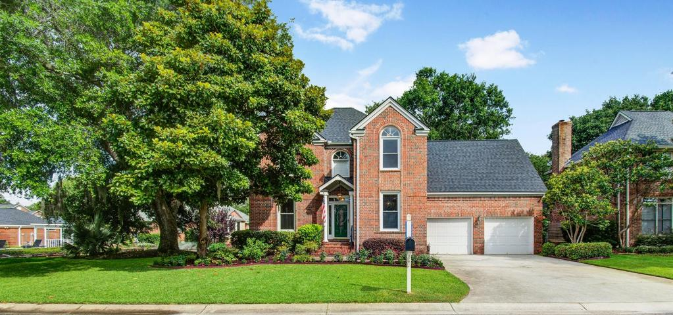
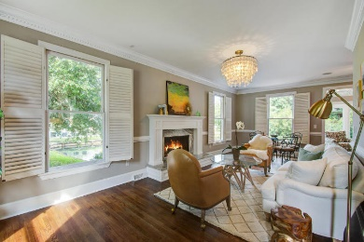
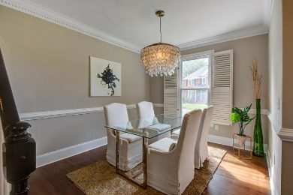
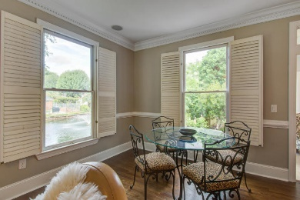
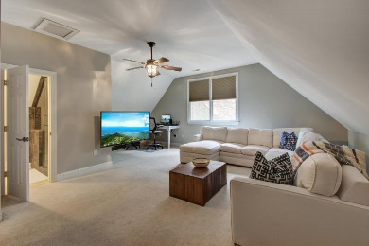
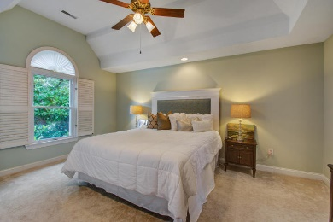
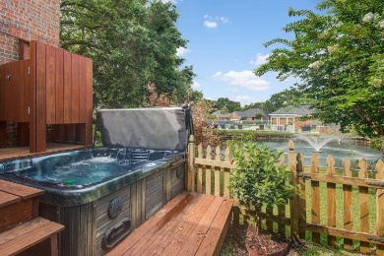
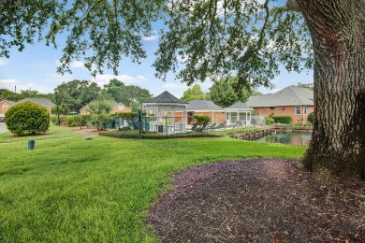



Agent Open House Thursday 11:30a-1:00p Light lunch and gift card!!
1324 Southlake Drive
Lakeshore ~ Mount Pleasant, SC 29464 MLS# 18018956 ~ $544,900
Location, Location, Location!!! Close to IOP! Walk to shopping! Gorgeous, immaculately maintained, move-in ready home! 2 Brand new HVAC's! Brick means easy maintenance! On pond lot and near community area. Enter this beautiful 2 story home to the foyer, to the right is the formal dining room, to the left is large family room. This home is great for entertaining! Spacious family room allows for quiet gatherings or larger groups to converse comfortably. The natural flow from family room to eat-in area, kitchen and sunroom makes this the area all will gather together. From sunroom extend the gathering to the deck and fenced in backyard with hot tub. Located on canal with fountain, this is a great place for relaxing. Upstairs find the huge bonus room(also the 4th bedroom), master and 2 additional bedrooms. The bonus room has ample storage, built-in desk and full bath with tiled shower. Down the hall are the secondary bedrooms with light and bright feel with trey or vaulted ceiling. Master is at the end of hall and is a retreat of its own! Trey ceiling, sitting area, bath with dual sinks, separate shower and garden tub, it will be a challenge to leave the comfort of this suite!
Lakeshore is located near IOP, shopping and easy access to town. The community has a pool and dock that allows for access to the lake. This is the home you have been waiting for!
Laurie Loparo (843) 442-1290 | laurieloparo@gmail.com
www.lauriesellscharleston.com
Keller Williams Realty Charleston | 496 Bramson Ct Ste 200 | Mt. Pleasant, SC 29464

