Slide 1
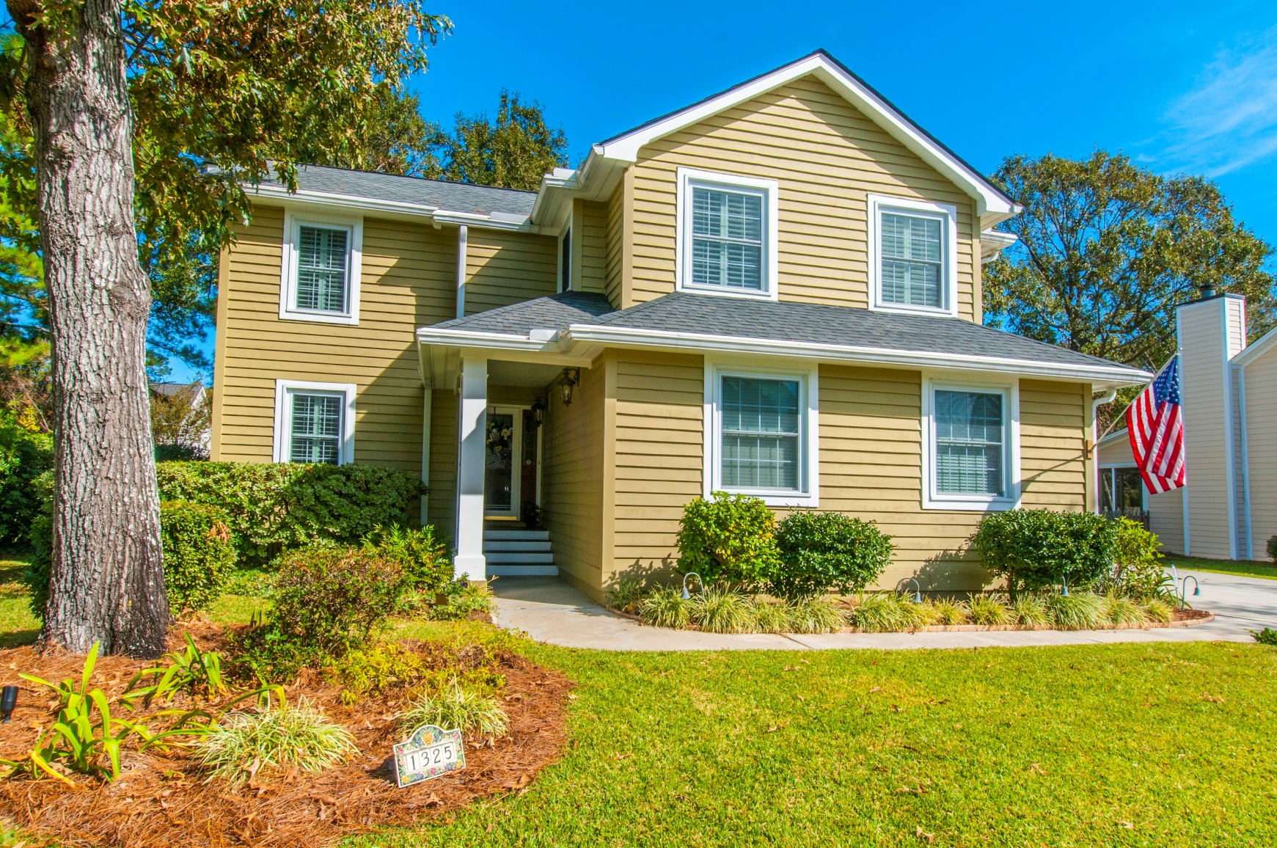
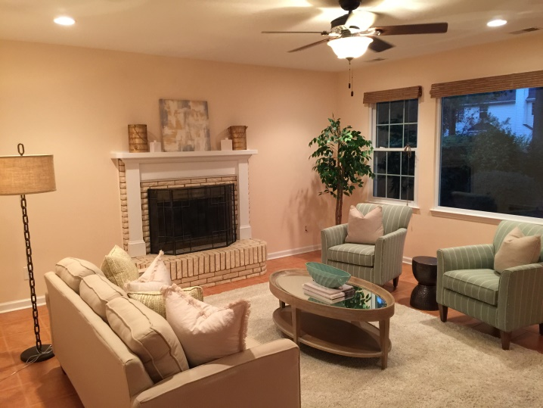
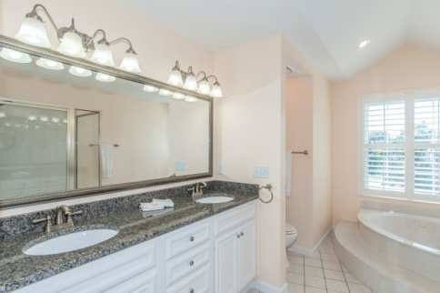
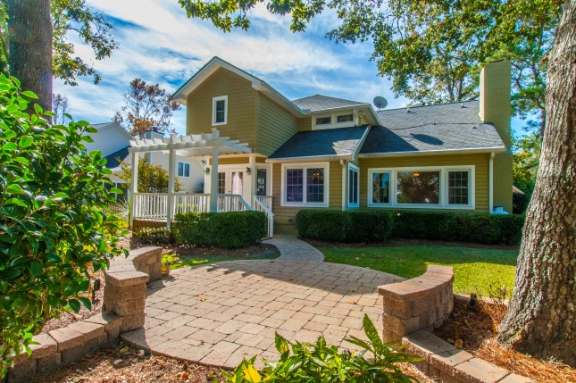


“Close to everything you love…”
1325 Hidden Lakes Drive
Mt Pleasant, SC 29464
Low $500s
$519K, and 3.25%
compensation
3 Bedroom, 2.5 Bath, 2340 SF
2 car garage, roomy lot, mature foliage
Walk to Shops & Restaurants! Beaches nearby! Neighborhood
amenities include boat storage, lake water irrigation…
All tile and hardwood, no carpet
Custom back patio w/accent lighting
Rear deck with pergola
Stainless steel appliances, granite
Cost-saving Tex-Cote® exterior finish
Spacious MBR suite
Good closet spaces
STEVE ROWE
,Realtor®
Retired Military. Active Agent.
(843) 303-7438
srowe@carolinaone.com
www.SteveRoweHomes.com

