Slide 1
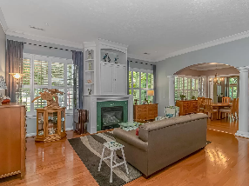
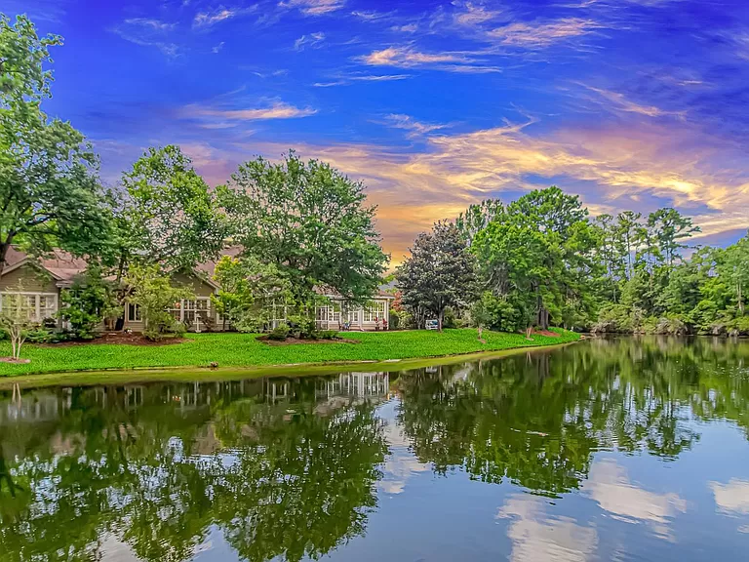
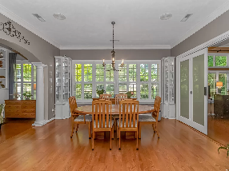
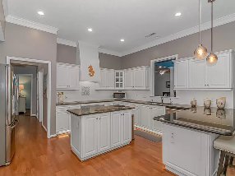
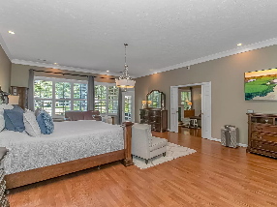
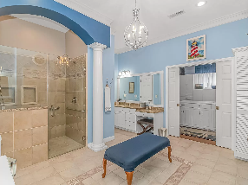
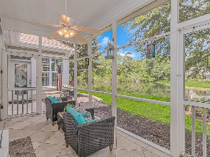
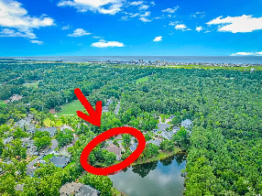
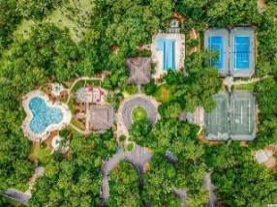
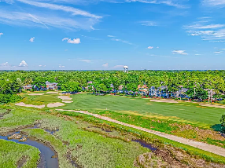
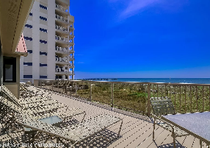
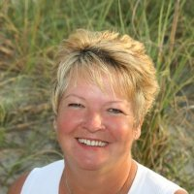

Luxury Home Tidewater Golf Plantation
1325 Lighthouse Dr
Tidewater Plantation
North Myrtle Beach, SC 29582
MLS# 2415951 | $950,000
Tidewater Golf Plantation Top rated golf course in South Carolina. This 3/4 bedroom 3 bath very unique home offers a second full master suite with a walk-in closet. Shear elegance and room to roam in this 4300 sq. ft. home. Offering a multi-generational living space this is a great home with lots of living space for privacy. The kitchen is equipped with top of the line Wolf electric range, Wolf oven and Bosch dishwasher. Granite counter tops and lots of storage with two pantries, and eat in kitchen. This beautiful home offers two suites, third bedroom with private bath, two laundry rooms, living room and dining area, two lots and two driveways for the drive thru garage which will accommodate 3 cars or a boat, also there are walk-up stairs to ample storage. The great room can be used as multi media room or home theatre with surround sound. The front porch, back screened porch and patio, offer lots of outdoor living space. As you enter the home there is a private office. There is a studio if you love to have your own private area. The studio has separate entry to make it very private and could be a home office. The home is located on an aerated lake/pond, sit on your screened porch and enjoy nature. Home is located on two lots to give you space for landscaping and working outdoors. Tidewater offers, tennis, golf, pools, fitness center, pickle ball, and of course the pro-shop and restaurant on site. The most wonderful place is an oceanfront beach cabana with ample parking in private lot.
Virtual Tour
Donna Fortney
703-624-3517
dofortney@aol.com
Robert Jacoby
843-455-7075
rcjacoby@aol.com
NEW WAY PROPERTIES MYRTLE BEACH

