Slide 1
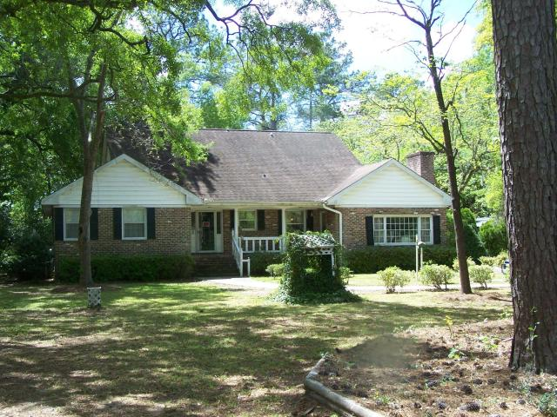
Big Price Reduction! House needs some TLC to make it into a fine family home
Just Reduced!!
1329 N Edgewater Drive
Edgewater Park ~ Charleston ~ MLS# 16026439 ~ $490,000
4 Bed | 2½ Bath | 2,654 sf
Just relisted as a stand alone property. Previously listed with Lots 65 and 66. This a great opportunity to acquire an incredibly beautiful property that is over 1 acre in size. The house is in need of upgrading but has wonderful possibilities. Very large den with huge brick fireplace. Separate dining area and large living room. Very quite tranquil setting for a warm and welcoming family home. Front porch and enclosed side porch. The house is being sold ''AS IS, WHERE IS''. The owner does not intend to make any repairs. IF SQUARE FOOTAGE IS IMPORTANT BUYER SHOULD HAVE HOUSE MEASURED. This home is close to schools and shopping. Easy access to Highway 17 and I-526.
Tommy Hartnett
tfhartnett@gmail.com | (843) 729-7222
The Hartnett Company, LLC | PO Box 247 | Isle Of Palms, SC 29451

