Slide 1
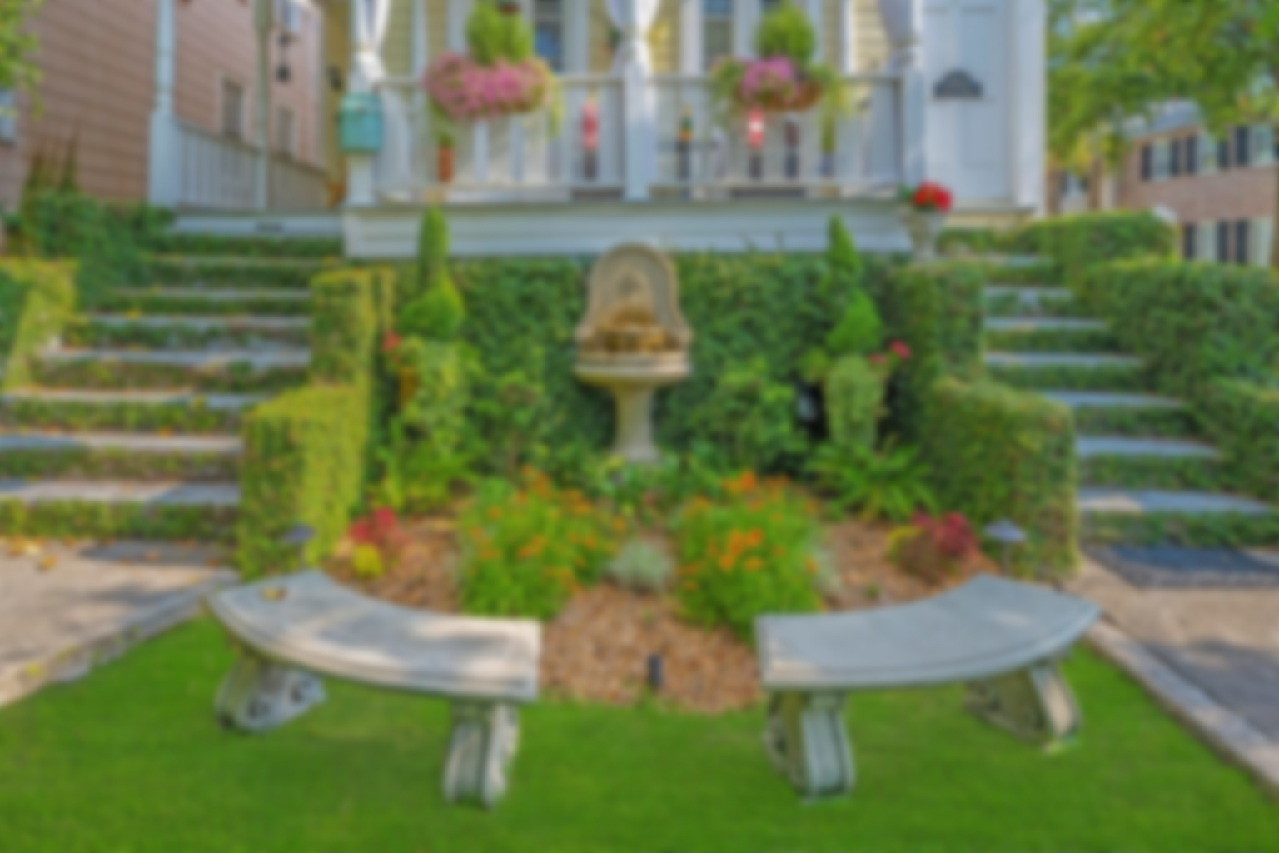
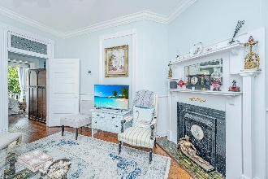
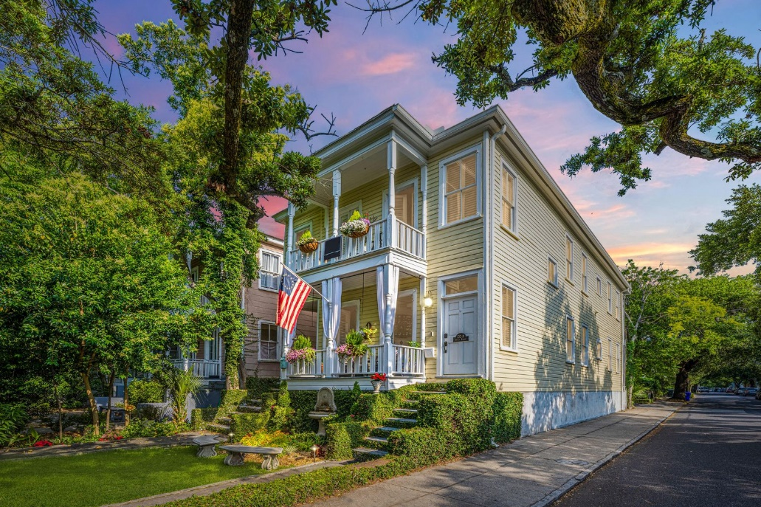
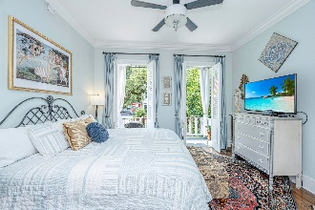
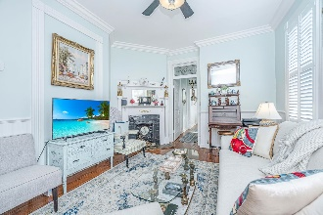
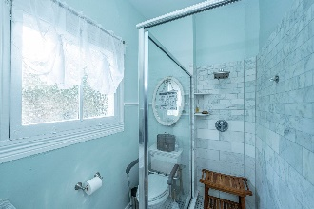
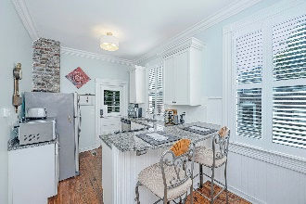
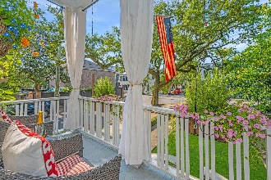
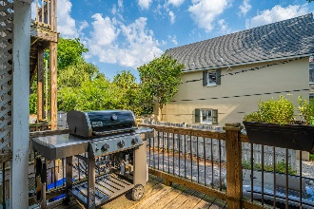
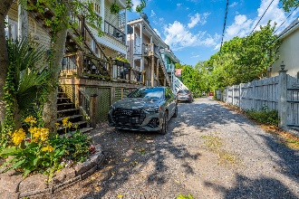
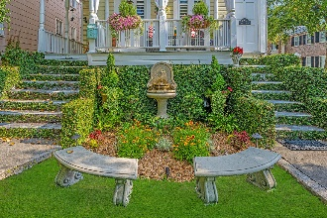
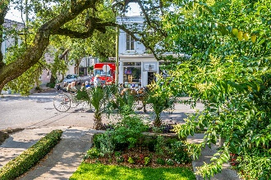
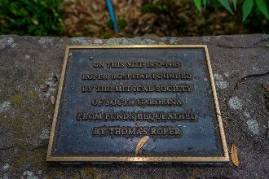


Just Reduced $25,000
Charming 1Bd/1 Ba Condo in the Heart of Downtown Charleston
132 Queen Street C
Harleston Village | Charleston, SC 29401 | MLS# 21014046 | $525,000
Enchanting condo located on one of the most iconic streets in all of Charleston. Steeped in history, this lovely 1 bed, 1 bath, 120 year old home/condo will take you back in time. With double front porches overlooking a beautiful fountain, gardens and the famed Queen St. Grocery, this home has original heart pine flooring, exposed hand-laid brick fireplace, 10' ceilings and custom crown molding. When you enter from the rear of the home, you are welcomed into a quaint eat-in kitchen equipped with stainless steel appliances, granite countertops, breakfast bar, and plenty of cabinet space. The kitchen opens up to the living room complete with a built-in curio cabinet and a fireplace. Just down the hall is the luxurious bathroom boasting a walk-in Carrera marble shower and updated counters. The spacious owner's suite with double French doors opens onto the front balcony overlooking Queen St. and is perfect for taking in the city life in Charleston from the horse drawn carriages to people watching. Conveniently located within walking distance to Colonial Lake, shopping, dining, and all that Downtown Charleston has to offer. As an added bonus, this unit comes with its own reserved parking space directly behind the unit. Don't miss this opportunity to own a wonderful piece of Charleston history.
Debbie Rogers
(843) 990-2915
deborah.rogers@carolinaone.com
www.DebbieRogersSellsCharleston
Carolina One Real Estate | 2713 Highway 17 North | Mt. Pleasant, SC 29466

