Slide 1
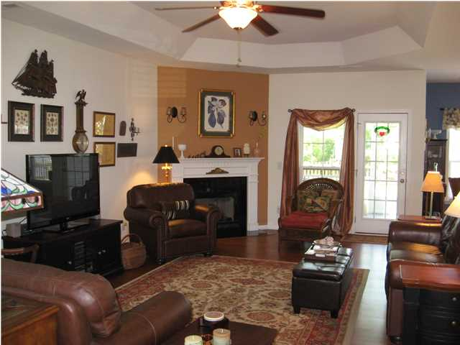
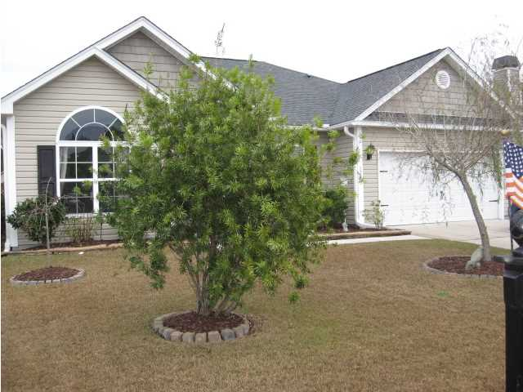
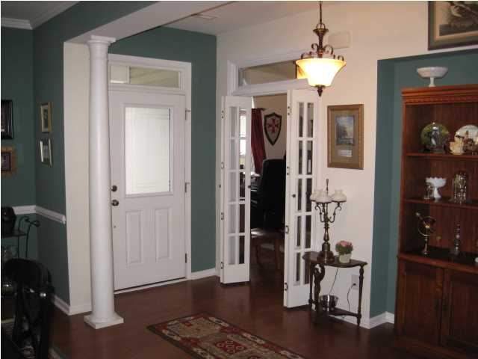
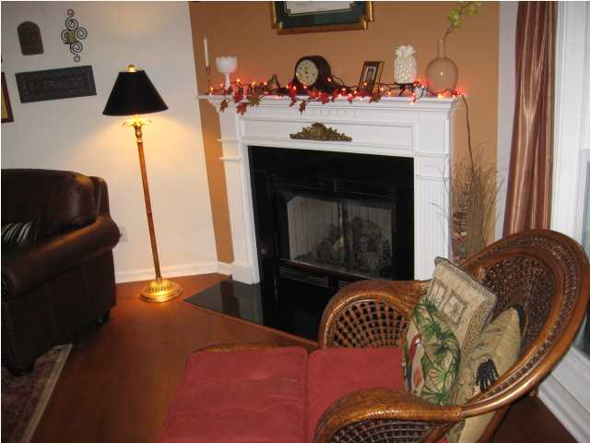
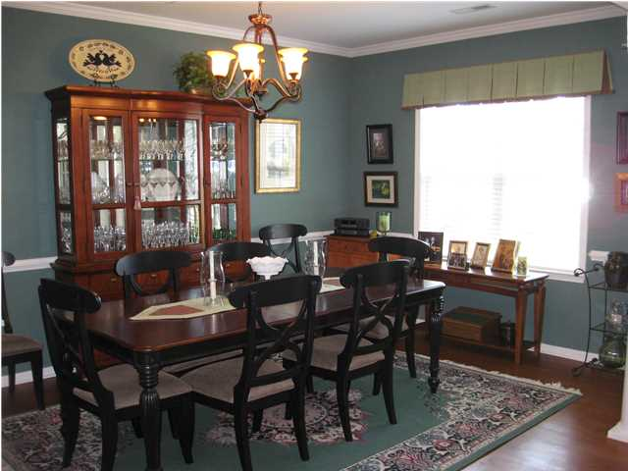
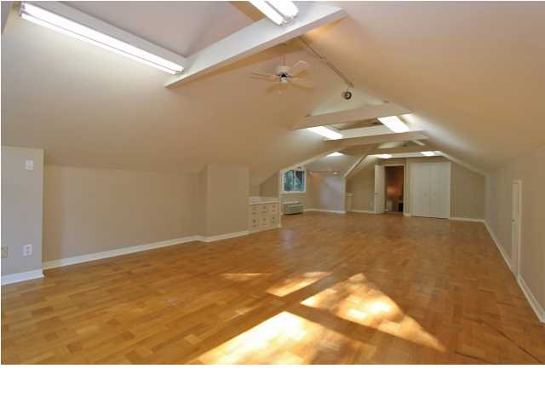
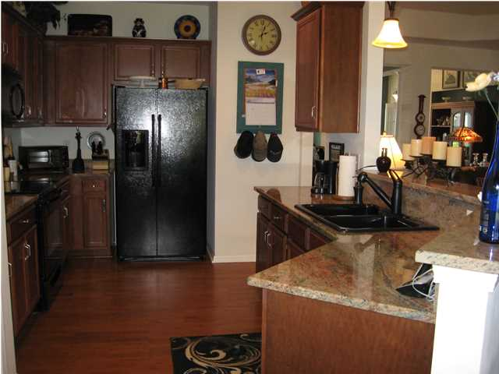
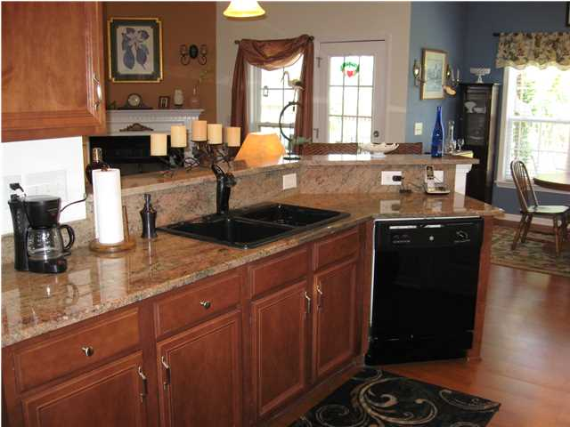
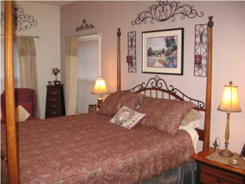
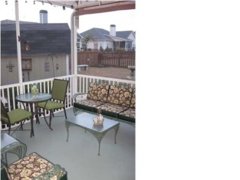
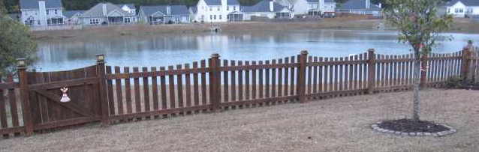
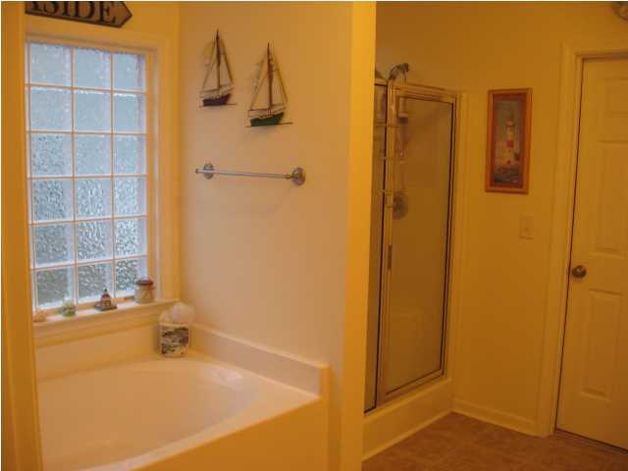
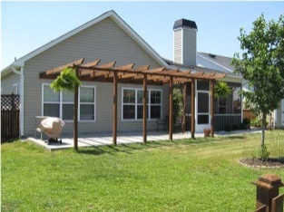

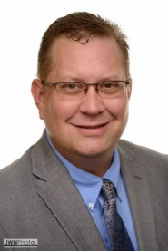
132 Cableswynd Way
Highwoods Plantation ~ Summerville
MLS# 1408804 ~ $210,000
OPEN HOUSE
Sunday, June 8th, 3-5pm ~ Refreshments provided!
POND FRONT! As you enter the front door you will be inspired by the open view, the columned entry way and oversized dining room! On your left a TRUE office with transom French doors.2 nice bedrooms and a full bath separate from the Master suite over looking the lighted, fountained pond! Fenced and landscaped yard includes a 12X18 shed. Screened porch includes an extended patio area with pergola for those relaxing views. Nice Screened porch, Immaculate Home! Open Floor plan. Large Master suite on rear with POND VIEW! 3 Bedrooms PLUS an office! Upgraded floors and Granite counters. New HVAC. A GREAT DEAL and a MUST SEE! Dorchester 2 Schools.
Christopher McCormick
Office - 843-974-6200
Cell - 843-224-3204
cjmccormick@carolinaone.com
Carolina One Real Estate
900 N Main St
Summerville, SC 29483

