Slide 1
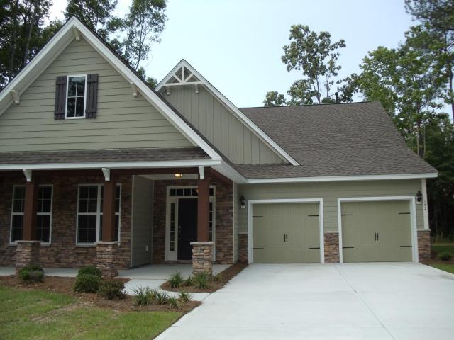
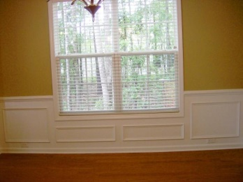
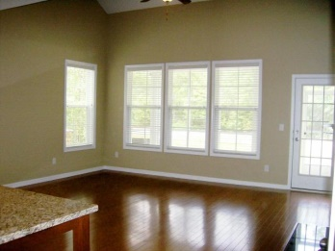
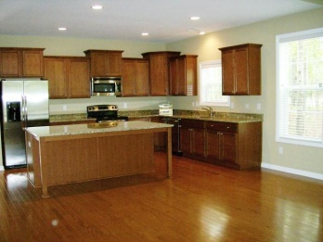
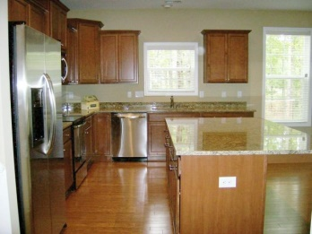
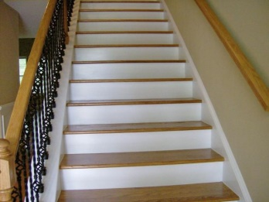
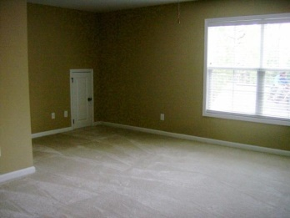
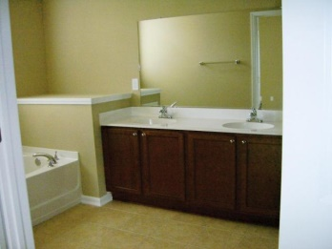
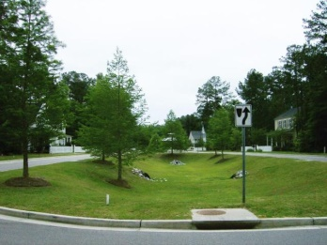


132 Comiskey Park Cir
Fieldview
Summerville
MLS# 15005496
$1,800/mo
3 Bedrooms
3 Baths
2,700 Sq Ft
Charming & Comfortable Living
Short-term Lease Available
Need a short term lease? Come take a look at this 4 bedroom,3 bath home in the beautiful Fieldview subdivision in Summerville. This open floor plan has a gorgeous kitchen, fireplace family room master, another bedroom, another full bath with a formal living and dining room to round out the first floor. Upstairs are two more bedrooms along with yet another full bath. Also, you can enjoy nature while sitting out on the screened-in porch. So come take a look and be ready to be impressed!
Liz & Bob Simonds
843-437-9696
lizandbob@agentowned.com
AGENTOWNED REALTY CO. PREMIER GROUP, INC.
141-A N. MAIN STREET
SUMMERVILLE, SC 29483

