Slide 1
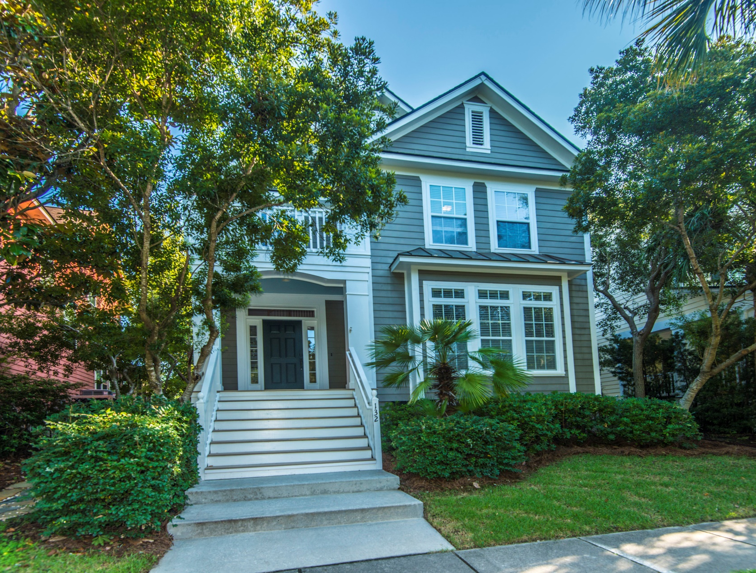
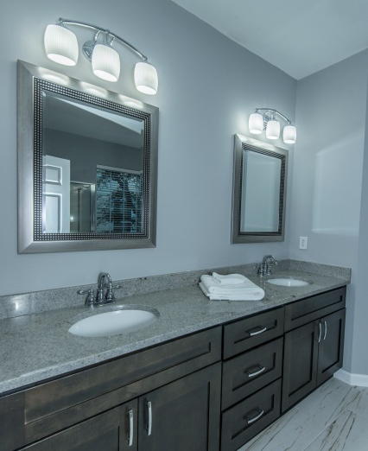
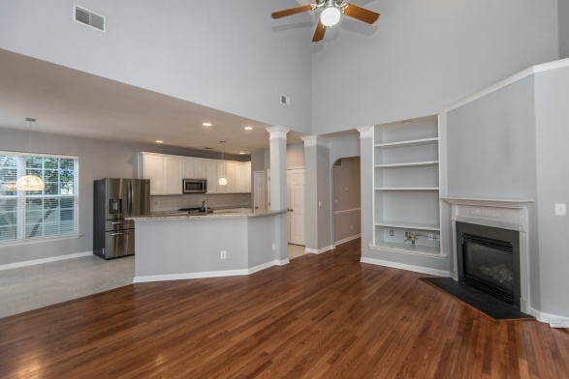
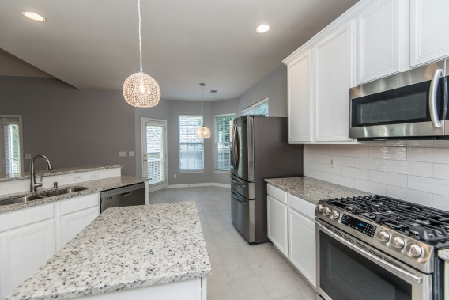


“ Great Daniel Island $$ value overlooking Etiwan Park green”
132 Etiwan Park Street
Charleston, SC 29492
$585K!
Saturday 16 Nov 11AM-1PM
Open House
Sunday 17 Nov Noon-2PM
4 BR, 2.5BA
2440 SF
Nice home, quality renovations, great setting…………
All hardwood & tile throughout – no carpet
MBR down; renovated bath suite w/garden tub and separate shower
NEW Granite counters,
NEW stainless steel appliances
Ready for fast move-in!
Park view front; pond behind
STEVE ROWE
,Realtor®
Retired Military. Active Agent.
(843) 303-7438
srowe@carolinaone.com
www.SteveRoweHomes.com

