Slide 1
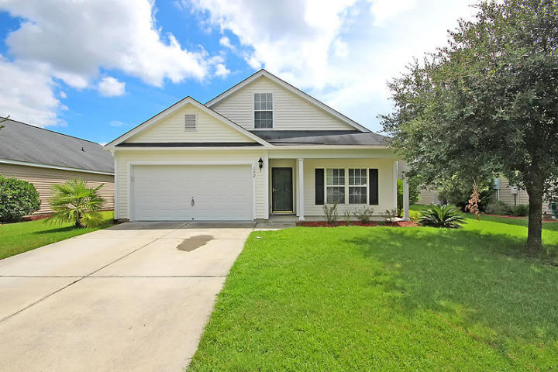
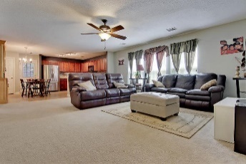
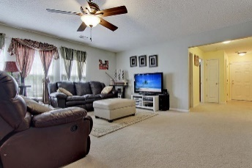
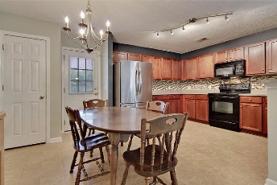
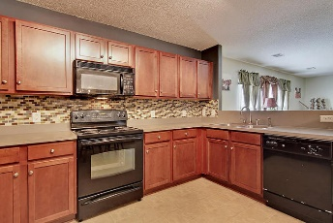
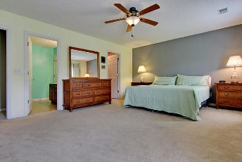
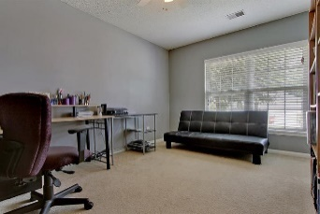
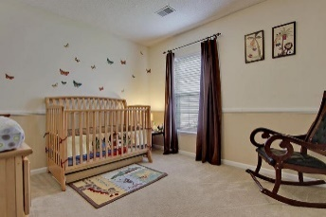
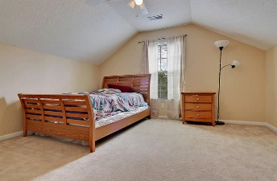
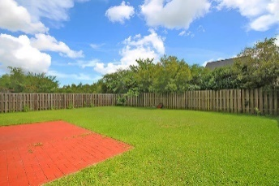
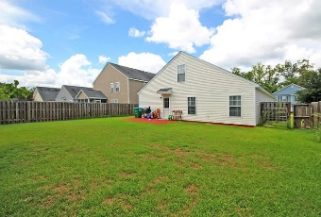
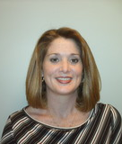

132 Malibu Road Brookwood Summerville MLS# 16019003 $209,900
$500 Agent Bonus With BIC Approval & Acceptable Offer
Open House Saturday August 27th from 12-2
Spacious 5 bedroom home in Summerville with 3 full bathrooms! Plenty of space for kids or guests to have their own privacy.
The open floor plan includes the dining area, kitchen, and living room. All bedrooms are decent size. The back yard has a 6 foot privacy fence and plenty of room for kids to play or for entertaining.
Sellers are motivated!
Michelle Riser
843-860-1229
mriser@ccim.net
Matthew Ryan Company, 104 Berkeley Square, PMB 59, Goose Creek, 29445

