Slide 1


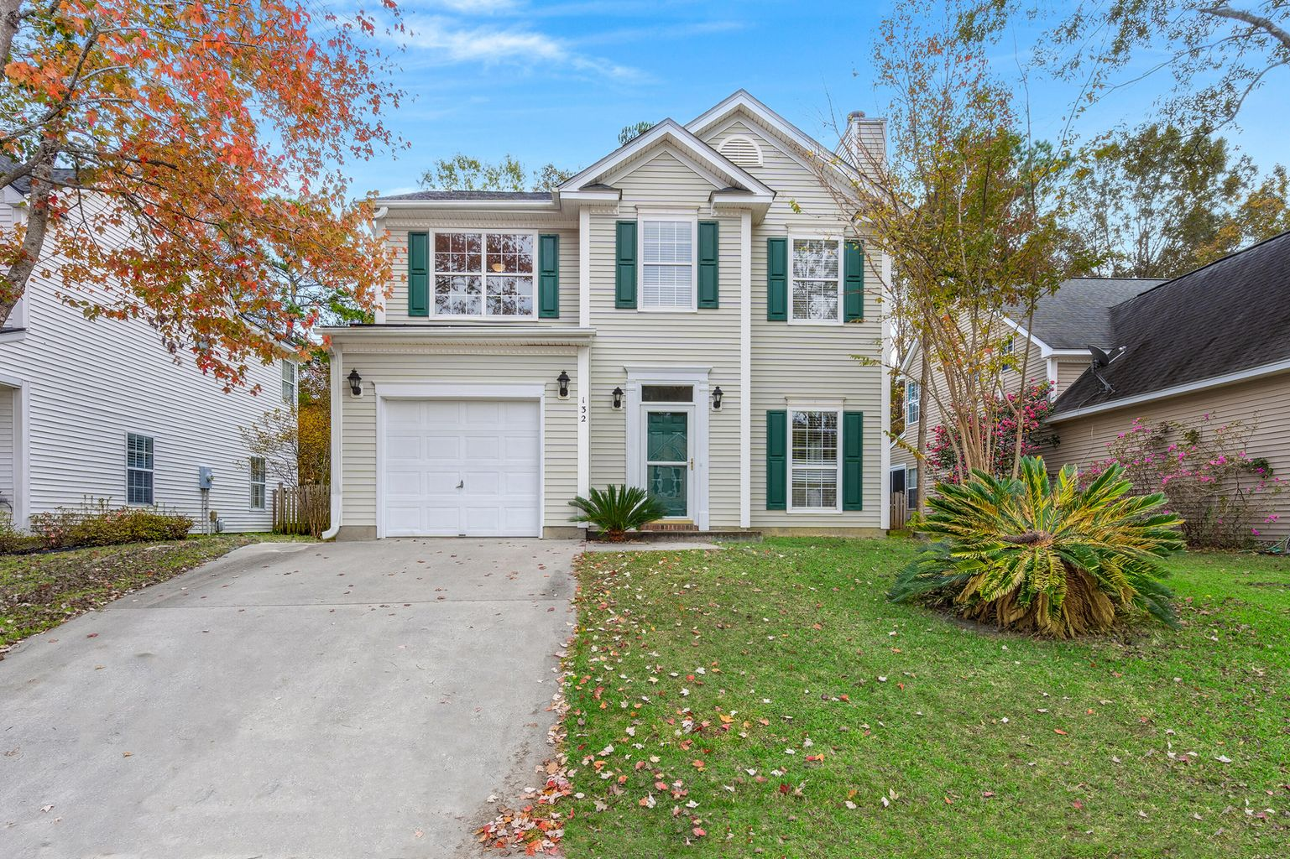
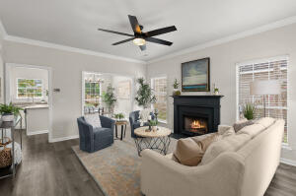
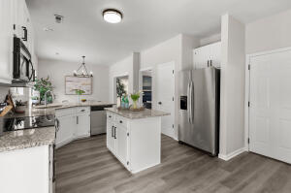
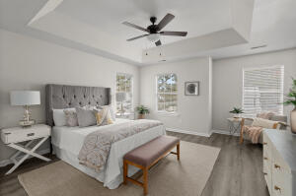
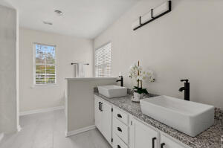
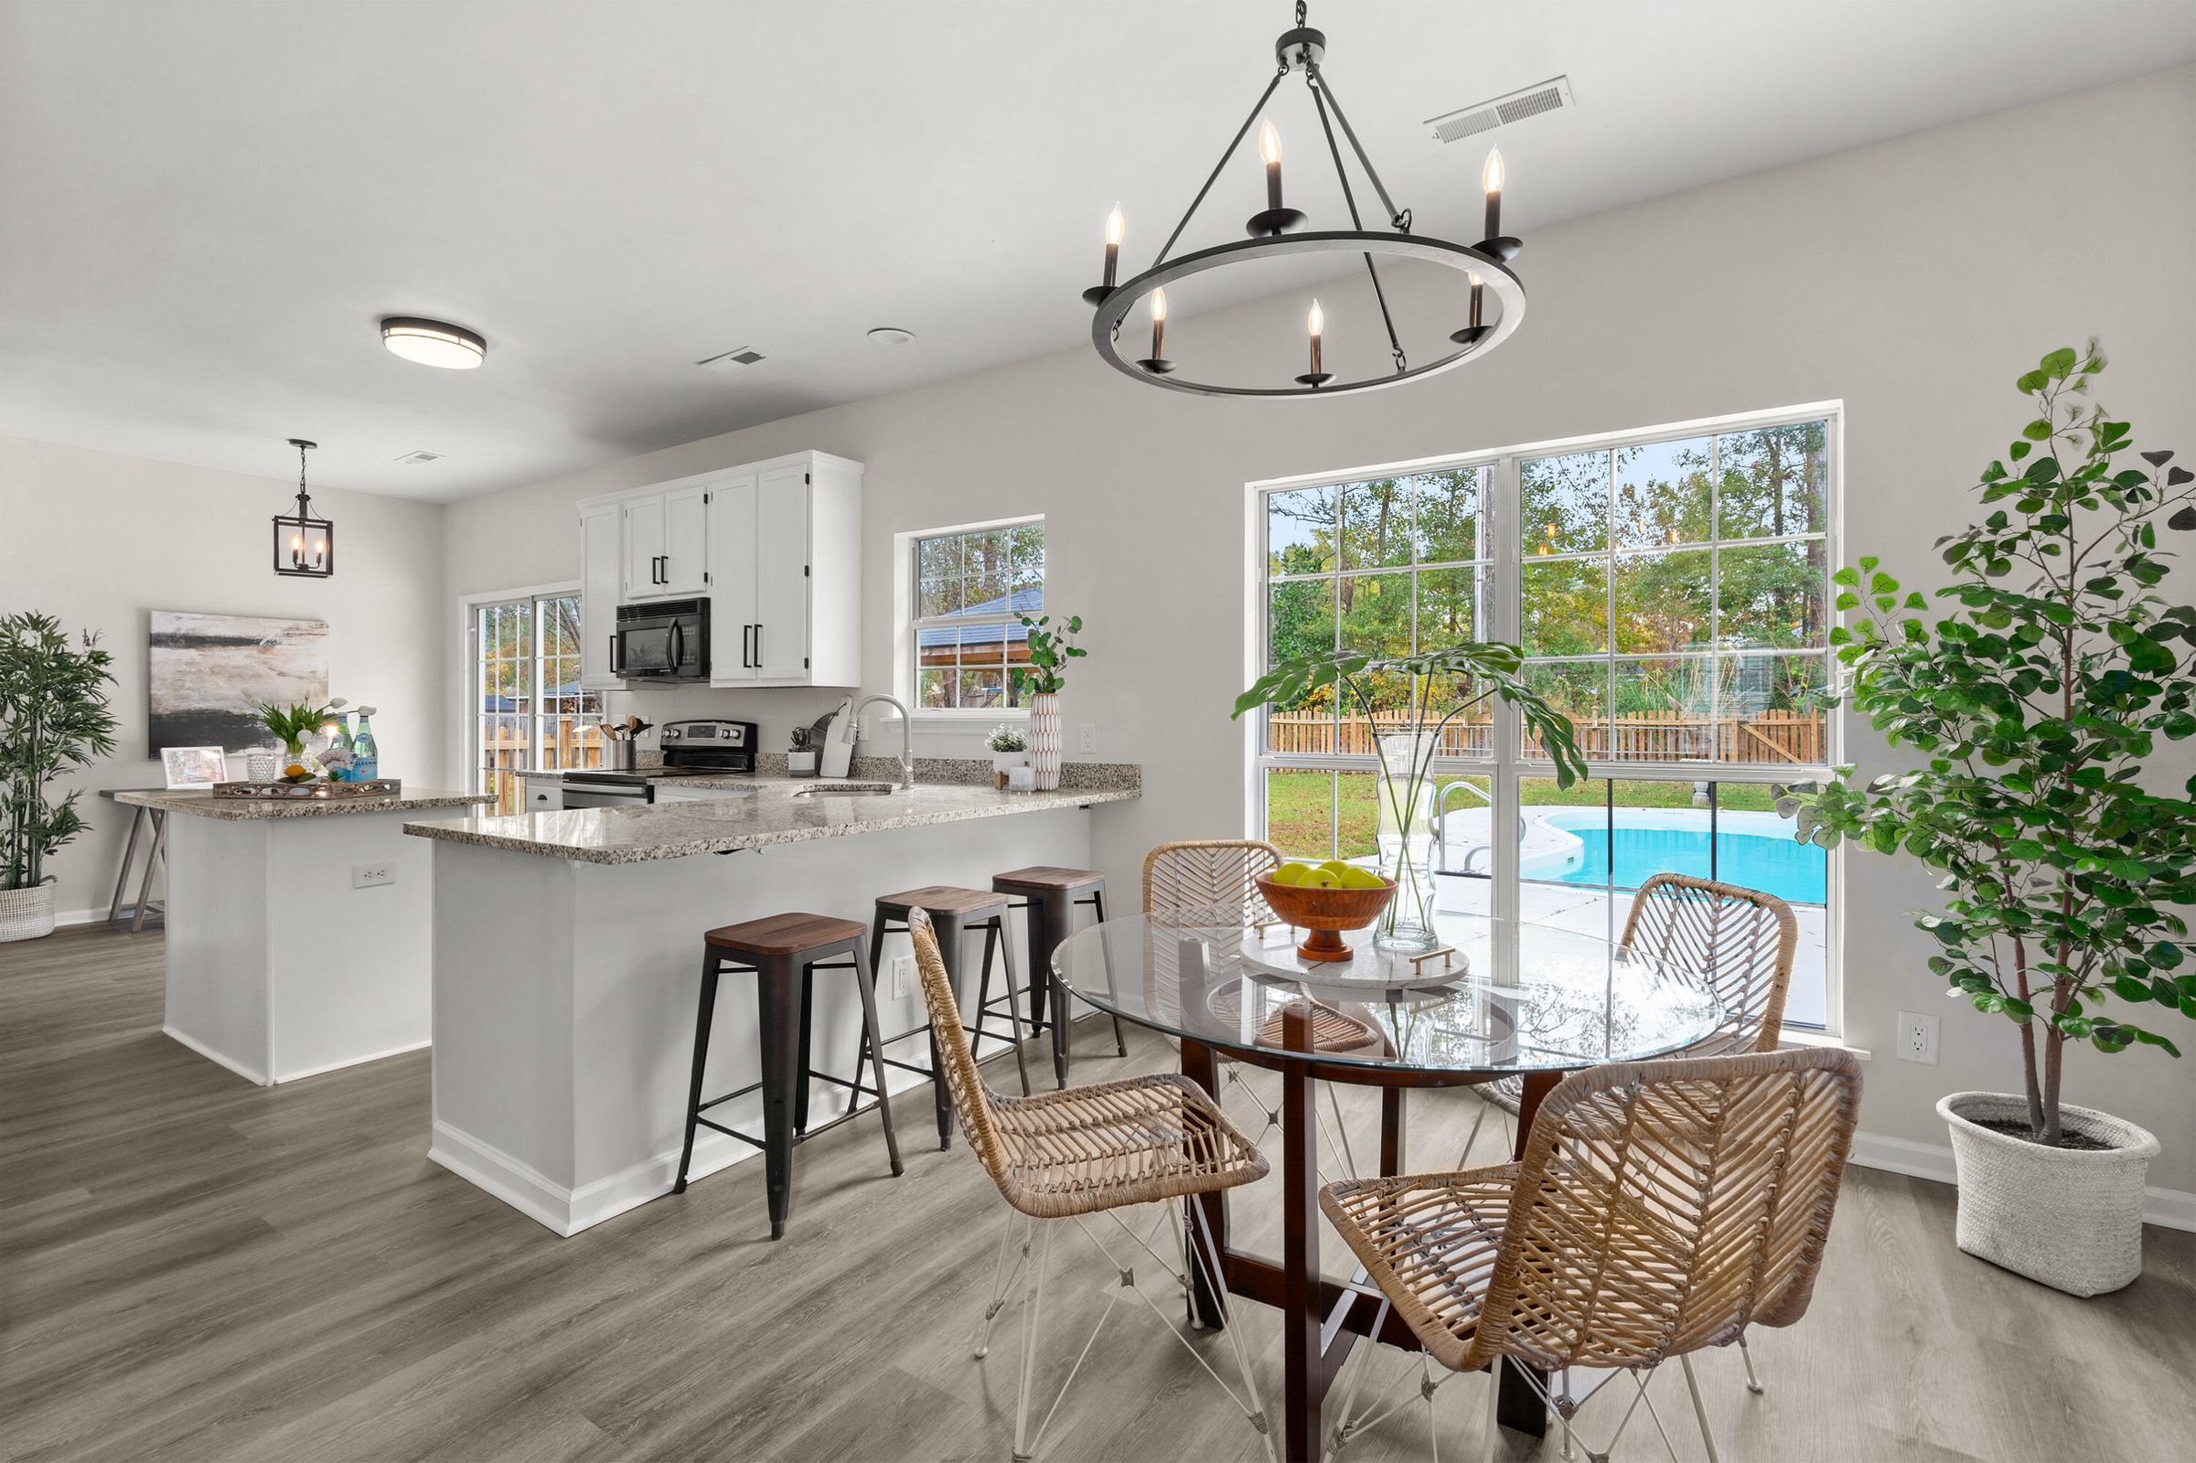
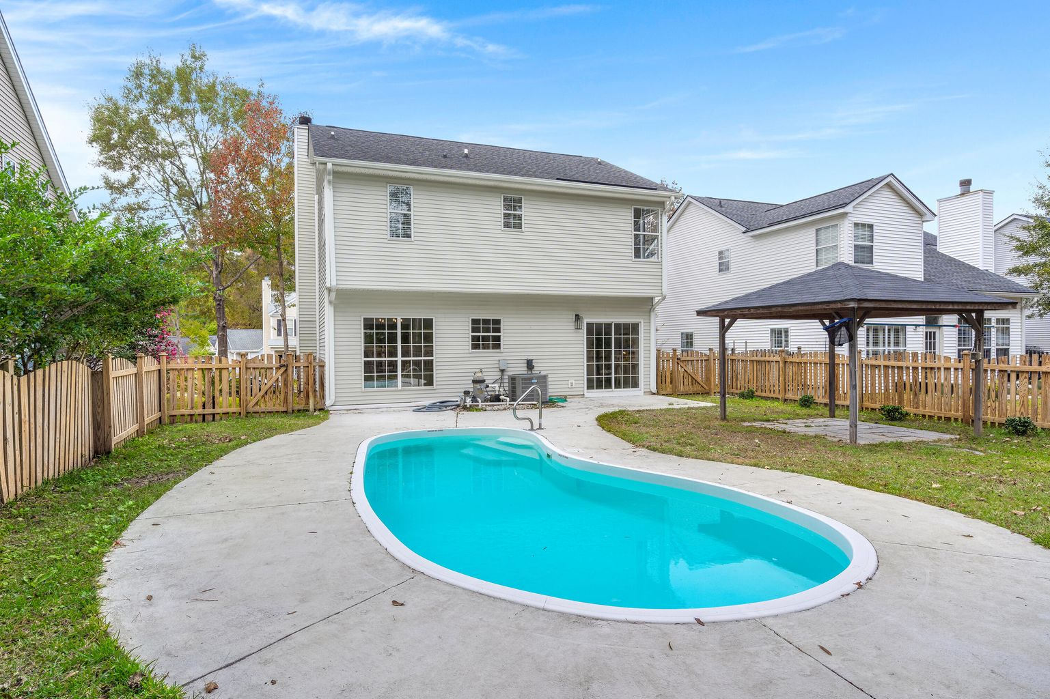
132 E Hartwick Lane
Crowfield Plantation
Goose Creek, SC 29445
MLS# 22029123 | NEW PRICE $359,900
3 Bed | 2½ Bath | 1,665 SF
Renovated 2 story home located on a high private lot with an inground pool, fully fenced yard in one of Goose Creeks premier neighborhoods.
Leah Rust
The Boulevard Company
806 Johnnie Dodds Blvd.
Mount Pleasant, SC
leahmrust@gmail.com
843-709-9211

