Slide 1
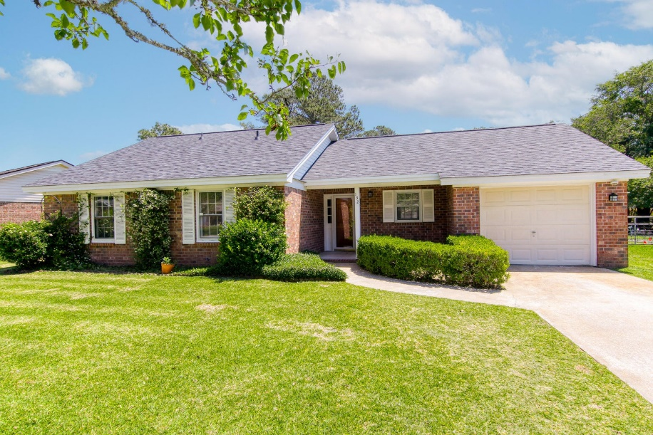
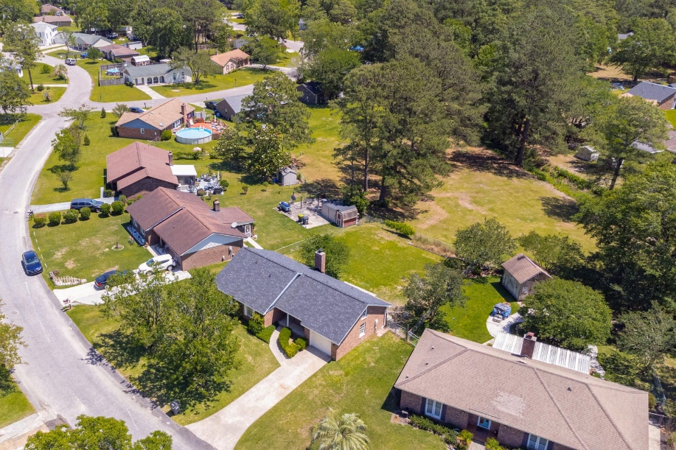
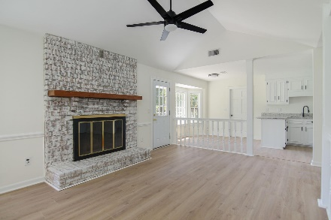
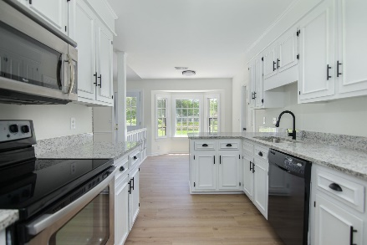
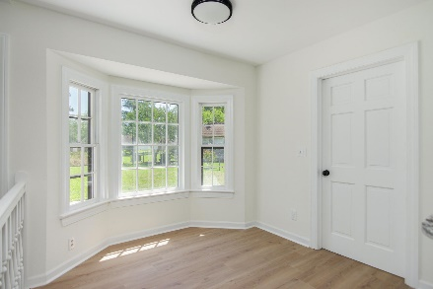
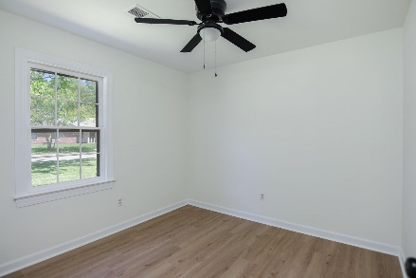
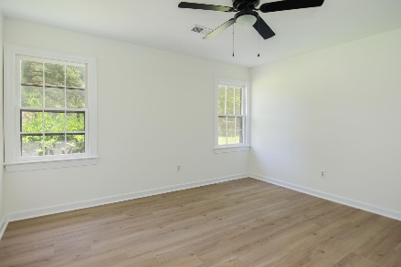
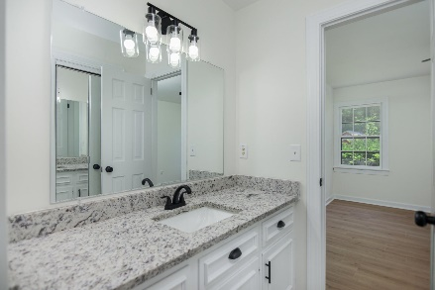
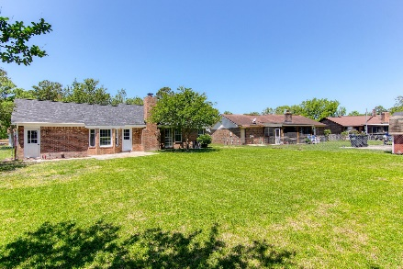
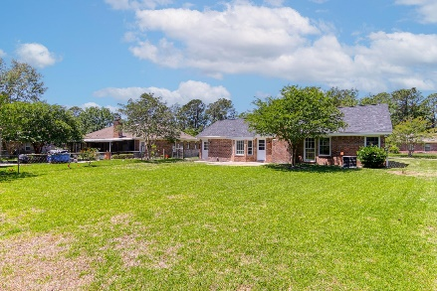
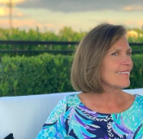


132 Marion Road
Sangaree | Summerville, SC 29483
MLS# 23009851 | $299,500
Back Yard Oasis
Welcome to your fully renovated dream home in the very sought out established neighborhood of Sangaree. No HOA! 3 bedroom, 2 full bath residence, perfect for family or first time buyer, has plenty of natural lighting throughout as well as a beautiful jasmine framed landscaped front creating curb appeal. There is a fully enclosed backyard which borders a green space offering a private oasis for entertaining. Step inside & view the pretty mantled fireplace, vaulted ceiling & solid wood interior doors. There are many new features which include brand new granite countertops in both kitchen and bathrooms, new light fixtures, new hardware, fully serviced HVAC. This is a true Gem and will not last.
Susan Stanley
832-323-5573
susancstanley@gmail.com
Brand Name Real Estate
4 Carriage Lane Suite 106
Charleston, SC 29407

