Slide 1

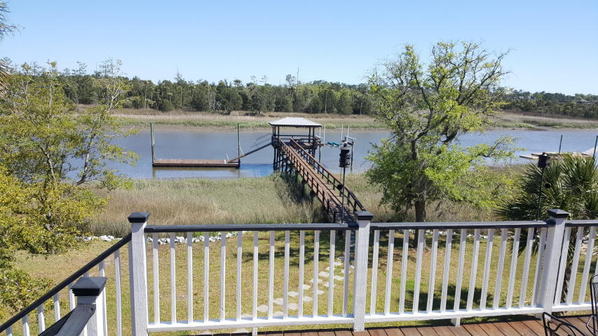
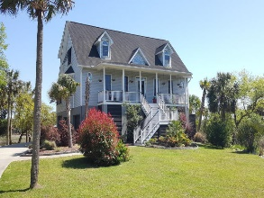
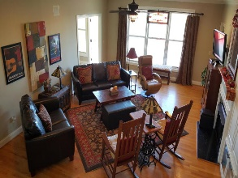
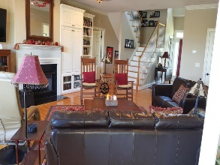
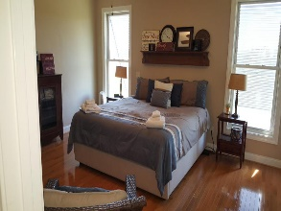

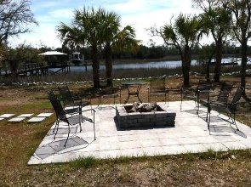
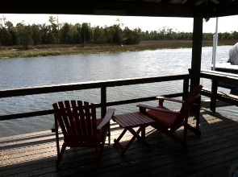
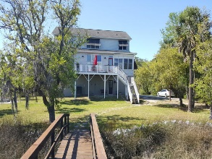
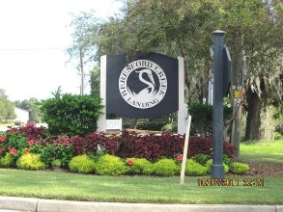


1330 Newport Court
Beresford Creek Landing | Charleston, SC 29492
MLS# 16009399 | $999,000
Best Deep-water Value in the Daniel Island Area
Decompress in style. If deep water dockage, a fabulous house and lots of privacy are your thing, then 1330 Newport Court is the place for you! The covered dock with 10,000 lb. lift has four feet of water at low tide! With five bedrooms and 5 1/2 baths this elegant lowcountry home built in 2000 has everything you need plus a private island feeling and the most peaceful surroundings you can find.
CSA Real Estate Services
339 Cabell Street
Charleston, SC 29407-6928
Charlie Smith
(843) 813-0352
csmith@csarealestate.com
www.csarealestate.com

