Slide 1
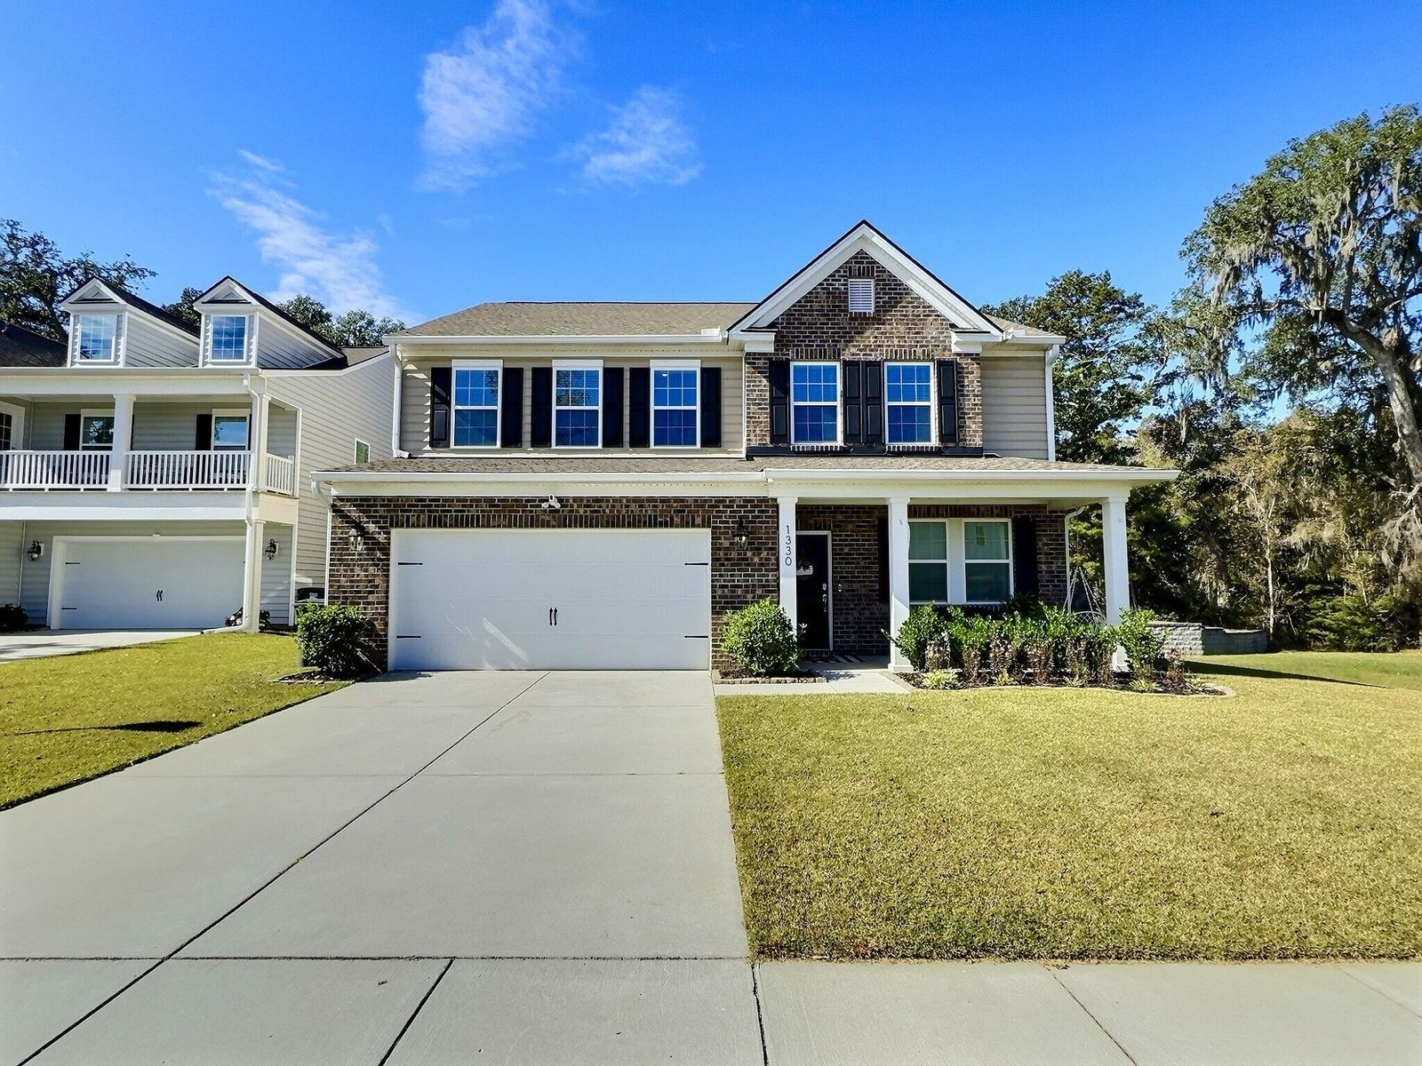
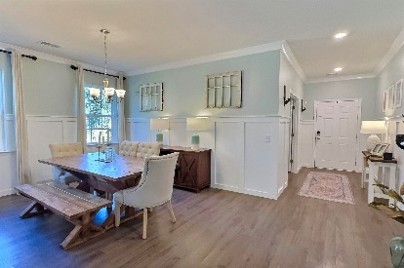
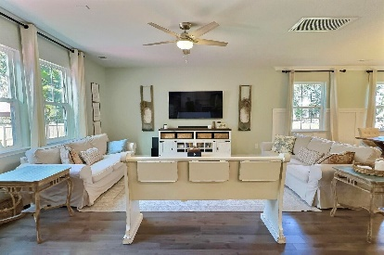
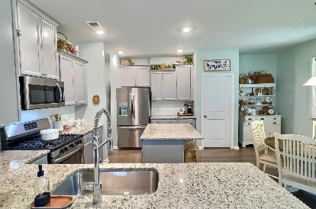
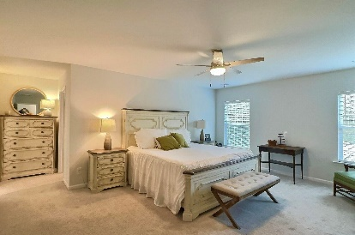
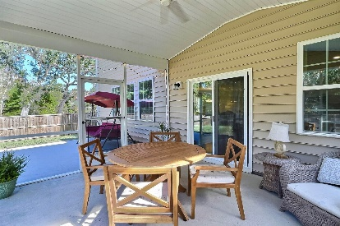
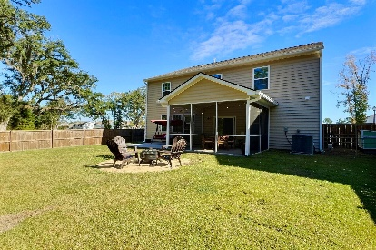
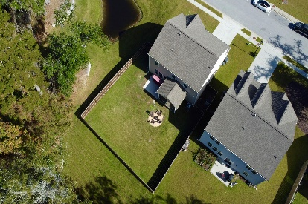


1330 Berry Grove Drive
Timber Trace | Summerville, SC 29485 | MLS# 23025255 | $445,000
OPEN HOUSE WEEKEND
SATURDAY & SUNDAY 1-3
Introducing a stunning home nestled on a premium lot, offering the perfect blend of comfort and privacy. Step inside to an inviting, light-filled interior offering an open floor plan that exudes warmth and style. The foyer and dining room feature added trim detailing, adding a touch of elegance to your living space. A flex room off of the foyer can be used in a multitude of ways. You will love the spacious kitchen with an island, loads of counter and cabinet space along with an eat-in area and breakfast bar. Head upstairs to the large Owner's Suite along with 3 additional bedrooms and a loft. This home offers a unique advantage with no neighbors behind or on the right side, ensuring unparalleled privacy. Enjoy the tranquility of your own oasis complete with a screen porch and spacious back patio, perfect for entertaining and relaxation. This home is the epitome of modern living in a serene, secluded setting. Highly rated DD2 schools, nearby shopping and restaurants plus easy access to I26, downtown Charleston and area beaches.
Take a virtual walkthrough!
Beth Mandell
M 803-463-7734 | O 843-871-2121
bmandell@century21properties.com
www.bestcarolinahomedeals.com
Century 21 Properties Plus of Summerville | 118 W Richardson Ave | Summerville, SC 29483

