Slide 1
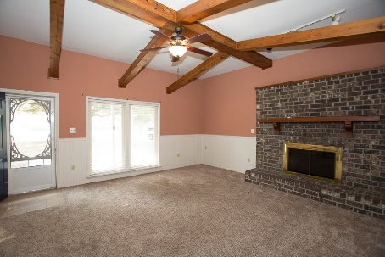
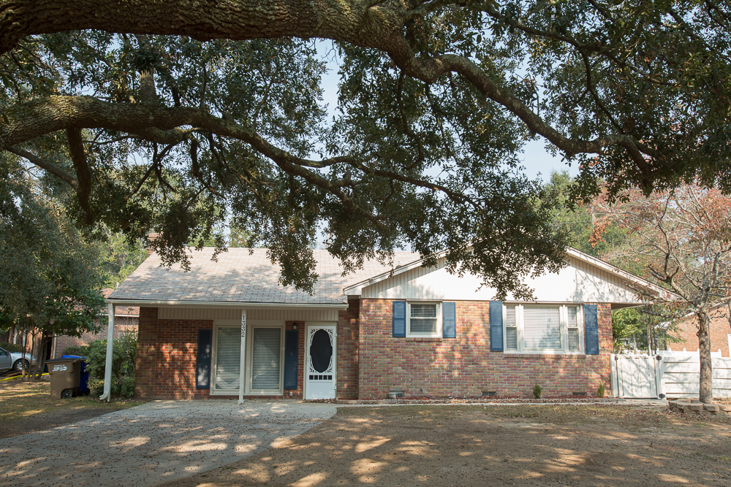
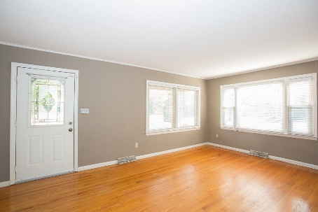
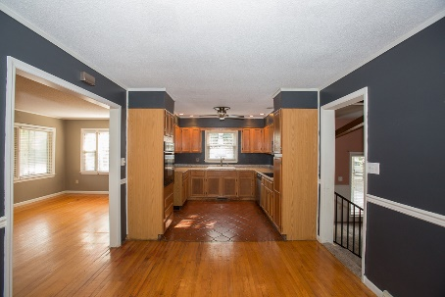
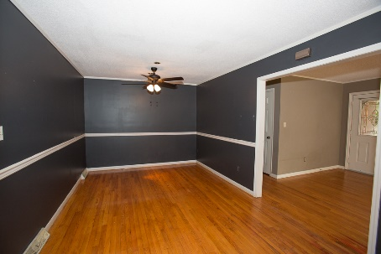


JAMES ISLAND! REDUCED $20,000
1332 Honeysuckle Lane
Farmington · Charleston
MLS# 16029345 · $249,000
Michael Dew
O (843) 870-7000
M (843) 870-7000
michaeledew@gmail.com
www.michaeldewrealestate.com
BRICK 3 BED 3 BATH HOME ON JAMES ISLAND. LARGE VAULTED FAMILY ROOM W/FIREPLACE. KITCHEN HAS OAK CABINETS, CERAMIC-TILED FLOOR AND IS OPEN TO DINING AREA. LIVING ROOM OPENS TO LOVELY SIDE YARD FEATURING IN-GROUND POOL WITH SURROUNDING FENCE. SCREENED PORCH, ACCESSED THROUGH DINING AREA AND FAMILY ROOM, ALSO HAS CERAMIC-TILED FLOOR. GREAT LOCATION! FLOORS IN BEDROOM NEED REPAIR.
AgentOwned Charleston Group
902 Savannah Hwy
Charleston, SC 29407
Real Estate ● Mortgage
Insurance ● Business Brokerage

