Slide 1
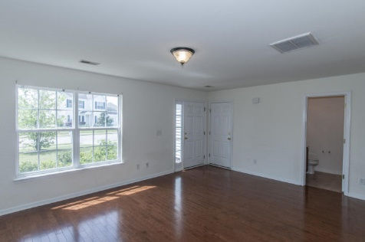
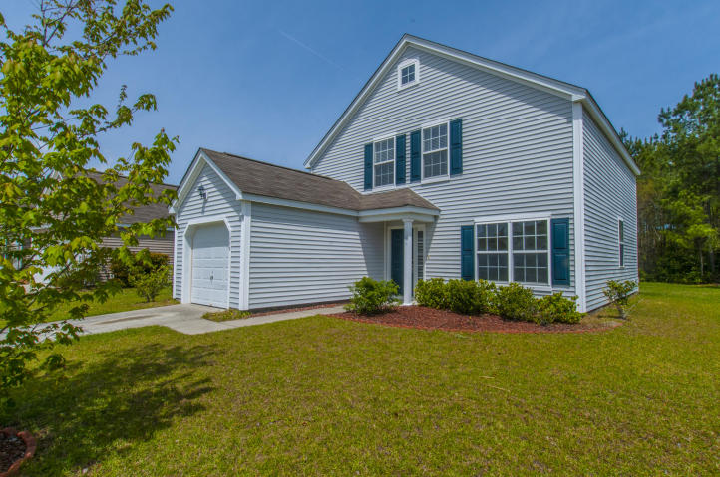
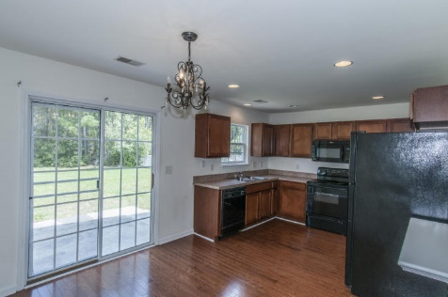
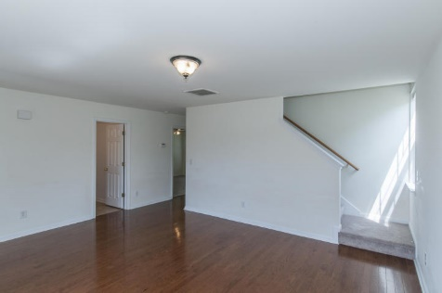
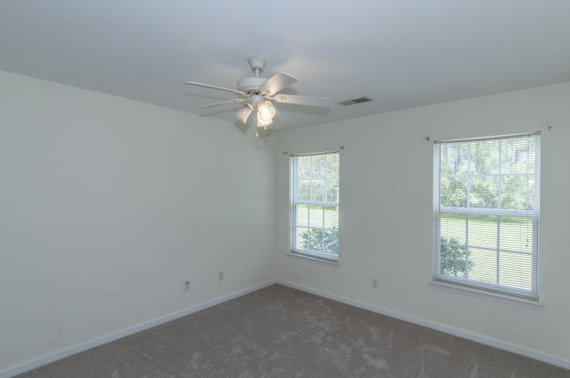
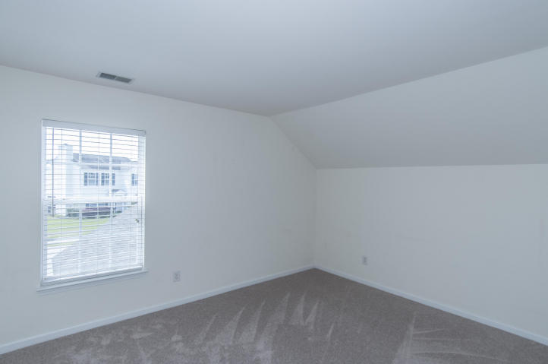
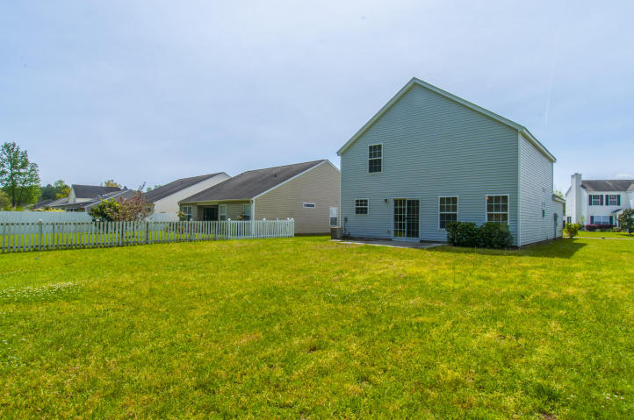


1332 Palm Cove Dr, The Peninsula, Charleston
Move in ready priced to sell!!!!
Charming 4 bedroom home in the desirable Peninsula. New hardwood flooring in family room and kitchen plus new carpet. Master bedroom on the first floor. Wonderful kitchen with eat-in dining looking out over the large back yard with a wooded buffer and patio. Large great room. Amenities include neighborhood swimming pool and play park. Conveniently located to Boeing, shopping, dining and beaches.
Asking $231,500
MLS# 16010584
1,656 SqFt
4 Bed/2½ Baths
Well Priced… Motivated Seller
Don Dawson
843-514-0452
ddawson@carolinaone.com
Carolina One Real Estate • 2713 Highway 17 North • Mount Pleasant, SC 29466
www.TeamDawsonSC.com

