Slide 1
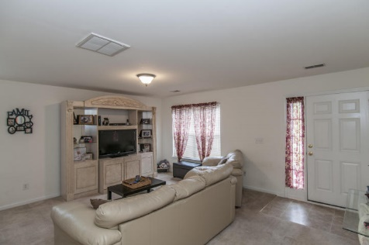
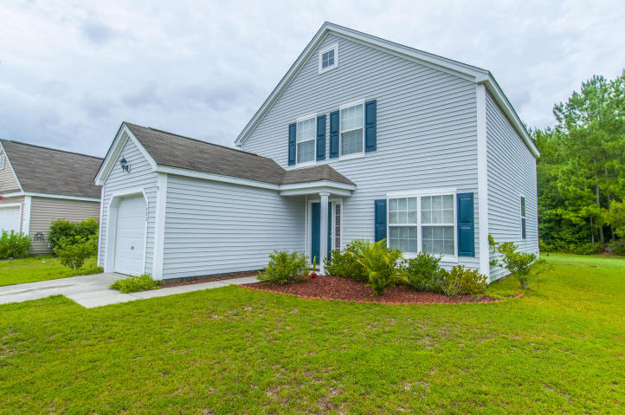
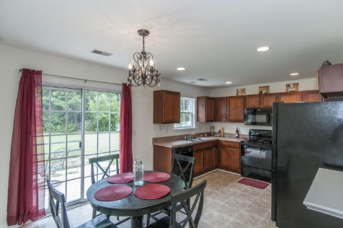
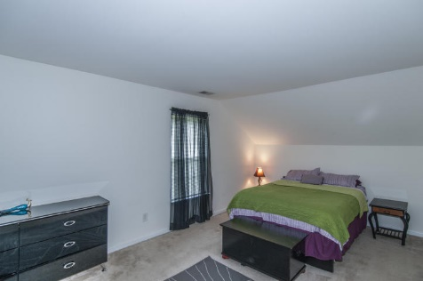
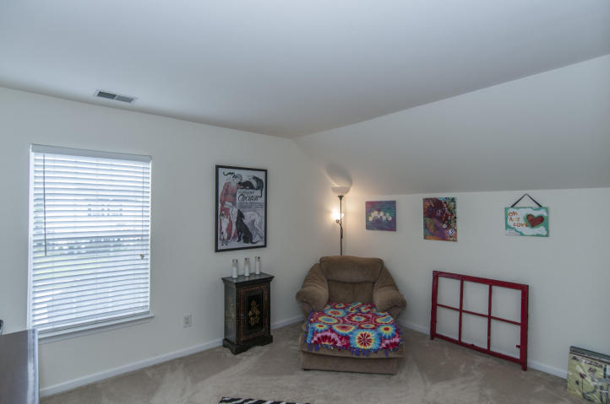
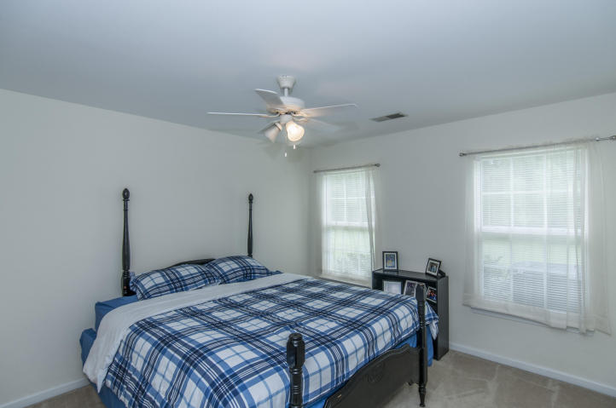
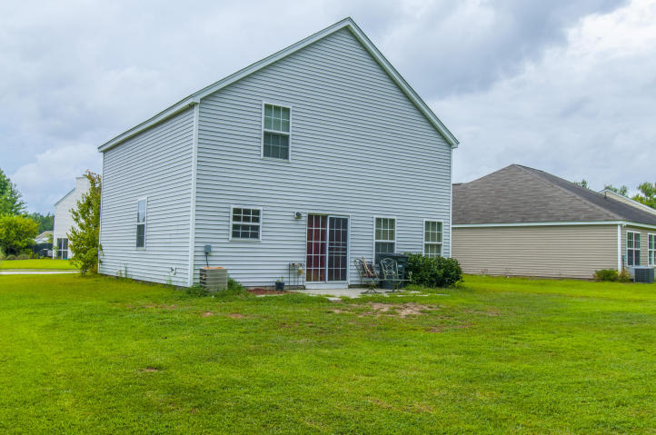


1332 Palm Cove Dr, The Peninsula, Charleston
Charming 4 bedroom home in the desirable Peninsula
Master bedroom on the first floor. Wonderful kitchen with eat-in dining looking out over the large back yard with a wooded buffer and patio. Large great room. Amenities include neighborhood swimming pool and play park. Conveniently located to Boeing, shopping, dining and beaches.
Asking $235,900
MLS# 15021865
1,656 SqFt
4 Bed/2½ Baths
Well Priced… Motivated Seller
Don Dawson 843-514-0452 ddawson@carolinaone.com Carolina One Real Estate • 2713 Highway 17 North • Mount Pleasant, SC 29466
www.TeamDawsonSC.com

