Slide 1
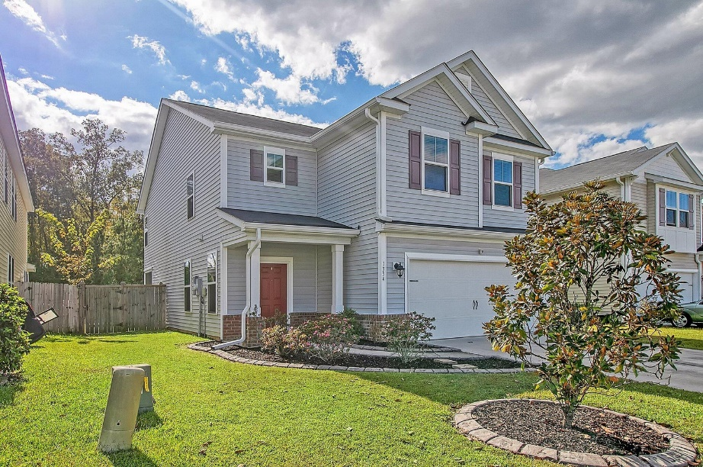
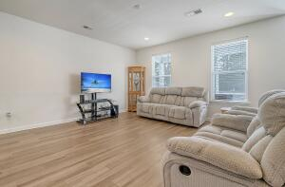
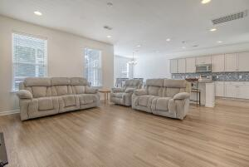
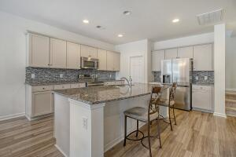
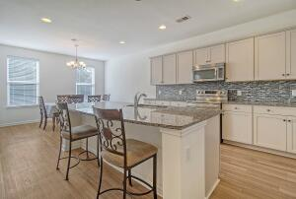
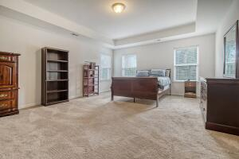
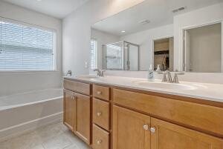
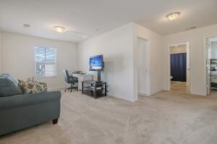
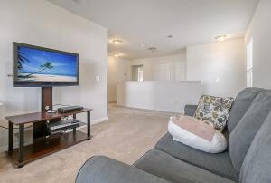
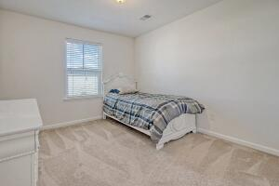
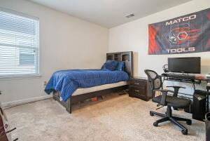
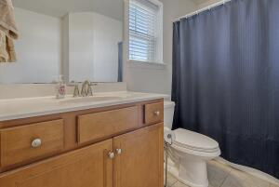
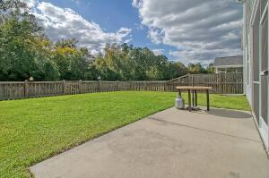
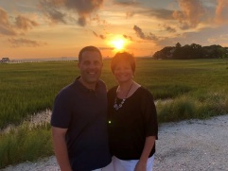

Like New Home in Summerville! Move Right In!
1334 Wild Goose Trail
Drakesborough
Summerville, SC 29483
MLS# 23023854
$359,000
3 Bedrooms | 2½ Baths | 2,283 sf
This beautiful 2,283 Sq. Ft. home offers 3BR and 2.5BA and is in excellent, move-in condition! On the ground floor, buyers will find a large family room which is open to the kitchen and dining room. The gourmet kitchen has granite counters, a large island with sitting bar, pantry, backsplash and plentiful cabinetry.
Upstairs buyers will find a loft which could be a home office, playroom or upstairs living room as well as 3 bedrooms and 2 full bathrooms. The primary bedroom is very large with an attached bathroom featuring dual vanities, separate tub and shower as well as a huge walk-in closet! The laundry room can also be found upstairs.
The home is nicely landscaped and offers a screened porch and fenced-in backyard overlooking a pond as well as a back patio.
This home is a must see!
Larry & Kathy Mazalatis
Larry Cell 843-693-0529
Kathy Cell 843-693-0159
mazteamrealty@gmail.com
AGENTOWNED PREMIERE GROUP | 1800 TROLLEY RD | SUMMERVILLE, SC 29485

