Slide 1
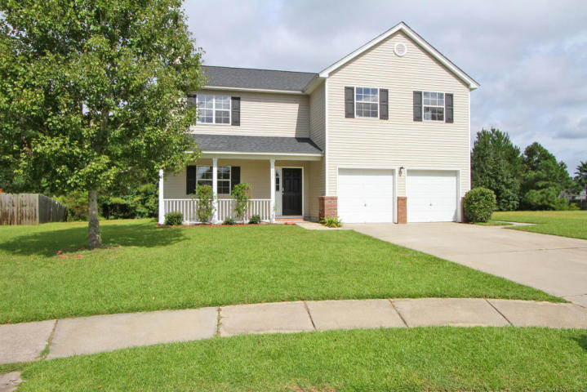
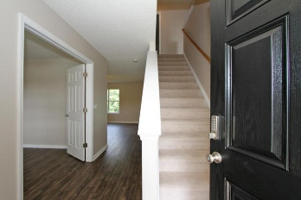
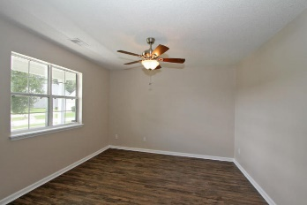
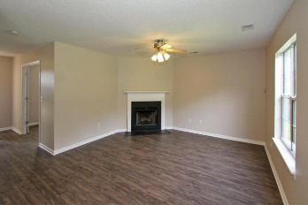
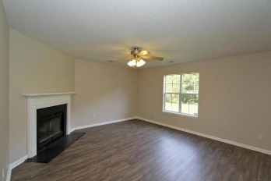
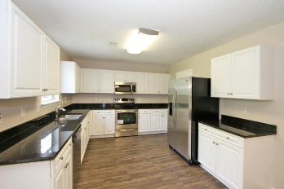
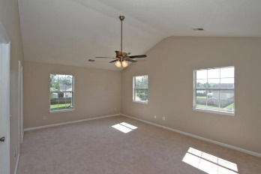
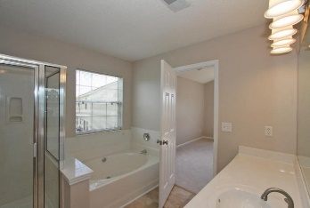
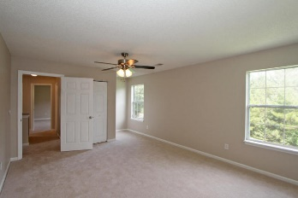
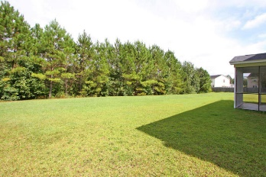
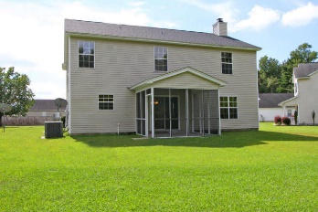

Just Remodeled…Like New!
1335 Bishop Pine Dr
Tall Pines · Ladson, SC 29456 · MLS# 15025356 · $210,000
YOU MUST SEE THIS LISTING!!
A beautifully remodeled home with 4 large bedrooms. Located on a beautiful large lot. This home has been meticulously remodeled to include new stainless steel appliances, granite counter tops, low maintenance vinyl plank flooring and carpet. The a/c is only two years old and the roof has just been replaced with architectural shingles. This home has two garages with automatic garage door openers. The large living area has a fireplace and the room in the front can be an office or dining room. The laundry/mud room is large enough for washer and dryer plus extra room for storage. Relax on the screened porch overlooking the large backyard.
RE/MAX Alliance
1200 Two Island Ct.
Ste. A
Mt. Pleasant, SC 29466
Ken Earnhardt
Office - (843) 352-7943
Mobile - (843) 343-3872
earnhardtken@gmail.com

