Slide 1
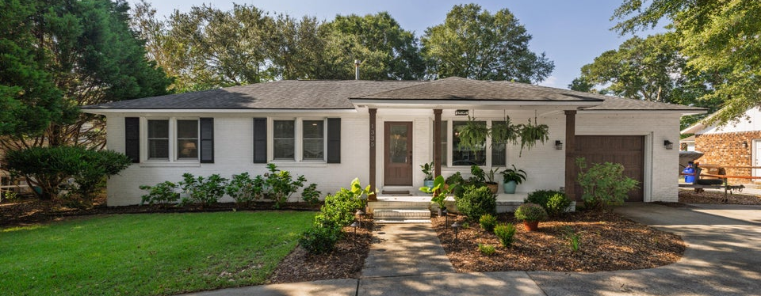

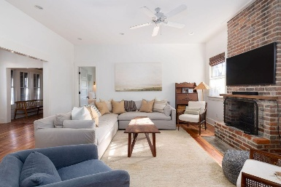
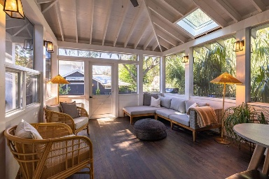
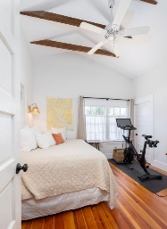
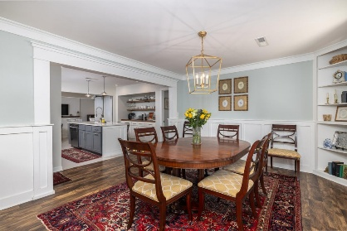
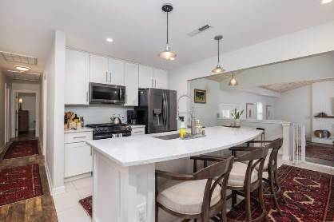
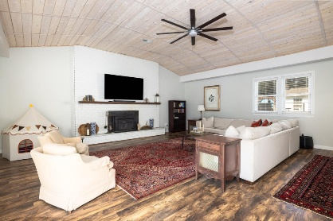
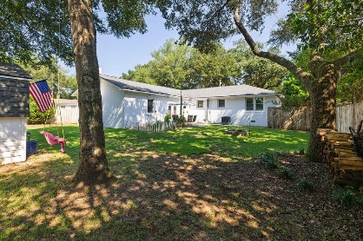

Offering $10,000 Agent Bonus On Top Of 2.5% BAC For A Ratified Contract Before Sunday (10/6)
1335 Camp Road
Farmington | Charleston, SC 29412 | MLS# 25025875 | $749,000
Nestled beneath majestic oak trees in the heart of James Island, 1335 Camp Road is a thoughtfully updated single-story ranch that perfectly blends timeless charm with contemporary style. Originally built in 1965, this 3-bedroom, 2.5-bath home has been beautifully reimagined with modern comforts and stylish details, making it the quintessential James Island retreat. From the freshly painted exterior and inviting front porch with rich wooden accents, the curb appeal sets the tone for what awaits inside. Step into a home designed for both relaxed living and elegant entertaining - where natural light, soaring wooden vaulted ceilings, and open, airy spaces create a true sense of warmth and sophistication.
The expansive living room is a showstopper, featuring a cozy sunken layout, wood burning fireplace, and built-in bar.
The updated kitchen has abundant built-in storage, a large island with seating, and a gas range. The separate dining room and eat-in breakfast nook provide flexibility for everyday meals and special gatherings alike.
The private primary suite has a steam shower and dual vanity. Additional bedrooms offer charming touches, including a built-in desk/vanity.
Enjoy evenings around the firepit and relax on the patio in the backyard. Mature oaks provide shade and privacy, while thoughtful landscaping enhances the beauty of the property year-round.
The property also features a one-car garage and a large laundry/utility room. Located just minutes from Folly Beach and downtown Charleston, this is the perfect opportunity to own a stunning, move-in ready James Island home where every detail has been carefully considered.
Greg Gelber
843-494-2354
greg.gelber@agentownedrealty.com
Kelly Snyder
843-457-5951
kelly.snyder@agentownedrealty.com
AgentOwned Charleston Group | 902 Savannah Hwy | Charleston, SC 29407-7802

