Slide 1
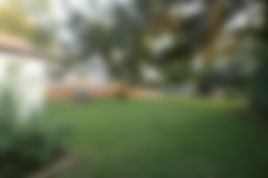
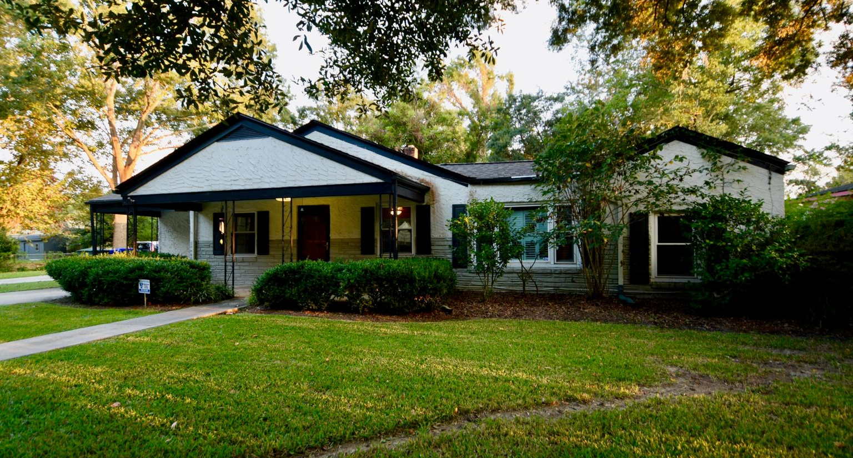
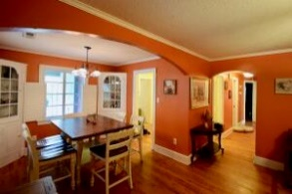
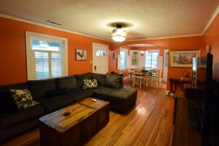
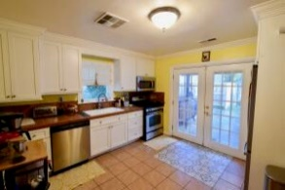
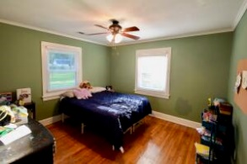
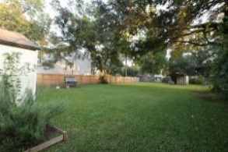


Priced To Sell
1335 Wallerton Avenue
Washington Park | Charleston, SC 29407 | MLS# 21029635 | $399,000
LOCATION LOCATION LOCATION! If you're looking for a well maintained ranch close to everything this is it! Turnkey 4 bedroom, 2 bath home with lots of improvements. The majority of the windows have been replaced, 2015 HVAC, new roof, tankless water heater, new breaker box, plantation shutters and updated kitchen. The home features beautiful hardwood floors throughout and a primary bedroom and bath separate from the other bedrooms. Enjoy close proximity to entertainment, restaurants and grocery stores as well as St. Andrews Parks and Rec Center. X flood zone and no HOA!
Gary Raymond (843) 729-3688 | gary.raymond@agentownedrealty.com
AgentOwned Preferred Group | 1400-G Palm Blvd. | Isle Of Palms, SC 29451

