Slide 1
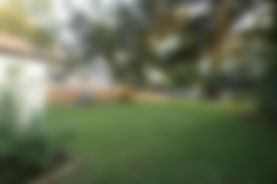
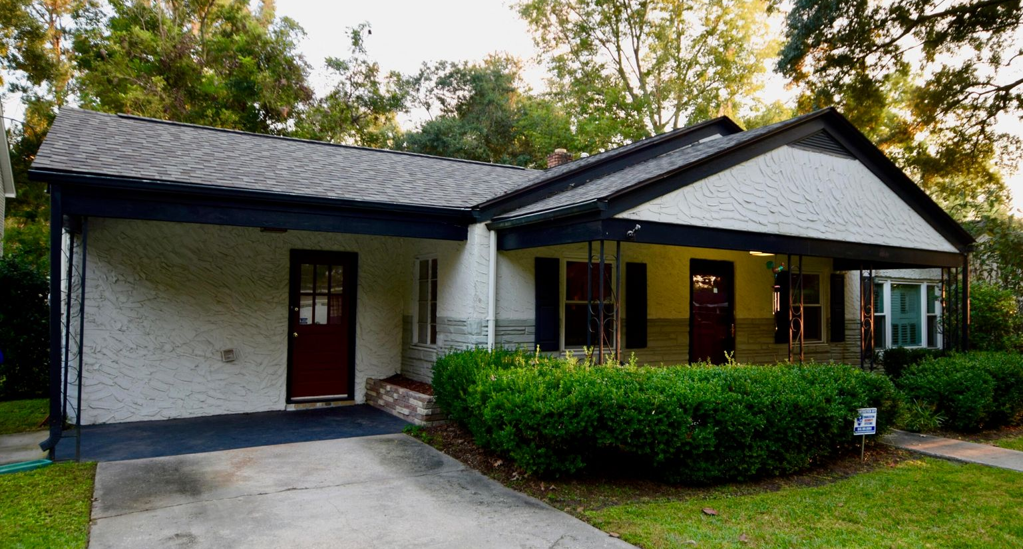
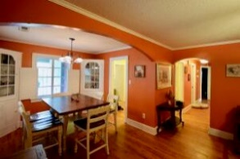
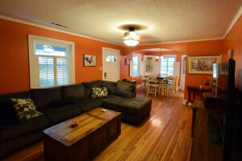
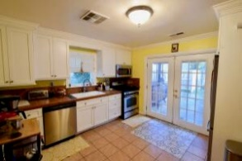
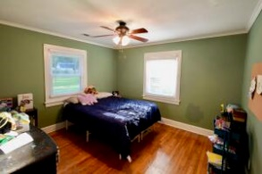
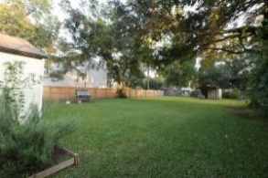


Open House Saturday Oct 30th 11-2pm
1335 Wallerton Avenue
Washington Park | Charleston, SC 29407 | MLS# 21028053 | $439,000
If you're looking for a well maintained ranch in a great location this is it! 3 bedroom, 2 bath home with an additional room that the owners currently use as an office. The majority of the windows have been replaced, 2015 HVAC, new roof, tankless water heater, new breaker box, plantation shutters and updated kitchen. The home features beautiful hardwood floors throughout and a primary bedroom and bath separate from the other bedrooms. Enjoy close proximity to bars, restaurants and grocery stores as well as St. Andrews Parks and Rec Center. X flood zone and no HOA!
Gary Raymond (843) 729-3688 | gary.raymond@agentownedrealty.com
AgentOwned Preferred Group | 1400-G Palm Blvd. | Isle Of Palms, SC 29451

