Slide 1
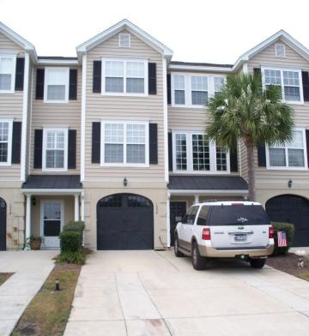
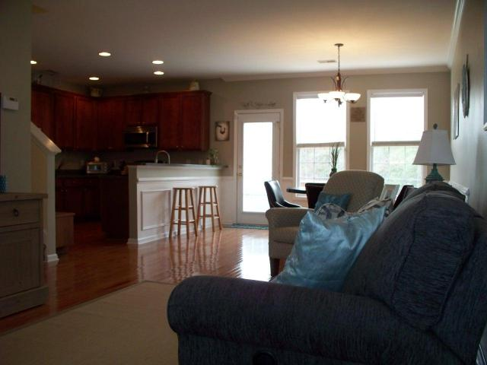
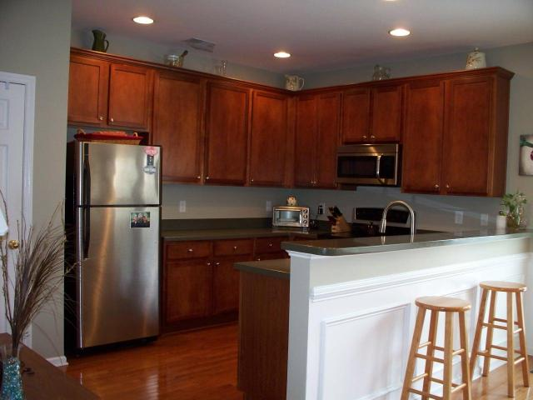
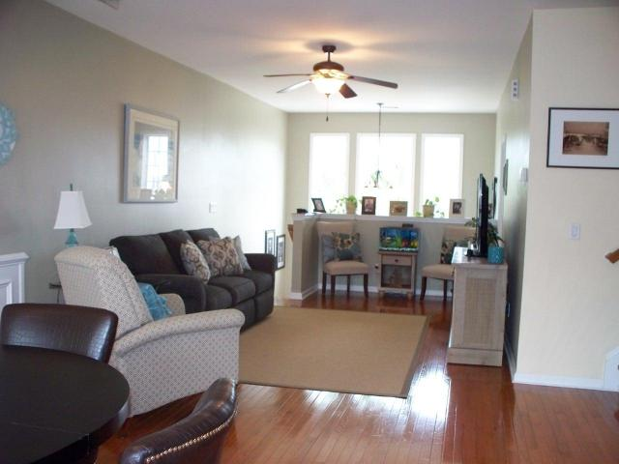
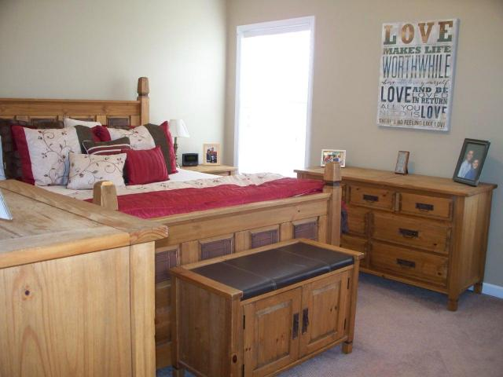
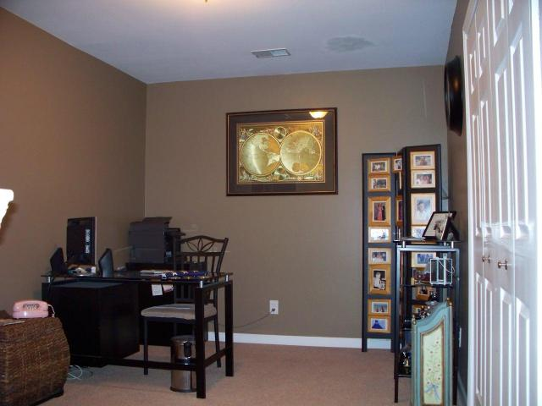
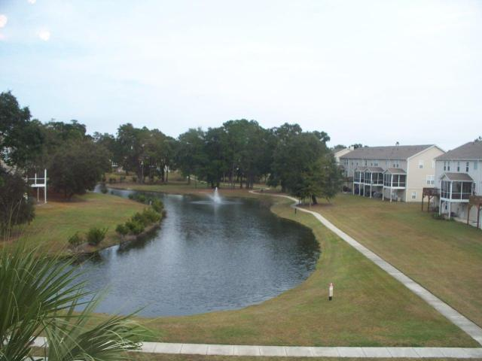


1336 Hamlin Park Circle
Hamlin Park ~ Mt Pleasant ~ MLS# 17031980 ~ $325,000
OPEN HOUSE SUNDAY 12/17/17 1-4PM
5 Bed / 4½ Bath
3,889 Sq Ft
Custom Home
Desirable Location
Hardwood Floors
2-Story Great Room
Great Backyard
This beautiful townhouse is spacious, well kept with an open floorplan. It's located just minutes to the beaches, shopping and dining at the Towne Center. The second floor living area boasts pristine oak wood flooring throughout the kitchen and living/dining room. Off the kitchen and dining room step outside to a deck that overlooks a pond and green space perfect for your morning coffee or to fire up the grill. The second floor main living area also offers a spacious bedroom with it's own full guest bath and a great walk-in closet with access to extra storage under the steps. This room would make a great office/playroom or guest bedroom. The upstairs consists of a loft/office, a master bedroom, 2 spare bedrooms and 2 full baths. The master bedroom offers vaulted ceilings, with 2 separate closets and an attached master bath with dual vanities, a stand up tiled shower and a separate garden tub. The home is wired for a security system and the kitchen and garage refrigerators convey with the home. The community amenities include: a swimming pool and small workout facility. DON'T MISS OUT...ONLY 2 ACTIVE LISTINGS AVAILABLE FOR SALE!!!
MAKE YOUR APPOINTMENT NOW...IT WON'T LAST!!
Leah M. Rust
843-709-9211 Mobile
843-856-8800 Office
leahmrust@gmail.com
Coldwell Banker RESIDENTIAL BROKERAGE

