Slide 1
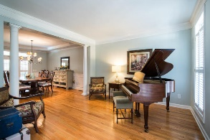
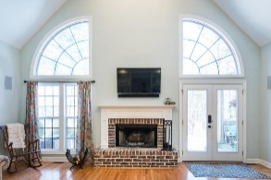
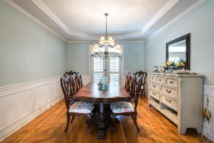
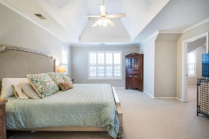
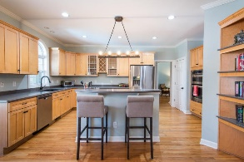
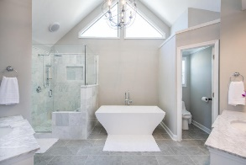
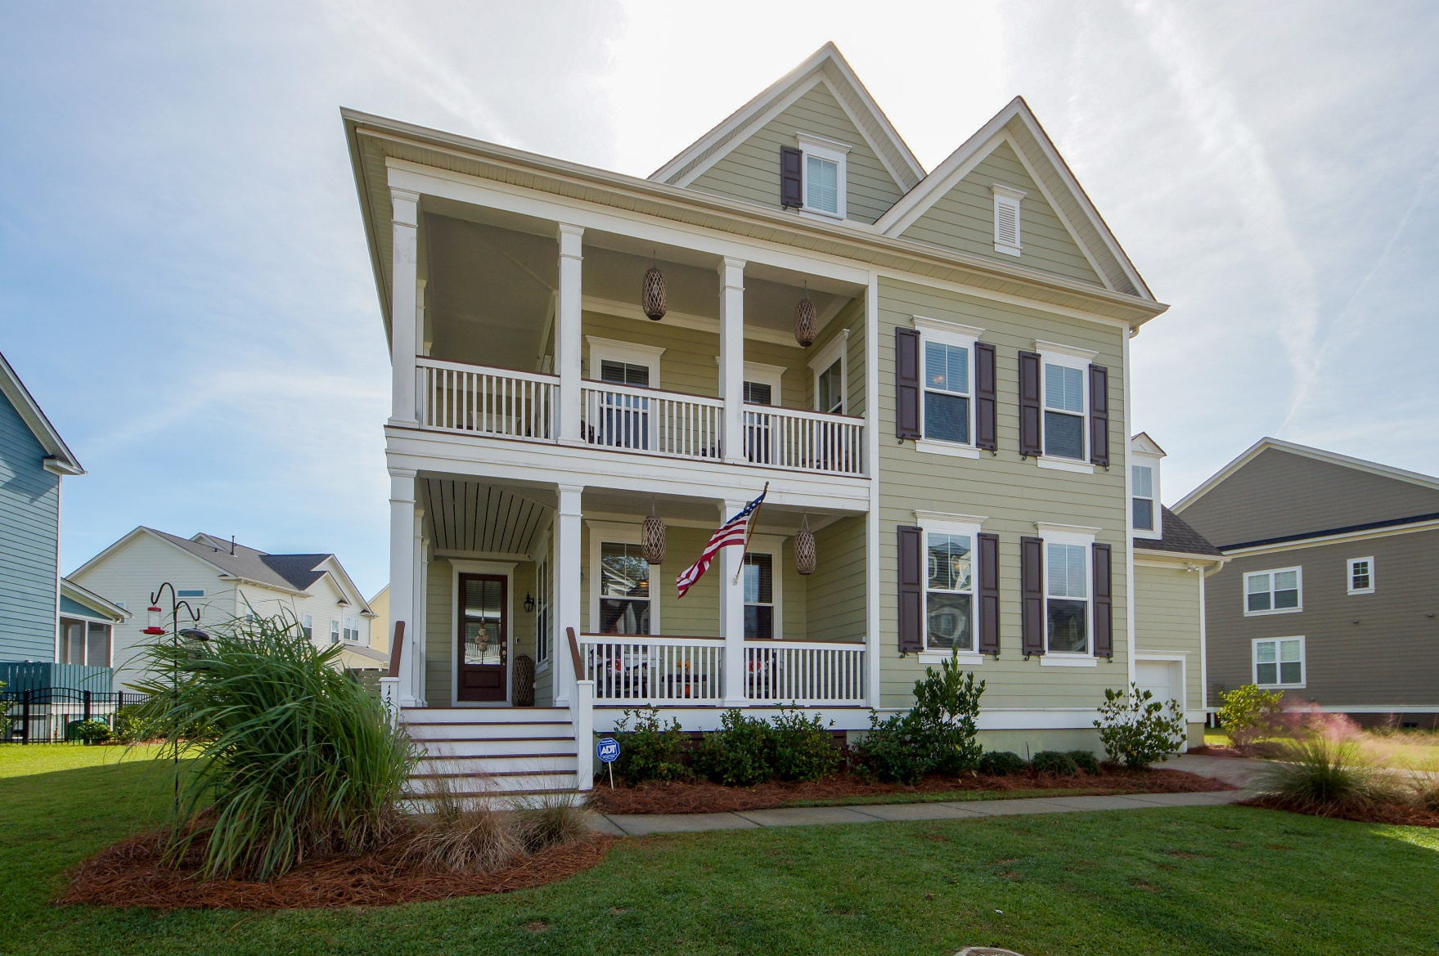
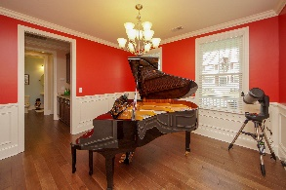
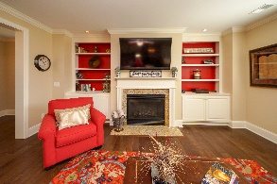
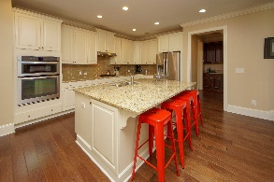
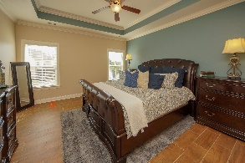
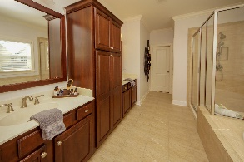
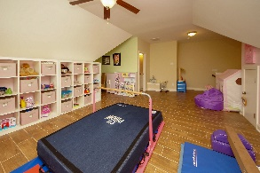
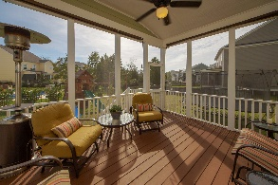
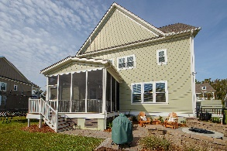
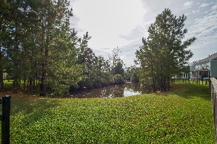


1336 Whisker Pole Lane
Dunes West ~ Mount Pleasant, SC 29466
MLS# 19007356 ~ $615,000
AMAZING PRICE!
Rent to Own!
Beautiful lowcountry home with 5 bedrooms, 5 bathrooms, and spans over 3700 square feet including a loft, huge bonus room, and outdoor living space. The upstairs and downstairs wrap around front porches welcome you into this home. You are greeted by a charming foyer that opens into the family room. The open floorplan is the ideal venue for entertaining. NO CARPET IN THIS HOME, wood and tile floors throughout making the floors maintenance free for kids and pets!! This home features a gourmet kitchen with beautiful cream-colored cabinetry with crown molding, granite countertops, glass tiled back splash, and center kitchen island. Any chef will enjoy the built-in wall oven and microwave, gas cooktop, and an abundance of cabinetry and counterspace. The breakfast area is located off the kitchen or you can enjoy the bar stool seats for casual dining. Relax by the warm glow of the gas fireplace with built-in book shelves. Butlers pantry leads to the formal dining room (currently used as a music room). Full guest bedroom and bathroom located on the main level. On the second floor you will find the master bedroom, 2 guest bedrooms, HUGE bonus room and Loft (currently used as an office). The master bedroom contains trey ceilings and 2 walk-in closets. Master bathroom features his & her vanity with soaking tub and shower. Enjoy the plank style tiled floors on this level- NO CARPET! One of the guest bedrooms has a private bathroom while a jack-and-jill style bathroom is located in between the other guest bedroom and loft. The HUGE bonus room is currently used as a home school room. The loft/office has direct access to the 2nd floor wrap around porch! On the third floor you will find the 5th bedroom and 5th full bathroom. This area is a perfect playroom, mother-in-law suite or guest bedroom. Lots of natural light and neutral colors throughout the home. Nice size screen porch off the back of the home. Enjoy the stone fire pit and fully fenced in backyard. Front and backyard irrigation and mosquito misting system already installed. Inside the 2-car attached garage you will find a storage room and monkey bar system for organization. This home is spacious and comfortable while showing pride of ownership! Dunes West is a private, gated community offering wonderful amenities and facilities. Golf, pool, clubhouse, play park, workout room, boat ramp, boat storage, and miles of walking and biking paths!
Cathy Sembower
843-259-1350
csembower@carolinaone.com
www.cathysembower.com
Carolina One Real Estate
195 W Coleman Blvd
Mt Pleasant, SC 29464-3495

