Slide 1

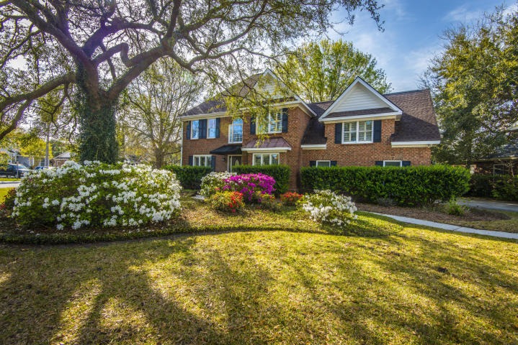
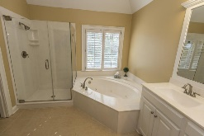
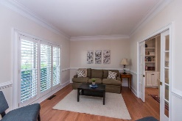
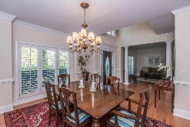
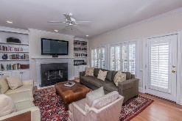
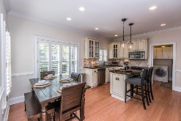
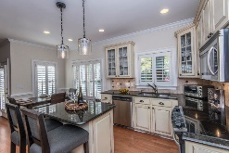
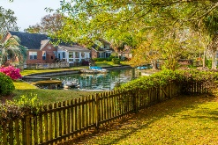
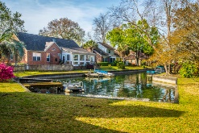
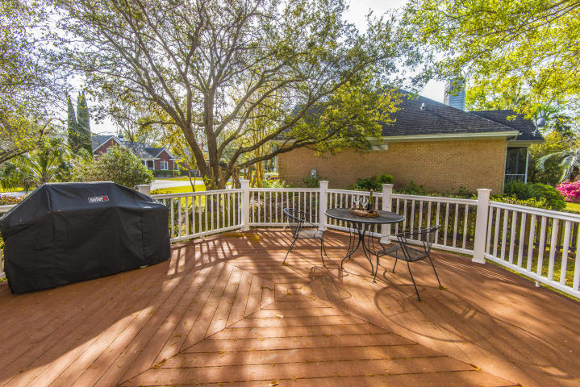
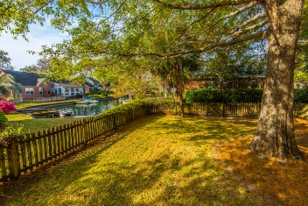
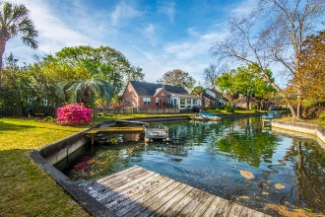


1337 Overcreek Ct
Mount Pleasant
Hidden Lakes
Motivated!! Price Reduction!
Beautifully updated and lovingly maintained, this stately and elegant all brick home is located in the heart of Mount Pleasant ~ close to everything, yet tucked away on the canal with a private dock! You'll love boating and fishing on the 50 acre stocked neighborhood lake.
If outdoor living is high on your list of priorities, don't forget to step outside into the backyard that is truly an outdoor oasis. With mature trees, a large deck and fully fenced yard, this is the perfect spot to unwind after a long day or host friends for a backyard barbeque. The serene view of your private dock down the canal to the lake is one that isn't easily found in the heart of Mount Pleasant! In addition to the lake, Hidden Lakes offers tennis courts, a club house and a neighborhood pool, conveniently located within walking distance from the home. Don't miss your opportunity to own this beautiful home so close to I-526, the beaches, Towne Center and the world-class dining and shopping of historic downtown Charleston!
Asking $668,000
MLS# 18008889
2,846 SqFt
4 Bed/3½ Baths
Short Drive to Historic Downtown Charleston & Beaches
Don Dawson
843-514-0452
ddawson@carolinaone.com
Carolina One Real Estate • 2713 Highway 17 North • Mount Pleasant, SC 29466
www.TeamDawsonSC.com

