Slide 1
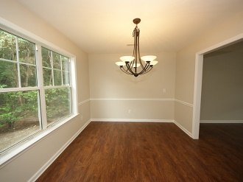
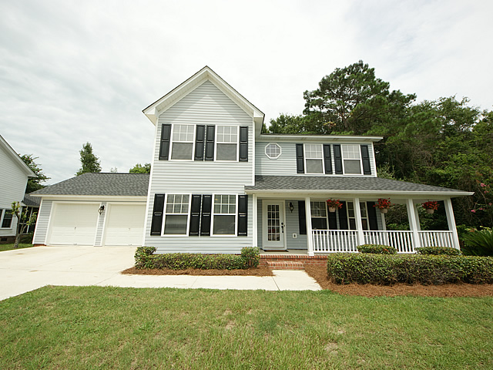
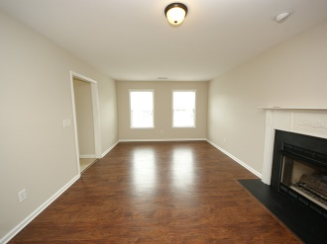
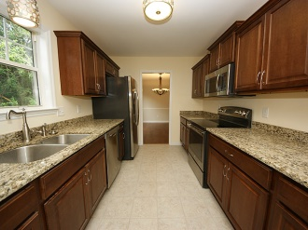
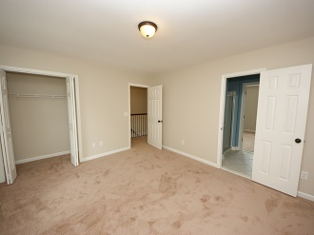
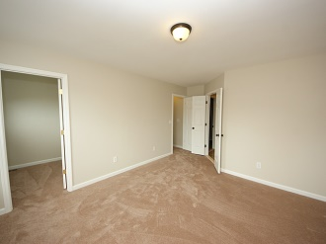
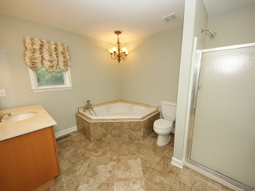
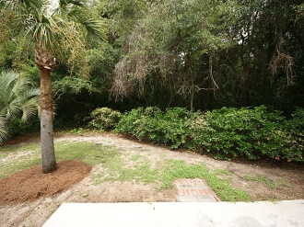
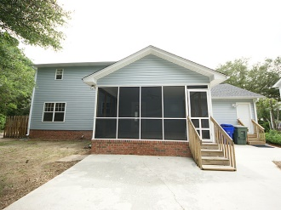
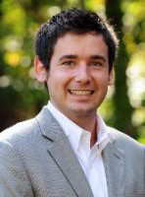

Bayview Farms Agent Open House Monday 11:30-1:30 · Lunch Provided
1338 Salt Marsh Cove
Charleston · MLS# 1419759 · $319,900
Schedule your appointment today to see this renovated, private, and move-in ready home in desirable and family-friendly Bayview Farms. The kitchen is all new, and includes beautiful cherry wood cabinets, granite countertops, stainless steel GE appliances including a flat top range, refrigerator, and built-in microwave, and new hardware and light fixtures. The family room features a gas fireplace, and has a nice flow leading to the kitchen. The family, formal living, and separate dining rooms all showcase new flooring, smooth ceilings, and updated light fixtures. The half bath has new plumbing fixtures and a granite-topped vanity. There is a large 2-car garage with a newly coated concrete floor, and there is also a large, private screened porch that is great for entertaining. The upstairs of this family home has all new carpet, smooth ceilings, new light fixtures, and fresh paint. The master bedroom has two enormous closets, and a full bath that has been updated in grand style. It features a separate tub with high-end plumbing fixtures, gorgeous vanity, and beautiful tile floors. The two additional bedrooms are ample size with plenty of closet space, and they share a jack-and-jill bath that has also been updated. The curb appeal is fantastic with a charming front porch, new roof, established landscaping, and lots of privacy. This home has no visible neighbors to the right of you or behind you, and is located in a quiet cul-de-sac. A new 50-year architectural shingle roof with transferable warranty rounds out this package. The Bayview Farms community offers amenities including 2 swimming pools, a tennis court, and play park. Buyer to pay at closing $520 to HOA Capital Contribution which goes towards Capital Reserve Account & The General Account. Schedule your appointment today before it's gone!
Casey Anderson
Cell 843-410-3525
casey@charlestondwellings.com
Keller Williams Realty Charleston | 496 Bramson Ct, Suite 200 | Mt Pleasant, SC 29464

