Slide 1
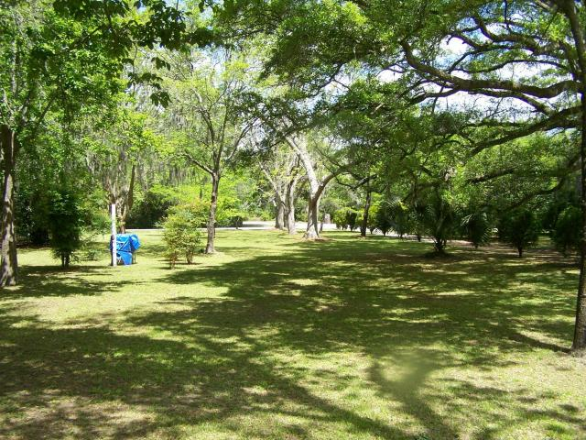
Landscaped Lot Ready To Be Developed
Just Reduced!!
1339 Emory Avenue
Stono Park ~ Charleston
MLS# 17010227 ~ $285,000
This is the first time this beautiful building lot has been listed for sale separately in over 40 years. It was previously listed with Lots 64 and 66. This is very large extremely well landscaped lot with flowering shrubs, towering trees. It is amply large enough to build a very big family home. This neighborhood is close to schools, shopping and easily accessible from Highway 17S and I-526. Public water and sewer are available to this lot. One of the last remaining large landscaped lots this close to downtown Charleston.
Tommy Hartnett
tfhartnett@gmail.com | (843) 729-7222
The Hartnett Company, LLC | PO Box 247 | Isle Of Palms, SC 29451

