Slide 1
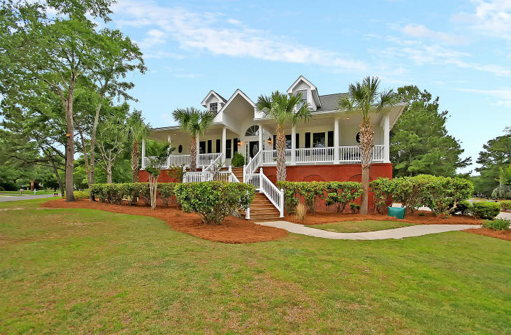
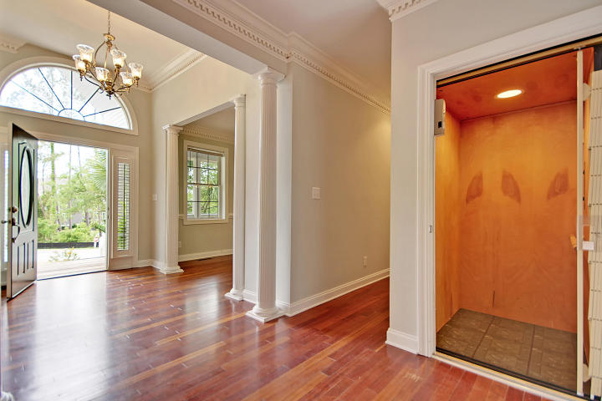
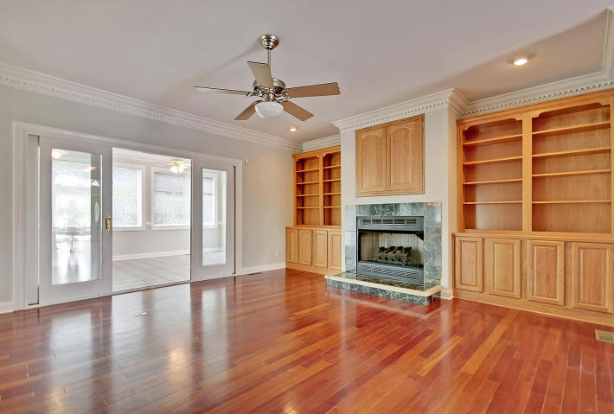
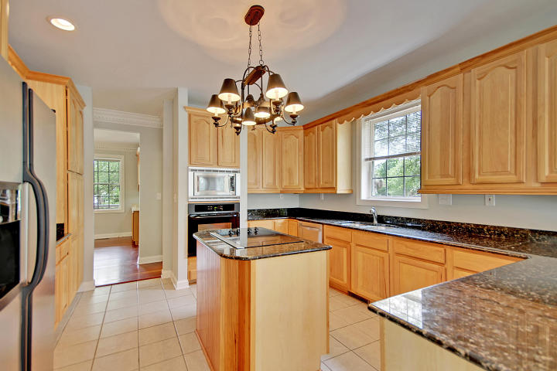
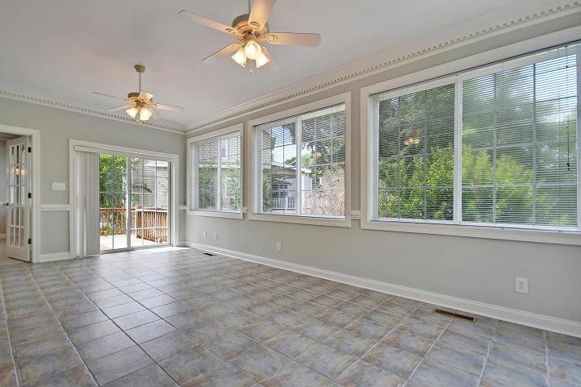
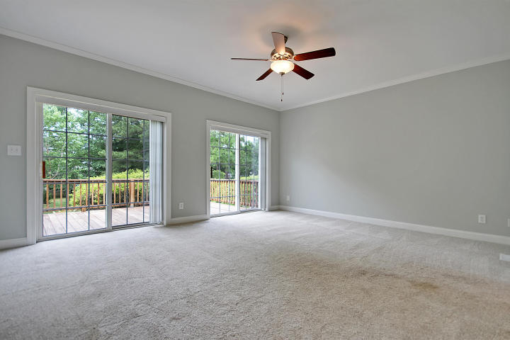
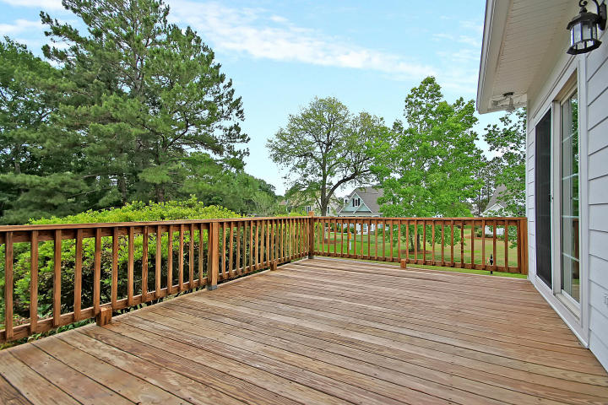
Great Downtown Investment Opportunity
Open House Sunday from 2-4
133 Berkshire Drive
St Thomas Point ~ Charleston ~ MLS# 18014125 ~ $575,000
Three levels of living that's better than new construction! Ready for immediate occupancy, this nearly 4000 square foot, home is situated on a spacious corner lot in St. Thomas Point, a private gated community that offers access to the Wando River with a boat ramp and community dock. This home has been impeccably maintained and has beautiful upgrades like built-ins throughout, stunning Brazillian cherry hardwood floors, an elevator and a home office/5th bedroom on the main floor. The ground level has an amazing in-law suite with a bedroom, full bath, kitchenette, living room, and a private entrance. The outdoors can be enjoyed from the expansive, wrap around front porch, and either one of the two decks in the back. Enjoy your morning coffee or evening glass of wine in the sunroom off of the living room with its cozy fireplace. Kitchen has granite counters, a breakfast bar, center island and eat-in area. Master bedroom is on main level has dual vanity, jetted tub, walk-in shower, walk-in closet, and access to a private deck. Oversized 3-car garage allows plenty of room for golf cart, bikes, and parking for 5 cars. For an added bonus: no flood insurance is required! The home is currently at the 6% property tax rate, but if made into a primary residence, the rate will be changed to 4% (approximately $2,597 annually).
This home is ready for immediate occupancy: come see it, fall in love and move right in!
Book your viewing today!
Paige Rhodes 843-830-3281
paige@mattoneillteam.com
Ben Laaper 843-642-3546
ben@mattoneillteam.com

