Slide 1

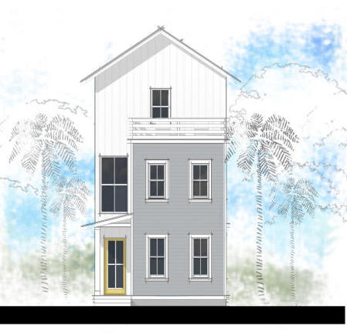
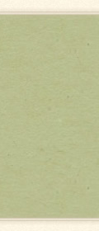

133 Bratton Circle
MLS# 15024021 ~ $555,000
Screened Porches and rooftop decks
Community green space
High walk and bike score to shopping, dining, pubs, & beaches
10 minutes to Sullivan's Island
15 minutes to downtown Charleston
Located behind Sea Island Shopping Center
For floor plans and additional information, visit www.villageparksc.com
Edmund Major
843-343-6666 C
edmund@flywaysc.com
www.flywaysc.com
Flyway Real Estate, LLC
1630 Meeting St.
Bldg 1
Ste 302
Charleston, SC 29405

