Slide 1
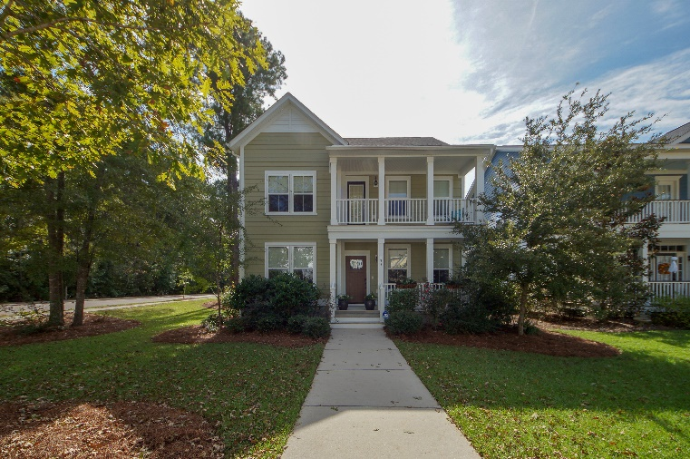
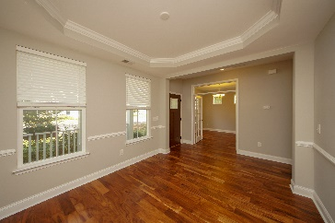
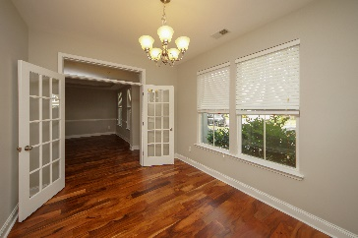
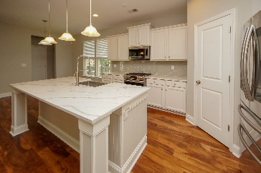
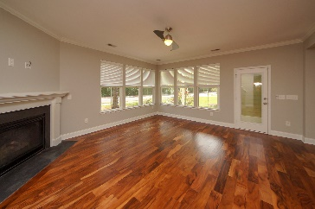
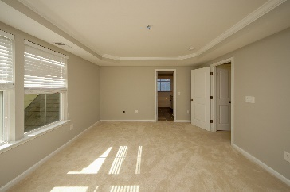
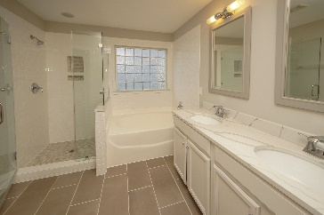
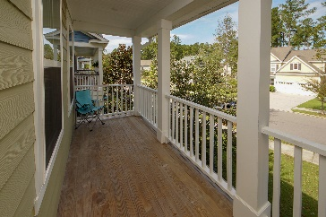
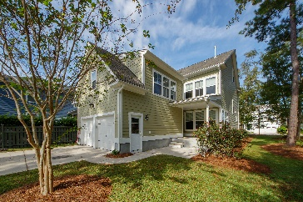

Beautifully renovated house at The Ponds
$5,600 Realtor Bonus with accepted offer
Open House Sunday 11/18 from 1-3pm
133 Musket Loop
The Ponds
Summerville
MLS# 18027781
$489,000
Great opportunity for anyone looking for a move-in ready house in one of Summerville's premiere neighborhoods... House was built in 2011 and has just under gone a complete remodel... Has everything and more than the new construction currently being built, without having to live in a construction zone for the next few years... Situated on a very unique corner lot on a very quiet street... Lots of families with children on street as well.
Daniel Sawall
(843) 597-0671
dsawall@canconethrealty.com

