Slide 1
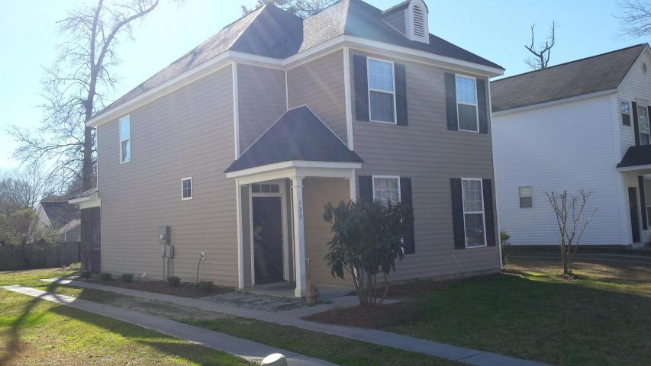
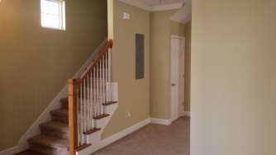
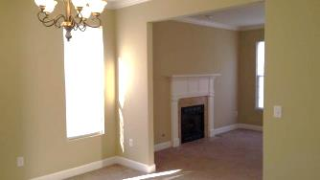
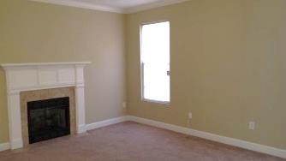
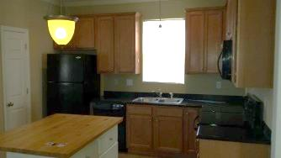
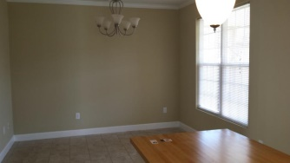
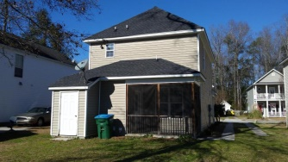


Open House Saturday & Sunday
Price Reduced!
133 St Phillips Row
St Phillips Place ~ Summerville
MLS# 1426325 ~ $159,900
Priced to sell, custom built home, in immaculate condition. This Charleston Single style is a great opportunity in an excellent location. Think classy upgrades- Smooth ceilings, crown molding, and brushed nickel hardware throughout. Enter through the covered front porch into a great living room with fire place Central island in kitchen has some overhang for a couple of stools. The bathrooms and laundry room have tile flooring. There is even cultured marble in bathrooms. Bedroom 2 & 3 have a ''Jack and Jill'' style bathroom. The large master bedroom has a tray ceiling and double doors to the master bath. There is also a screened porch- perfect for morning or evening coffee. Check out the location- Close to: YMCA pool, Hike/Bike trail, Publix, Bi-Low, restaurants, Pivotal Fitness Center, tals all located near this quaint (one street) cul-de-sac. It is easy to get to Dorchester Rd, Ladson Rd, 26, etc. Get it while you can.
Randy Stuckey, Realtor
843-906-7997
randystuckey@msn.com
ERA Wilder Realty, 125-F Wappoo Creek Dr, Charleston, SC 29412

