Slide 1
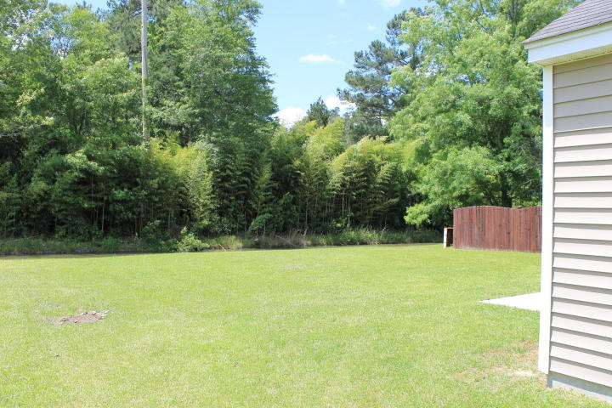
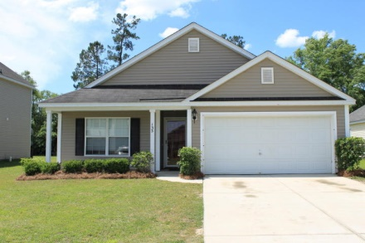
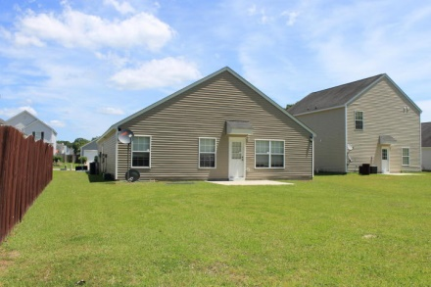
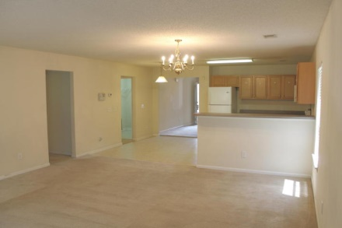
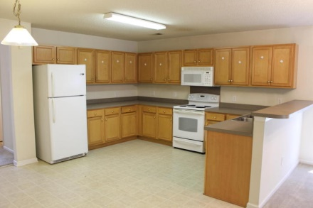
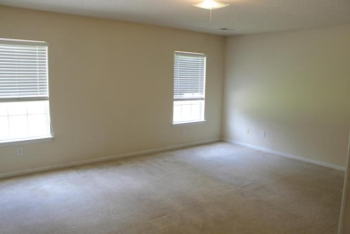
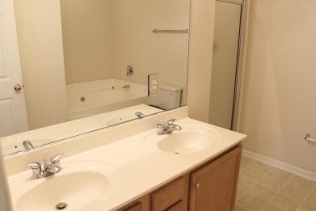
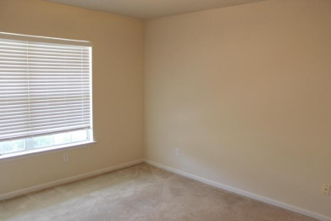
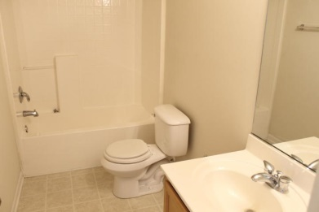
$750 Agent Bonus - PRICED TO SELL!
133 Tyron Road
Scotts Mill
Summerville, SC 29483
MLS# 15007723 | $151,900
Fantastic location! A few minutes drive from downtown Summerville, this home has been well maintained and ready for its new owners! The open floor plan is very inviting and offers plenty of space. The downstairs master bedroom is huge and offers a walk in closet. The master bathroom has his and her sinks, stand up shower, and separate tub. The backyard has lots of room and backs up to a wooded buffer for added privacy.
Sean Harrington
(843) 226-9652
sean@milerproperties.com

