Slide 1
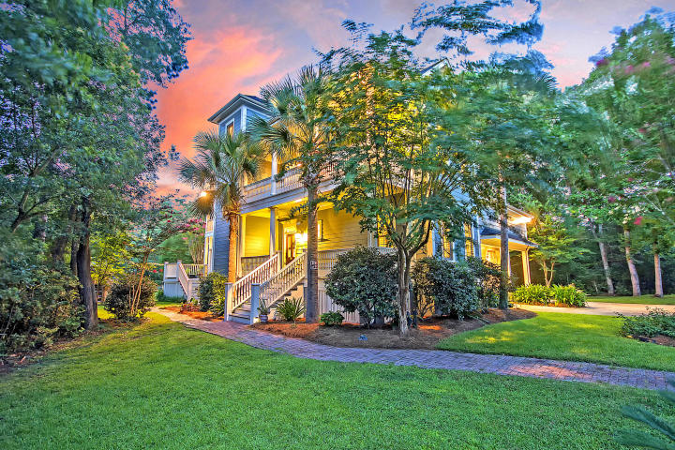

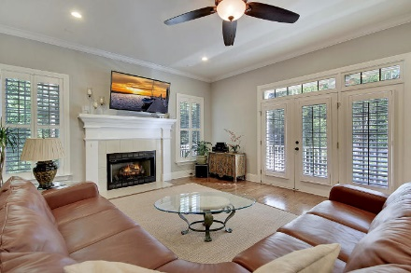
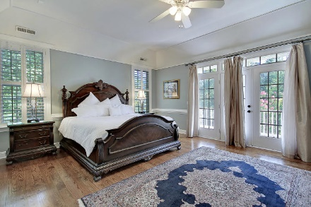
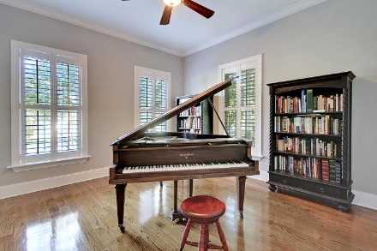
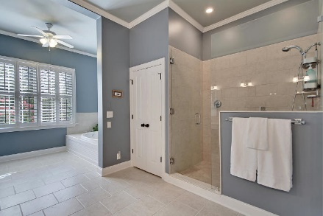
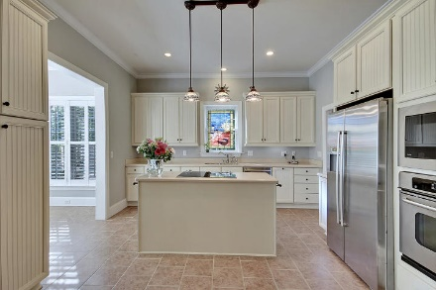
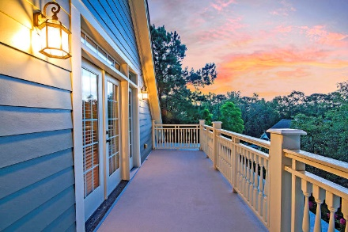
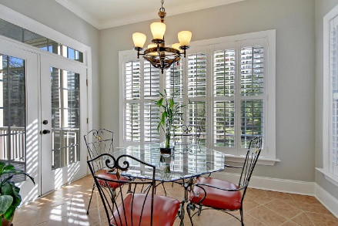
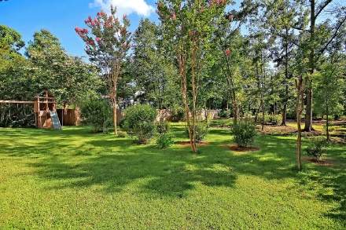
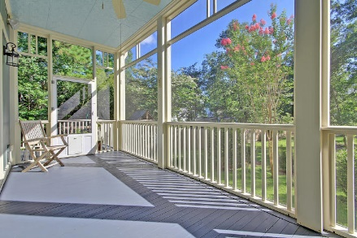
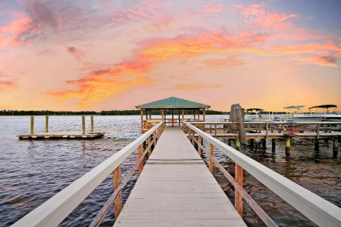
Price Reduced!
New Price!
$25.00 gas card giveaway. Chicken Salad Chick lunch provided by Warren Armstrong of Fairway Mortgage
133 Wando Reach Drive Wando Point ~ Charleston, SC 29492 ~ MLS# 19021696 ~ $617,400
Three levels of luxurious, spacious living await you in the scenic, waterfront, gated community of Wando Point!
This home welcomes you with high ceilings, gleaming hardwood floors, columns that take you into the living room w/its cozy fireplace, a formal dining room w/chair rail molding & eat-in kitchen w/center island that any chef will love!
The master suite is massive all around, has a tray ceiling, a sitting area that leads to the walk-in closet & incredible en-suite bath w/its dual vanity, jetted tub & walk-in shower. There is access to the screened-in porch which is one of FIVE spectacular outdoor living spaces.
The top level features 2 large living spaces w/a full bath in-between & access to the balcony.
You can walk to the community dock & even rent a boat slip if you'd like!
True Edwards true@trueedwards.com 843-442-6253

