Slide 1

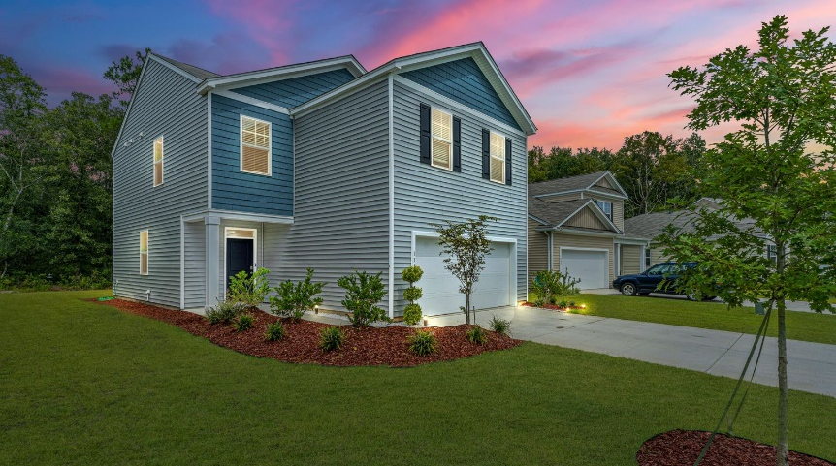
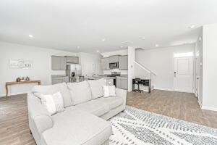
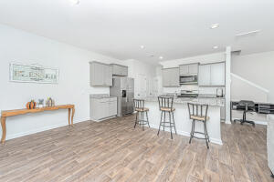
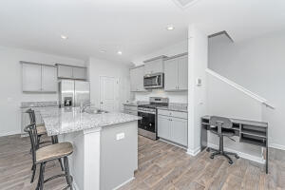
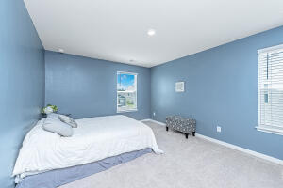
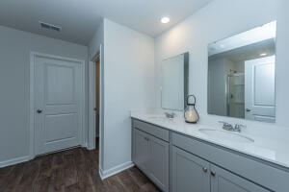
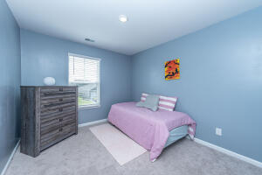
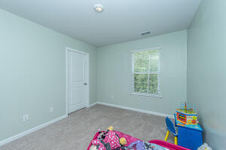
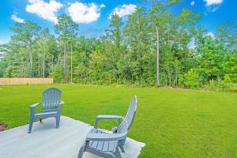
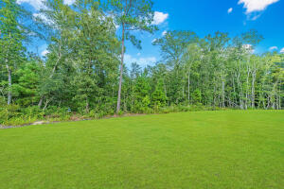
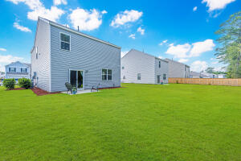


2K PAID TOWARDS CLOSING COSTS W/ ACCEPTABLE OFFER
THE PRICE ON THIS HOME HAS JUST BEEN IMPROVED
133 Lagoona Drive
Mallard Crossing
Summerville, SC 29483
MLS# 22022958 | $369,000
4 Bed | 2½ Bath | 1,928 SF
Located just minutes from Downtown Summerville and I-26 this nearly new beautiful home in Mallard Crossing Subdivision is ready for new owners. Why wait for new construction when you can move in NOW! Downstairs you will find a fully open concept floor plan combining a large family room, kitchen, dining area, and half bath. Warm neutral grays are highlighted in the wall colors, cabinets, LVP flooring, and granite countertops. A large kitchen island complements the space and provides additional seating. Upstairs is a large master en-suite along with three additional bedrooms, full bath, and laundry. This home is immaculate, move-in ready and located in the DD2 school district. A $1,400 Lender Credit is available and will be applied towards the buyer's closing costs and pre-paids if the buyer chooses to use the seller's preferred lender. This credit is in addition to any negotiated seller concessions.
TAKE A VIRTUAL TOUR: https://my.matterport.com/show/?m=DpwrXwQ2bSu
Robin Pye
843-908-2474
robin.pye@carolinaone.com
Carolina One Real Estate
900 N Main St.
Summerville, SC 29483-6633

