Slide 1
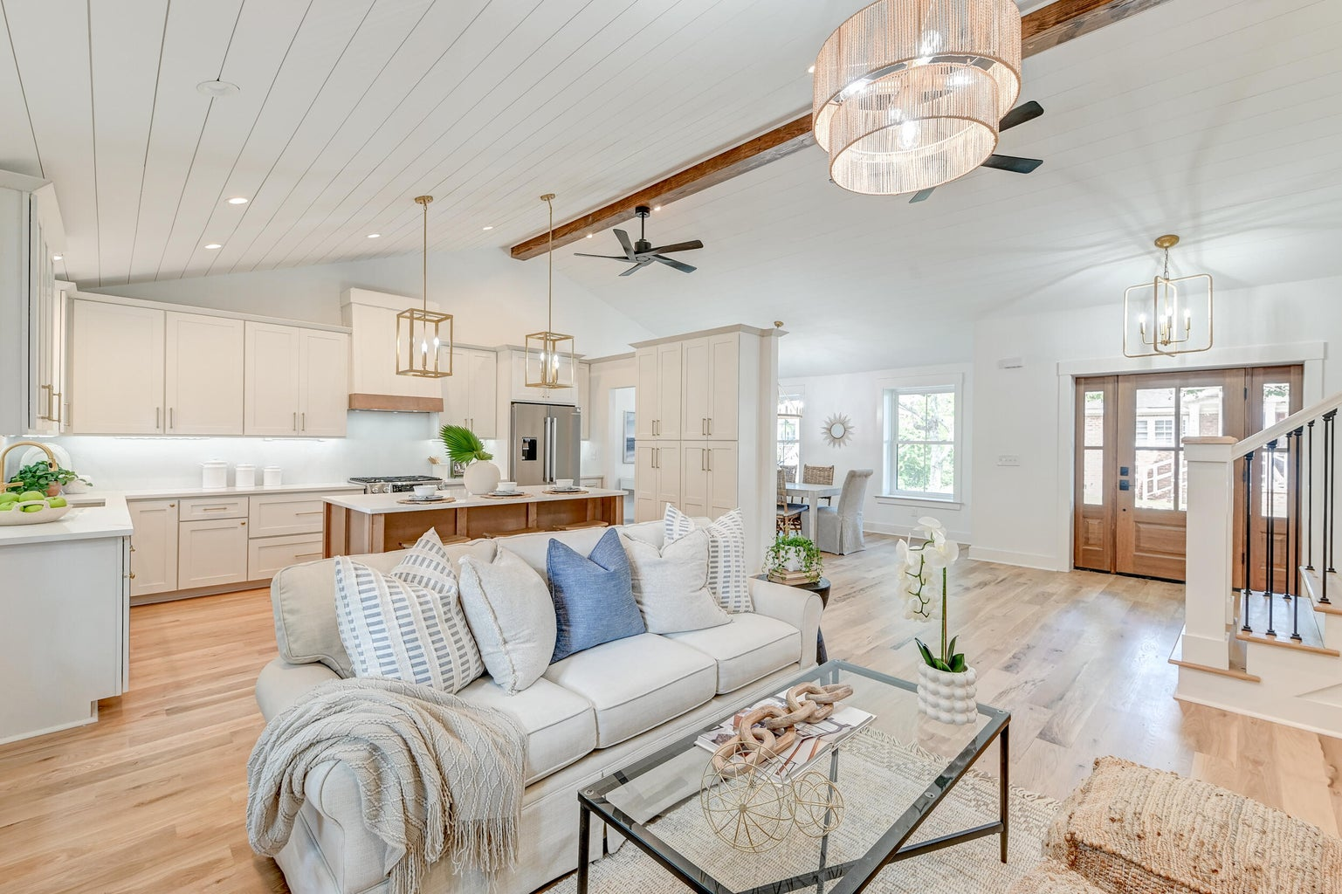

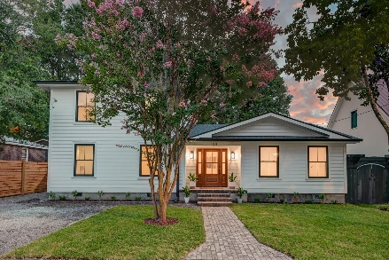
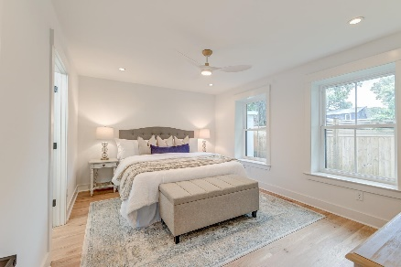
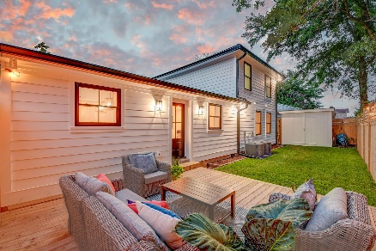
Old Village Downstairs Primary
OPEN HOUSE
SATURDAY 12-3
Open House Saturday 12-3
133 Rose Lane
Old Mt Pleasant | Mount Pleasant, SC 29464 | MLS# 24017752 | $1,875,000
Welcome to an exquisite haven in Old Mt. Pleasant, where luxury and modern elegance blend seamlessly. This completely updated home sits on the quaint Rose Lane, just moments from the charming Pitt Street shops and vibrant Shem Creek, promises a lifestyle of sophistication and convenience.
✨ Pristine landscaping and a striking exterior with custom brick paver walkway
✨ 5'' white oak hardwood flooring, a vaulted, beamed shiplap ceiling
✨ Open floor plan bathed in natural light
✨ 7' island, quartz countertops, elegant cabinetry, and Bosch stainless steel appliances with gas range
✨ Downstairs primary suite with a luxurious ensuite bathroom and a walk-in closet.
✨ 3 spacious bedrooms upstairs, all feature custom closet systems, with one bedroom boasting a stunning ensuite bathroom
✨ Private outdoor space which includes a 16x16 deck, a 7' privacy fence, and large storage shed
Located just 1.5 miles from Pitt Street Bridge, 3.7 miles from Sullivans Island, and 4.5 miles from downtown Charleston, this home perfectly balances tranquility and city life. Don’t miss out on this gem in Old Mt. Pleasant!
Book your showing today!
Stacy Danosky sdanosky@mattoneillteam.com 843-860-8048

