Slide 1
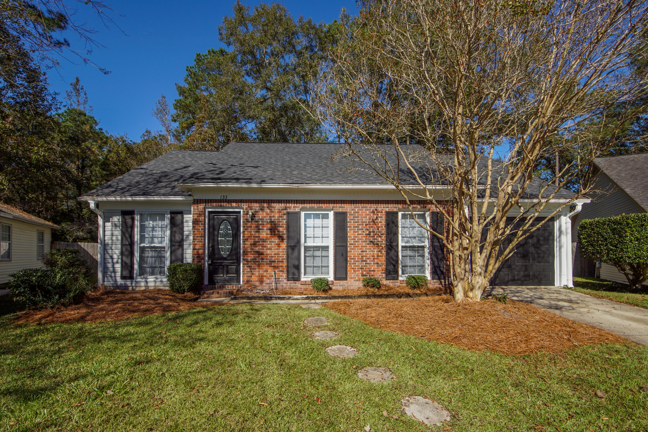
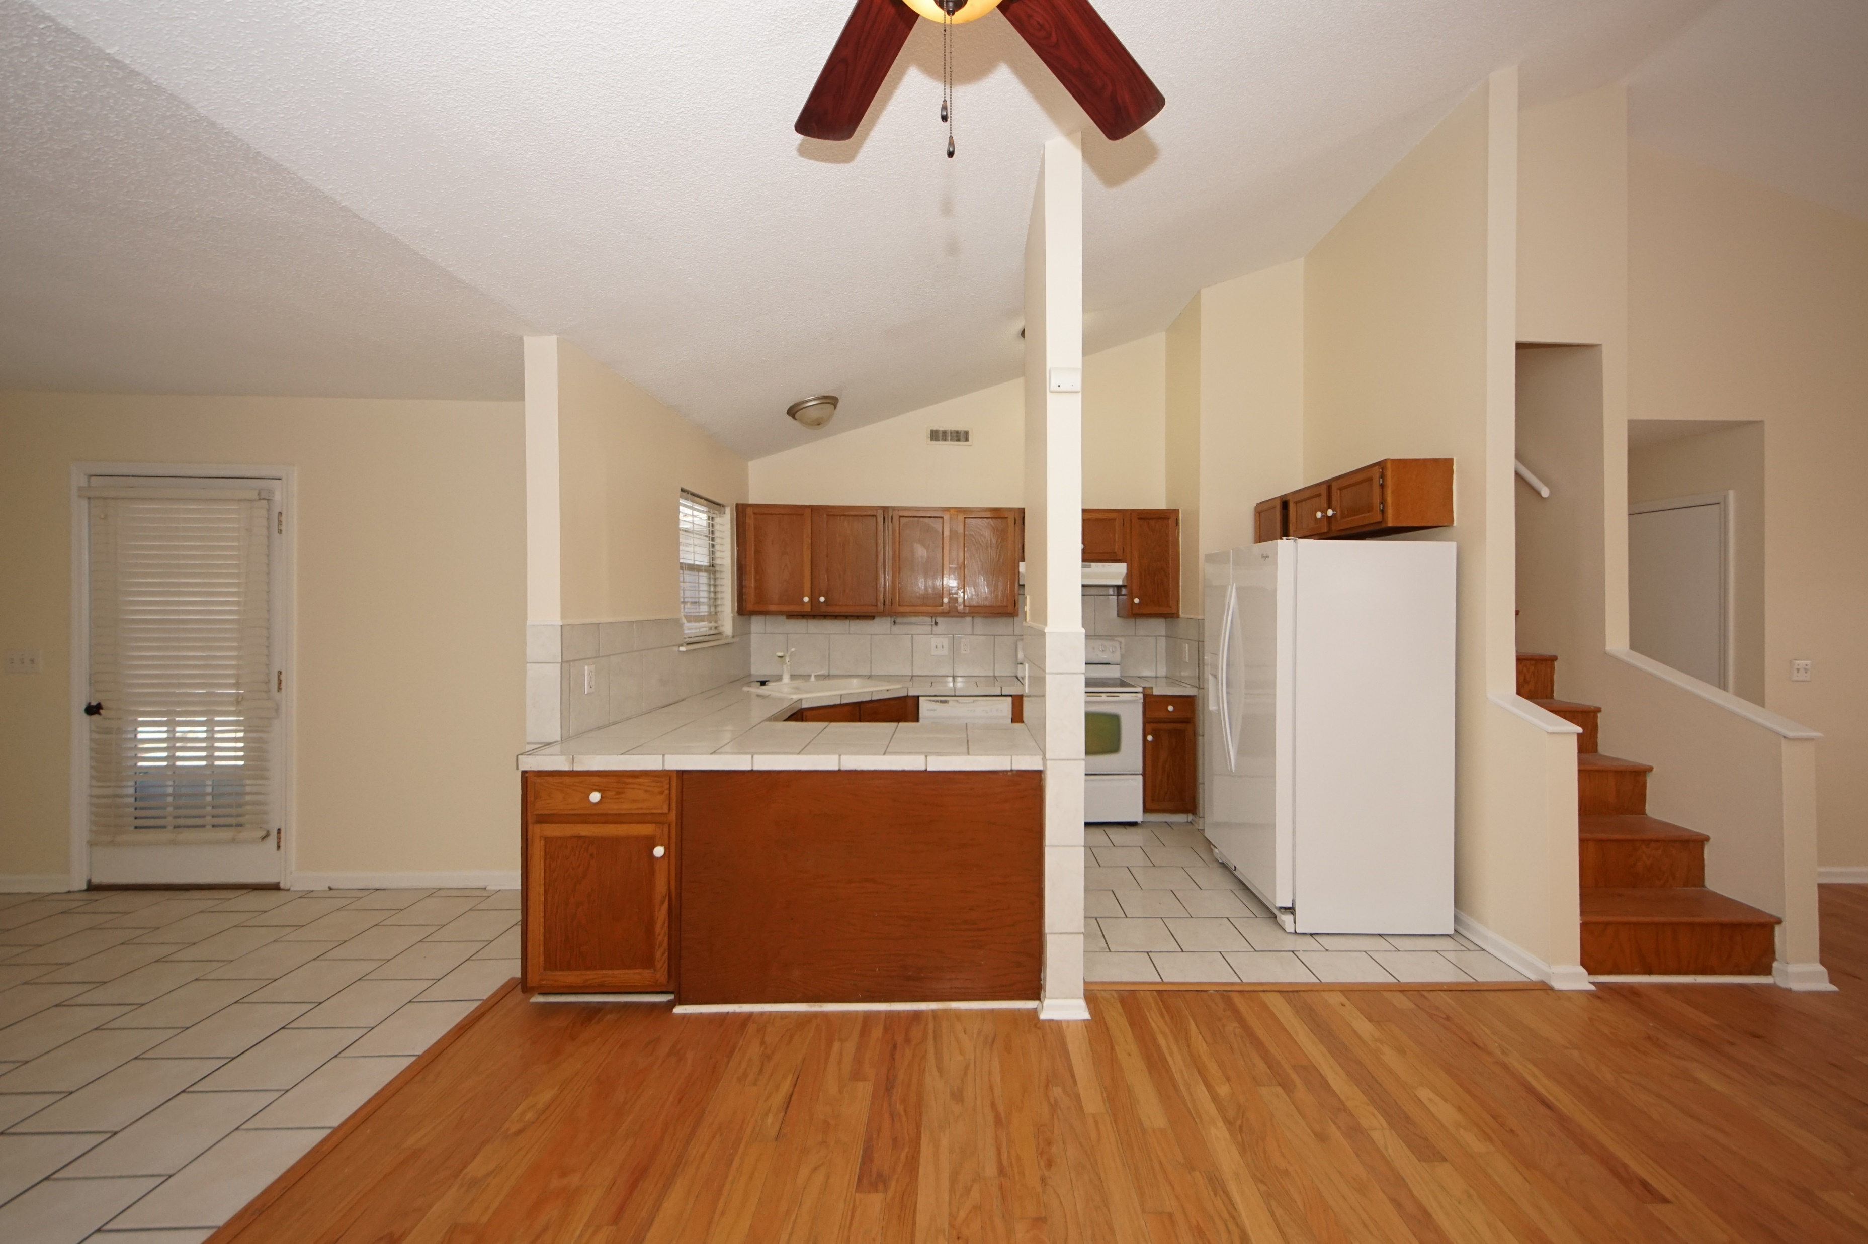
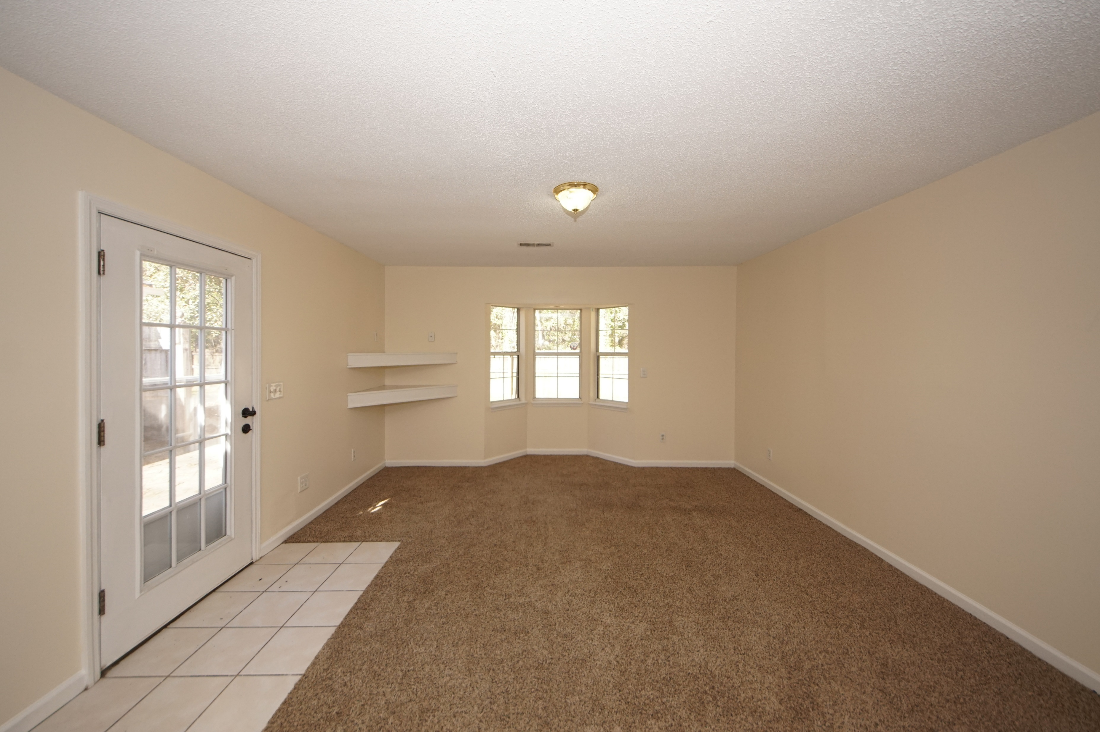
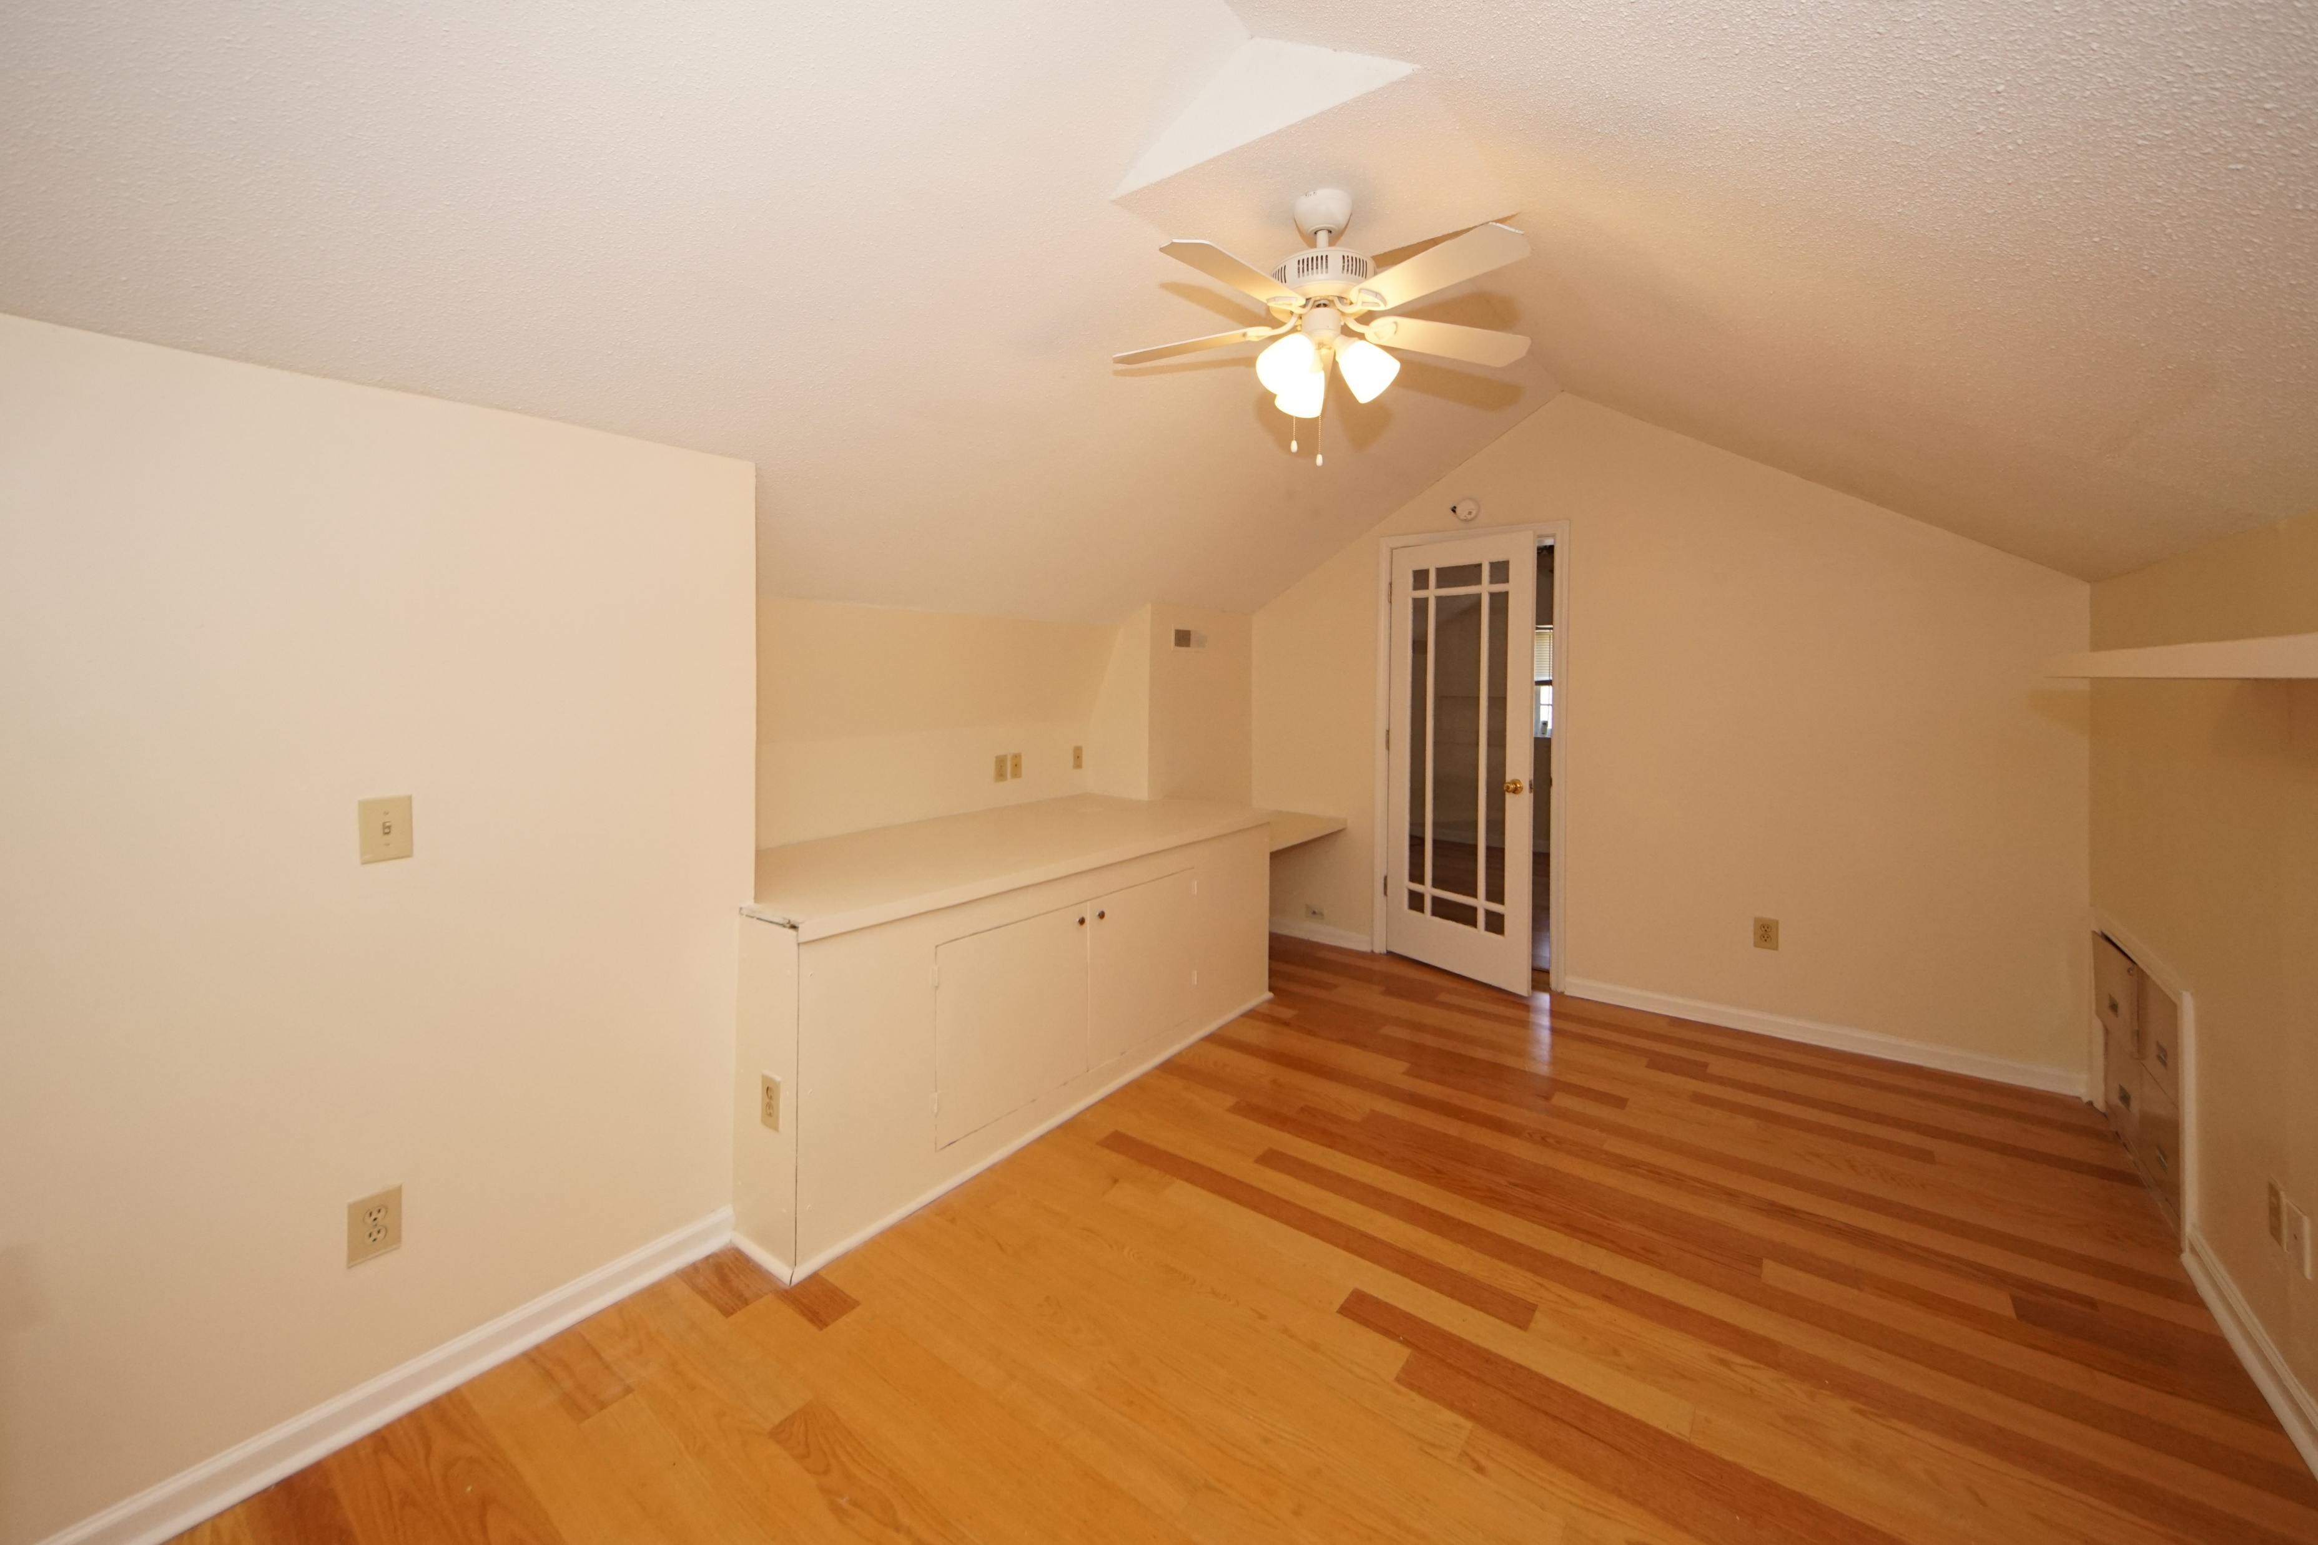
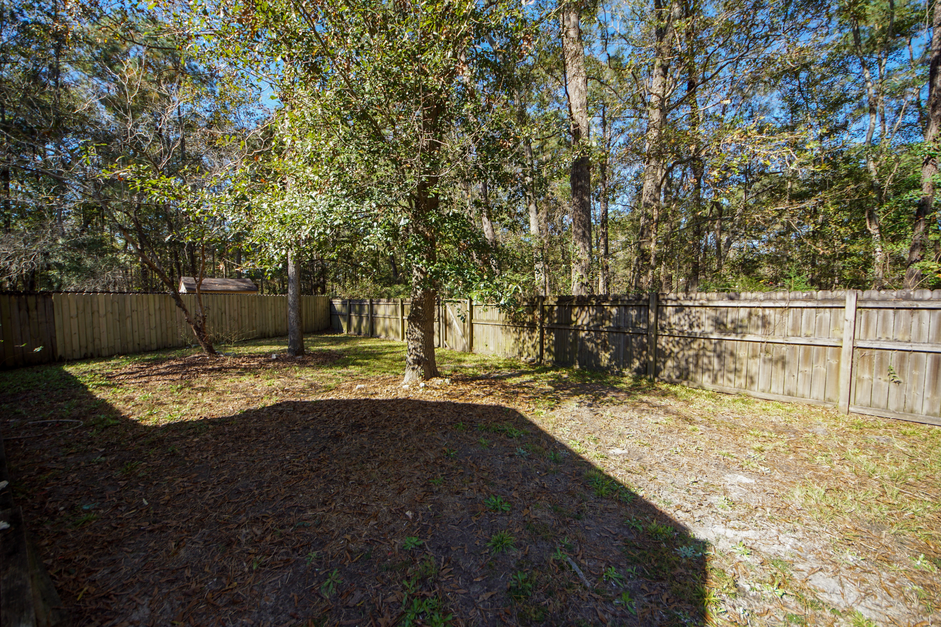

133 Shropshire Street
Crowfield Plantation ~ Goose Creek
MLS# 20031156 ~ $245,000
REDUCED!
REDUCED!
PRICE REDUCED!! MOTIVATED SELLERS!! MOVE IN READY!!
Charming ranch home located in the Alston Court subsection of Crowfield Plantation. As you enter the home you are greeted to a large open floor plan with hardwood floors and ceramic tile. On the first level you have two bedrooms and two bathrooms. The spacious master bedroom on the first floor features three closets and en-suite bathroom. You also have access to the patio from the master suite. The third bedroom is on the second level. You won't be able to tell how large this home really is until you go inside. The fenced in yard includes a patio area that is perfect for dining. This neighborhood includes a playground, tennis court and baseball field. The roof is one year old. This home has a transferable termite bond.
Renata Smalls
stinsonspace@bellsouth.net
www.thespacecompany.com
O 843-577-2676 | M 843-864-3990

