Slide 1
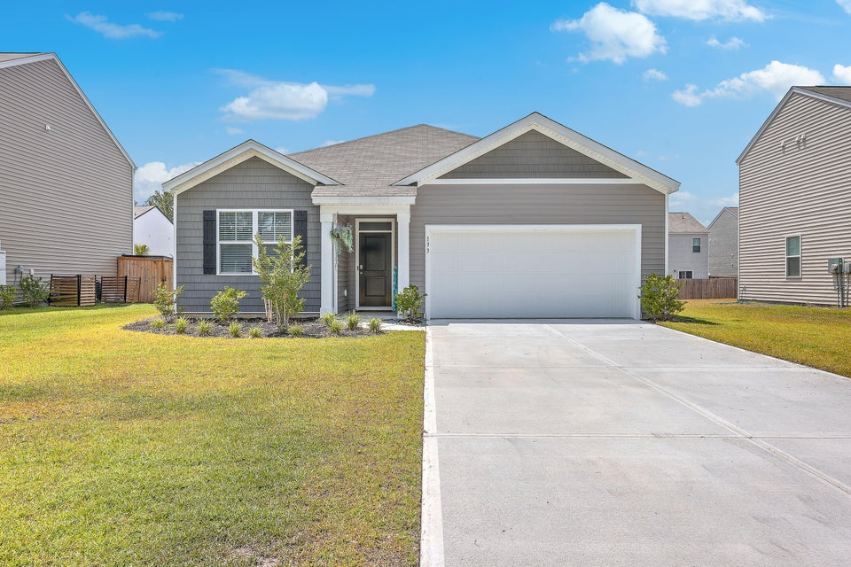
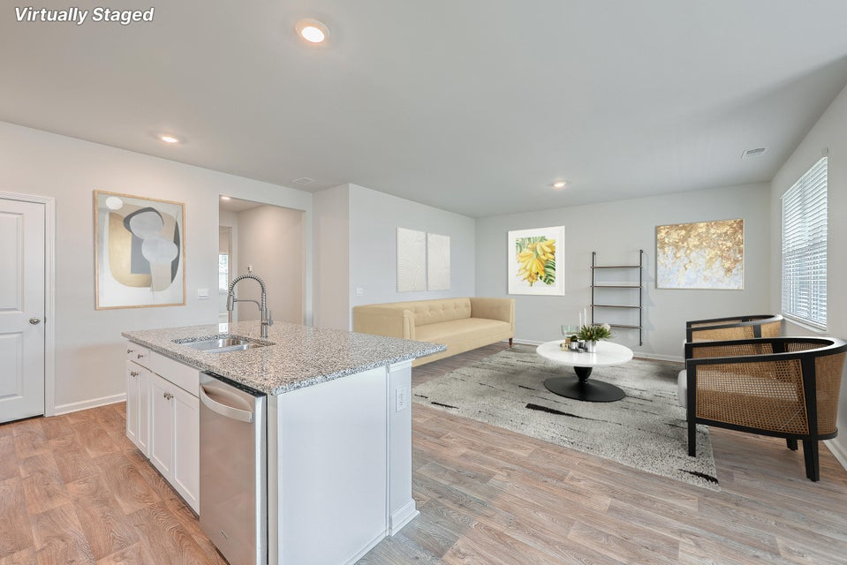
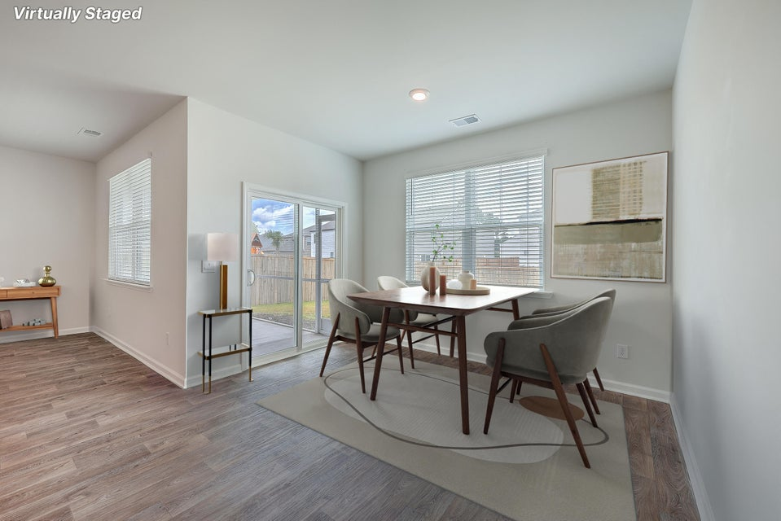
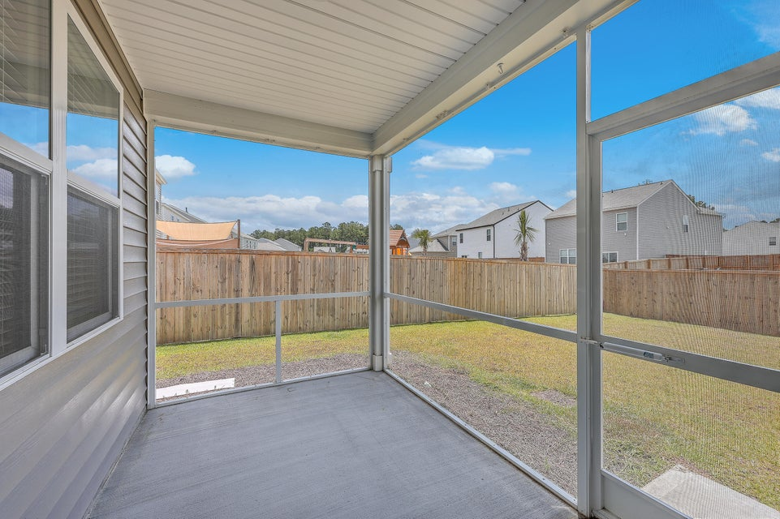


133 Summit View Drive
Cane Bay Plantation | Summerville, SC 29486 | MLS# 24016061 | $373,900
Take a look
at this listing!
NEW CONSTRUCTION!!!
OPEN HOUSE
SATURDAY 12-3PM
Snacks and Tea
while you tour
SELLER CONCESSIONS ARE NEGOTIABLE
SELLER HAPPY TO HELP WITH CLOSING COSTS WITH AN ACCEPTABLE OFFER.
Preowned, but like new everywhere. Why wait for a build, when you can own this home now. Owner lived in this home for a short time and relocated. Home shows like new. Owner installed privacy fence and upgraded the screen porch size. Recently purchased washer/dryer conveys with warranty and all window treatments/blinds will convey. The Aria floorplan features an open concept living space with a large kitchen island, primary bedroom with a walk-in closet and includes a spacious two-car garage that offers additional storage with garage door opener as well. This home is in like new condition. Great neighborhood in Cane Bay Plantation. Easy to see and ready for you to make your own as the owner left the home in its original excellent condition.
BUYER AGENT COMPENSATION OFFERED
Steve Priola
843-425-1641
stevepriola.realtor@gmail.com
Brand Name Real Estate :: 4 Carriage Lane Suite 106 :: Charleston, SC 29407

