Slide 1
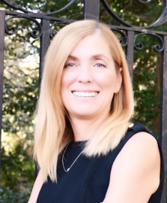
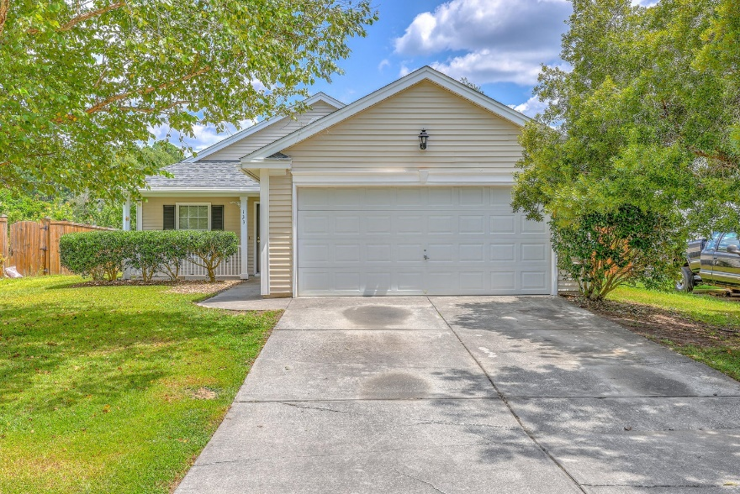
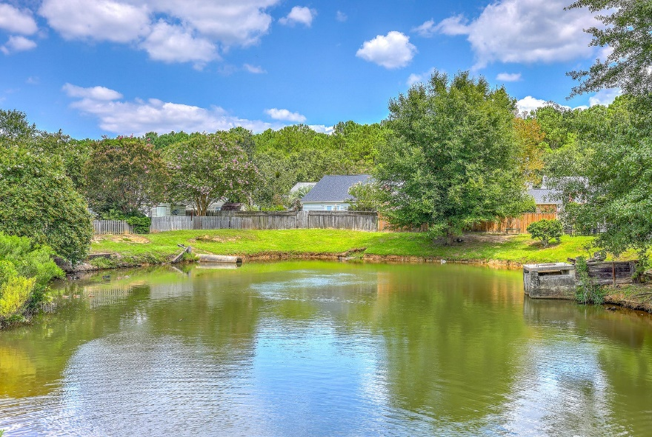
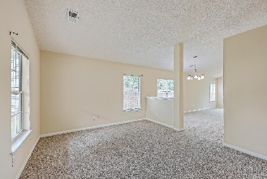
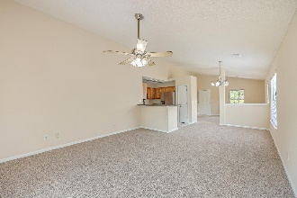
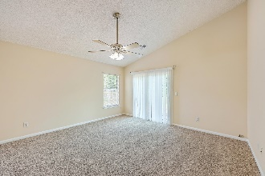
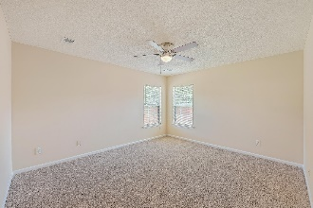
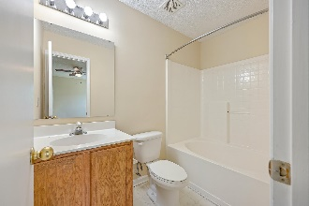

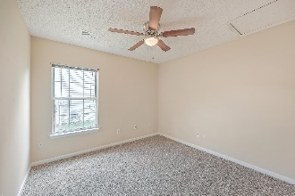
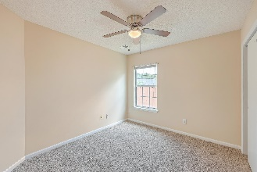
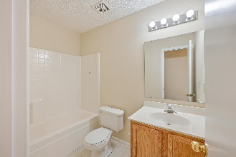
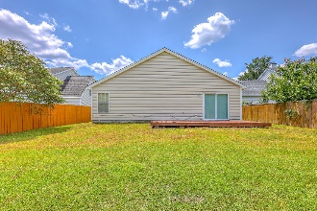
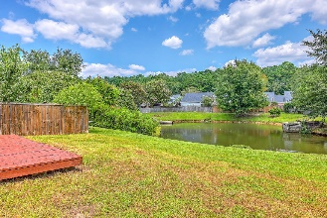
Single-story Perfection
in the Heart of Dorchester District 2!
Debbie Cromer
ABR, RSPS, REALTOR, CRS
(843) 437-6342
debbie@debbiecromer.com
www.debbiecromer.com/
133 Two Pond Loop
Brookhaven | Ladson, SC 29456 | MLS# 23019154 | $300,000
Welcome to single-story perfection in the heart of Dorchester District 2! This inviting home boasts a spacious master suite, complemented by two additional bedrooms, offering both privacy & comfort. The combined family room & dining area, along with a separate living room, provide versatile spaces for relaxation and entertainment. Kitchen features new stainless steel appliances including smooth top range, microwave, dishwasher & refrigerator! Enjoy tranquil pond views from your 10x20 deck, creating a serene backdrop for everyday living. Vaulted ceilings elevate the ambiance, while the convenience of a 2-car garage adds practicality to your lifestyle. With new HVAC, a newer roof, & fresh carpet & paint, this home is ready to embrace its lucky new owners with modern comfort and style!
Century 21 Properties Plus | 1090 Park West Blvd; Ste 103 | Mount Pleasant, SC 29466

