Slide 1
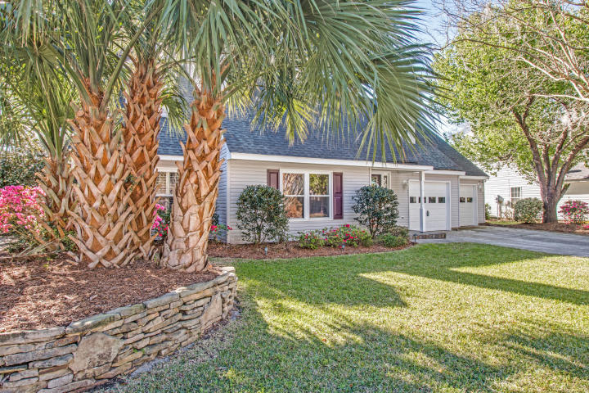
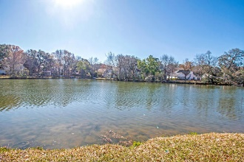
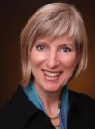

Public Open House ~ Sunday 1:30-3:30
1340 Center Lake Dr Center Lake ~ Mount Pleasant, SC 29464
MLS# 18007302 ~ $499,900
Renovation List
New interior paint throughout the house
New carpet in bedrooms, family room and hallway
New Quartz countertops-white with a tiny bit of gray with warm and cool tones
Painted kitchen and Master bath cabinets white
New cabinet pulls, knobs and hinges for kitchen and bathrooms
New stainless-steel appliances, refrigerator, stove, built in microwave
New light fixtures in dining room and at front door
Replace fogged windows
Kay Kennerty MBA, ABR, CRS, GRI
843-345-5011
KKennerty@aol.com www.KayKennertyHomes.com
The AgentOwned Realty Company
824 Johnnie Dodds Blvd, Mt. Pleasant, SC 29464

