Slide 1
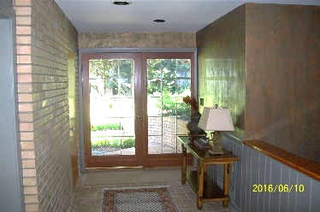
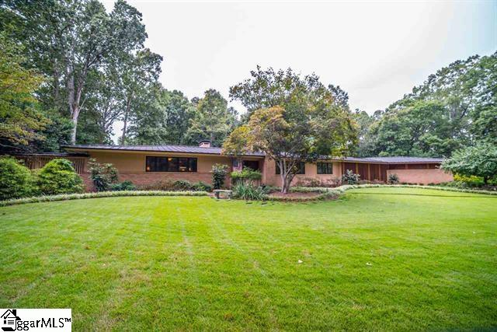
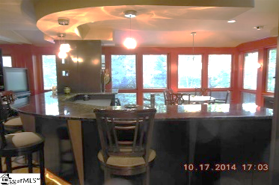
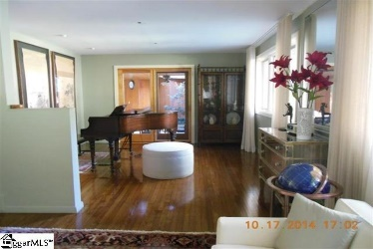
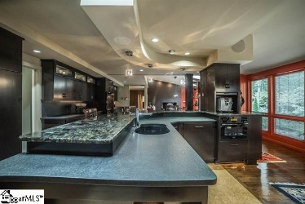
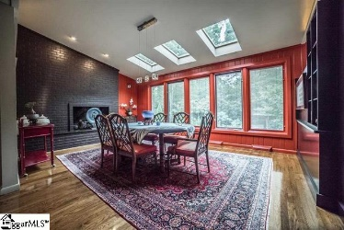
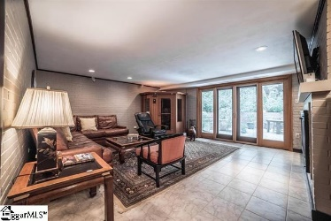
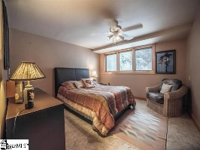
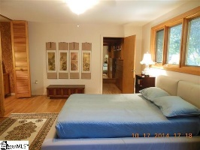
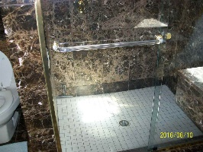
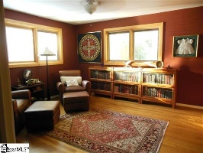
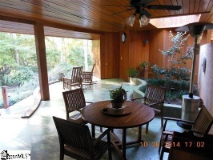
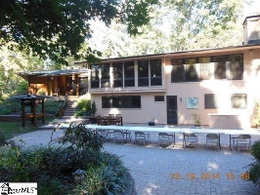
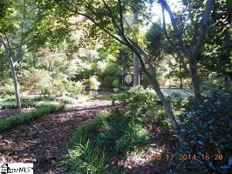


1340 Pinecrest Rd, Spartanburg, SC 29302
Architecture inspired by Frank Lloyd Wright
Pass through the gate and a Zen- like setting awaits. This extraordinary home is nestled in one of Spartanburg’s most beautiful and prestigious eastside neighborhoods. Frank Lloyd Wright- inspired architecture artfully integrates unique design with exquisite tranquil gardens. Inside, you will find an entertainer's kitchen at the center of this home with appliances integrated into expresso wood custom cabinets and oiled bronze hardware. Direct and indirect light showers through skylights to enhance the elegance of top line appliances. A Tuscan outdoor room with half bath allows indoor/outdoor flow. The home has seen 4 children grow up, has hosted too many gatherings to count, and has welcomed more than 150 company interns as long-term guests in its 35 plus years within the same family. The owners have taken exceptional care in the maintenance of this home and have assembled a captivating abode- see the amenities list attached to the MLS listing; they are too numerous to name. Once you visit you will want to stay for a while to meditate.
MLS# 235863
$725,000
Carolina Country Club, 367 Twin Oaks Drive, Spartanburg, SC
Peggy Wilson
Realtor, Broker, GRI, ABR
864-415-3958
peggy@realtysc.com
www.realtysc.com

