Slide 1
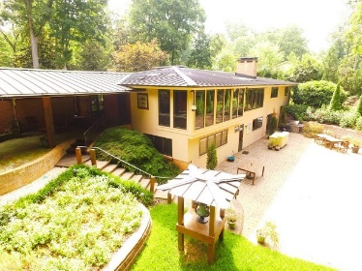
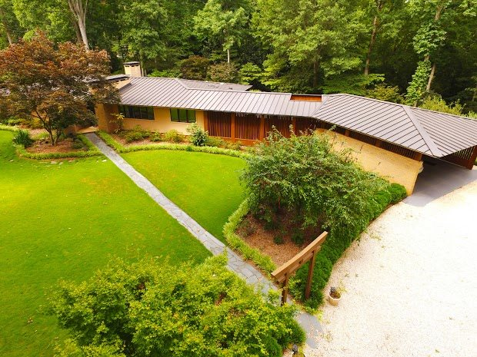
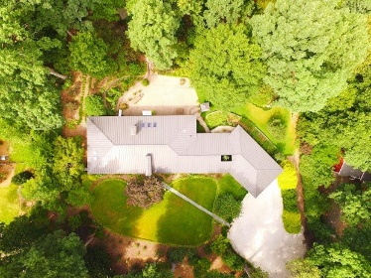
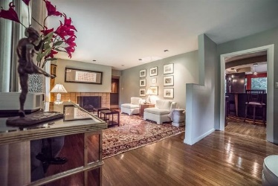
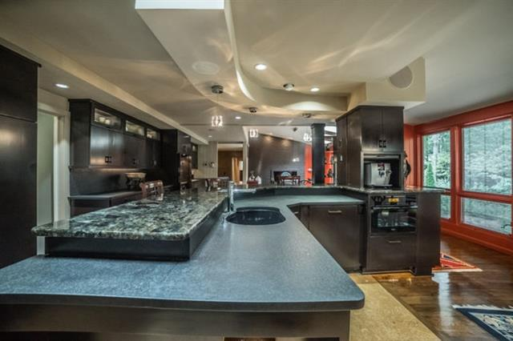
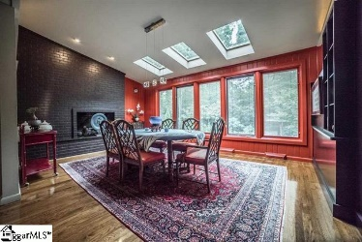
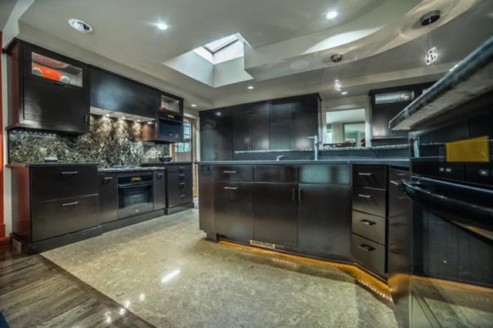
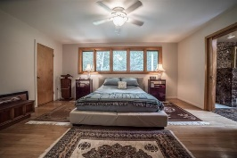
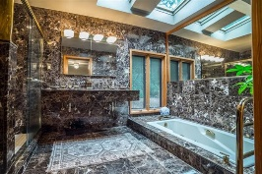
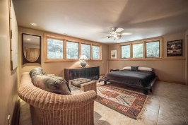
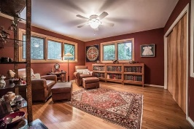
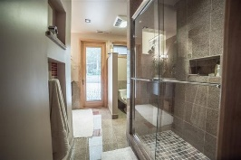
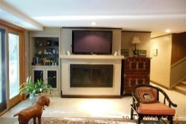
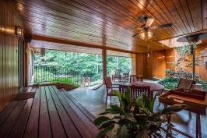


1340 Pinecrest Rd, Spartanburg, SC 29302
Frank Lloyd Wright Architectural Style
Blends Harmony with Nature…
Melding Quiet Earthiness with Artistic Flair
The Kitchen captures the Heart of this Aesthetic
The Covered Terrace “Tuscan Room” with half bath overlooks the outdoor gardens
Stroll through the courtyard paved in Tuscan-Style Brick beside a railroad bell nested in a tower,
a bocce alley just out of sight along a walking path. Enjoy afternoons of relaxed camaraderie.
MLS# 235863
Make An Offer Today!
Asking Price $699,900
Check out the video tour!
www.youtube.com/watch?v=ckDZRqQN7aQ
Carolina Country Club, 367 Twin Oaks Drive, Spartanburg, SC
Peggy Wilson
Realtor, Broker, GRI, ABR
864-415-3958
peggy@realtysc.com
www.realtysc.com

