Slide 1
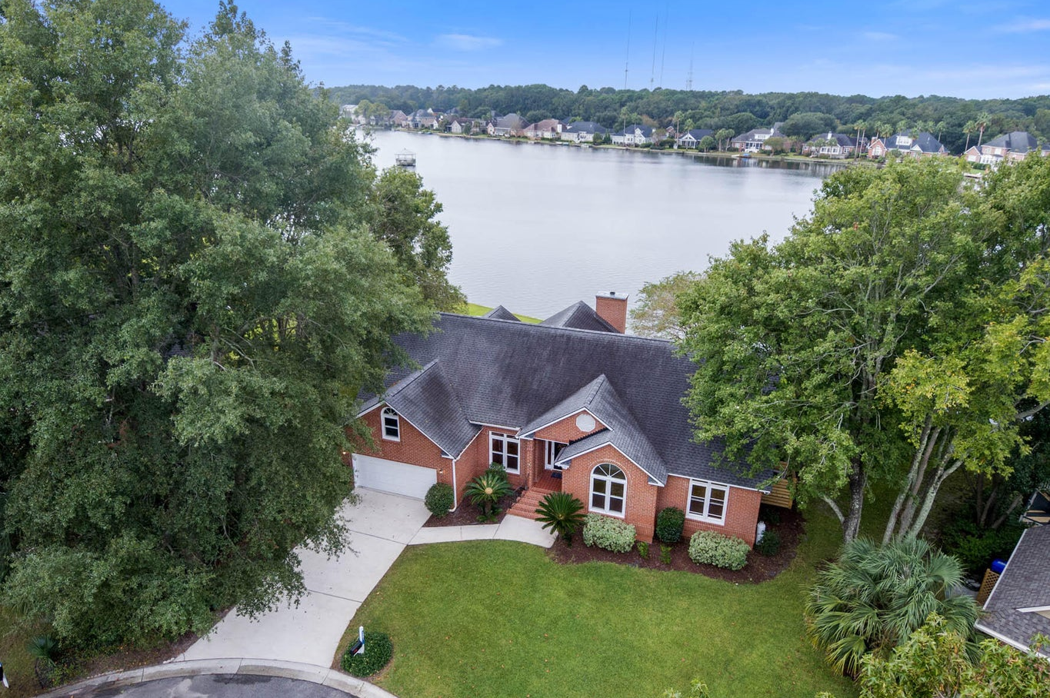
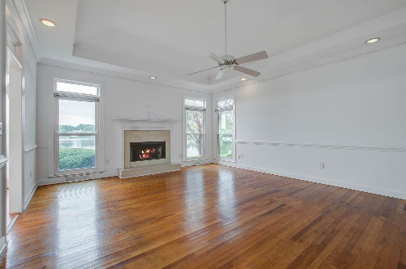
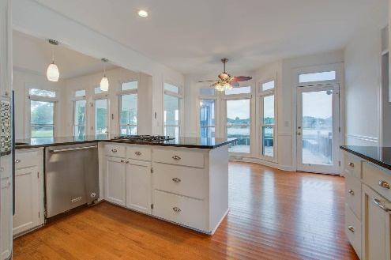
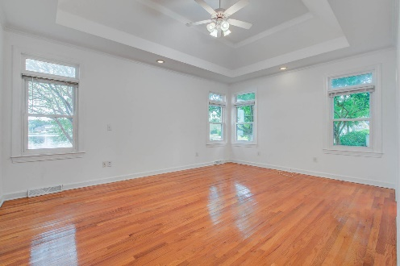
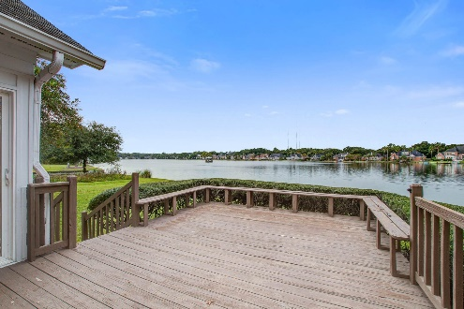


JUST LISTED IN HIDDEN LAKES
LAKEFRONT!
1341 Topsail Court
Hidden Lakes · Mount Pleasant, SC 29464
MLS# 23023009 · $1,250,000
Michael Dew
O 843-769-5100
M 843-870-7000
michaeledew@gmail.com
www.michaeldewrealestate.com
4 bedroom 3 bath brick home on cul-de-sac in desirable Hidden Lakes. This property is situated on one of the largest lake frontage lots with 170 ft of lake frontage. Fabulous open floor plan. Eat in kitchen with island, stainless steel appliances, tile backsplash and granite counter tops. Family room with built ins, fireplace, and trey ceilings. Large master ensuite on main floor with dual vanities, separate tub and shower. 2 additional spacious bedrooms and bath on first floor. 4th bedroom is frog. Beautiful sunroom with views of the lake. Large deck overlooking backyard with expansive water views. Enjoy fishing and boating on this pristine 52 acre lake with canals. Amazing location in the heart of Mt. Pleasant. Convenient to beaches, shopping, restaurants and 526.
Hidden Lakes offers many amenities and organizes several community events. An absolute must see!!
AgentOwned Charleston Group
902 Savannah Hwy
Charleston, SC 29407
Real Estate ● Mortgage Insurance ● Business Brokerage

