Slide 1
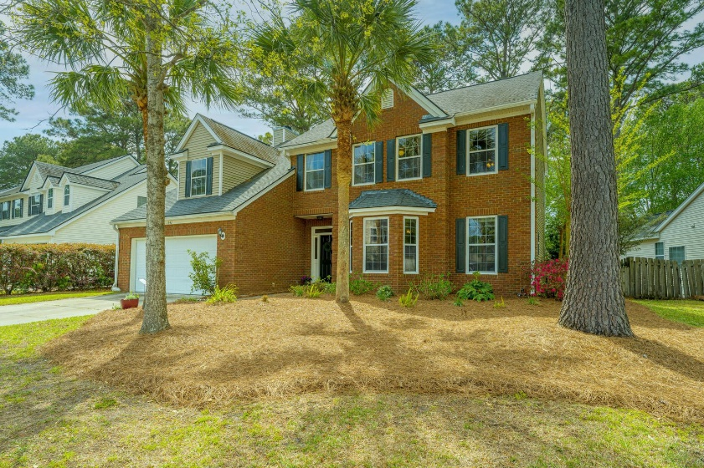
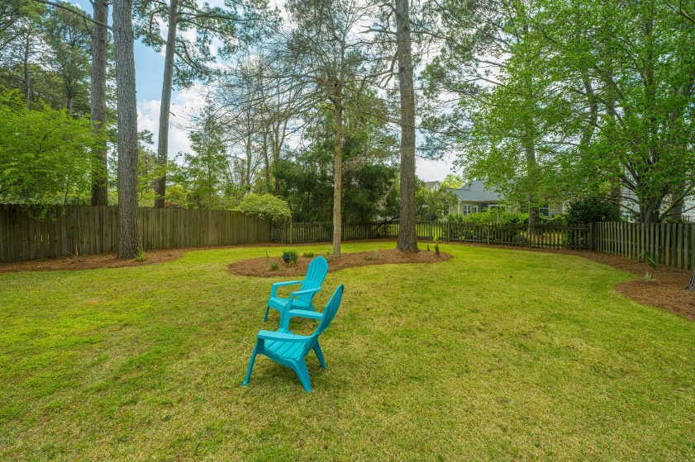
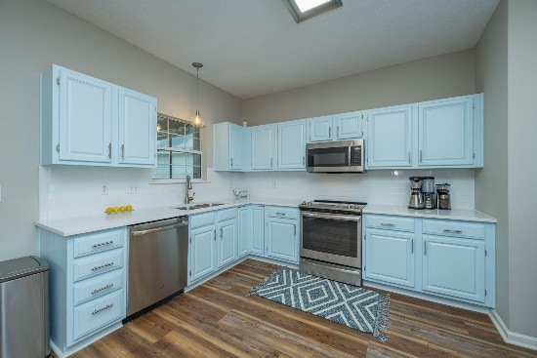
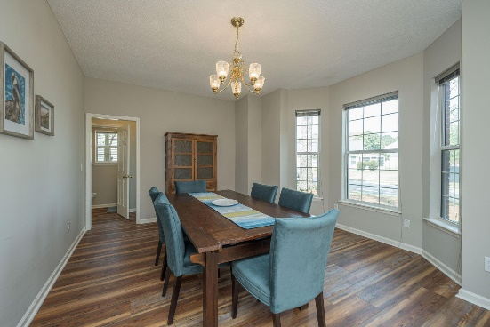
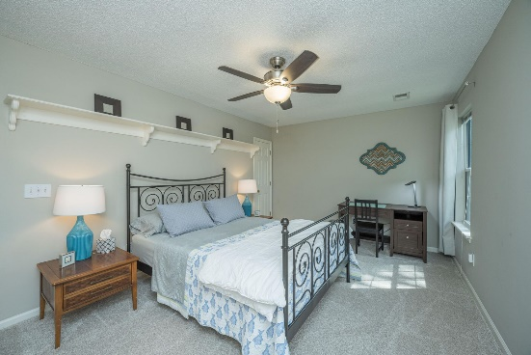
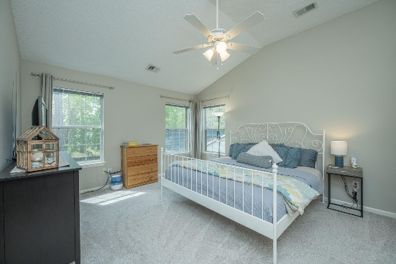
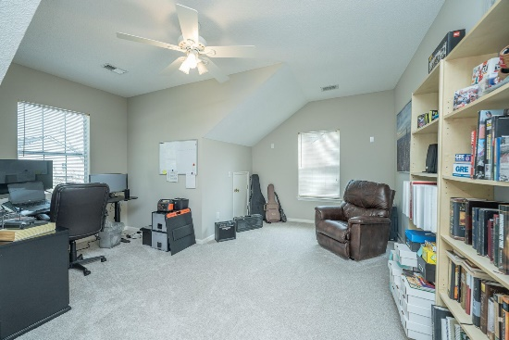
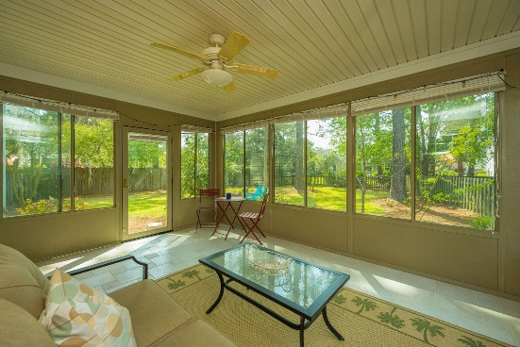



Why wait for new construction?
This Park Circle area home is LESS THAN 2 YEARS!
New Charleston National Listing
1342 Somersby Lane
Charleston National · Mt Pleasant · MLS# 22008156 · $600,000
Welcome home to 1342 Somersby Lane in the Westchester Section of Charleston National! This 3 bedroom, 2.5 bath with a large FROG has to be seen in person to appreciate its beauty and finishes. From the entry foyer, you'll see the bright dining room on your right with large bay windows. Around the corner, find the open living room with views to the large backyard where mature orange trees grow. Across from the living room, the spacious kitchen is a cook's dream with quartz countertops, stainless steel appliances, and beautiful coastal blue vibes. Off the kitchen, you'll discover the west-facing sunroom that is the perfect spot for morning coffee, birdwatching, and Lowcountry sunsets. Head upstairs, past the large picture window that brightens the whole home, to find a roomy primary suite, 2 bedrooms that share a hall bath, and a large FROG that could be a 4th BR, office or bonus room.
Take a Virtual Tour: https://my.matterport.com/show/?m=F9hAhkkueuC
Del Shaffer
843.408.6821
dshaffer@carolinaoneplus.com
2713 Highway 17 North
Mt. Pleasant, SC 29466

