Slide 1
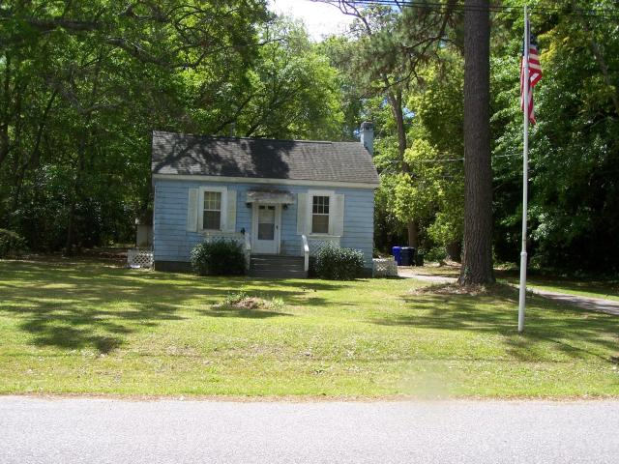
~ Close to Everything ~ Ready To Be Developed
Just Reduced!!
1343 Emory Avenue
Stono Park ~ Charleston ~ MLS# 17010252 ~ $285,000
This is the first time this property has been listed separately. It was previously listed with Lots 65 and 66 as a package. This lot is presently improved with a small cottage that was built in 1947. This property is being offered for sale as "if Vacant". No value has been assigned to the improvements. This lot is over 1 acre in size and is beautifully landscaped with flowering shrubs and towering oaks and pine trees. This is such a lovely site located in a quite and tranquil setting. It would make a perfect site for a large and warm family home. It is close to schools and shopping and is easily accessible from Highway 17 and I-526. THIS PROPERTY IS BEING OFFERED FOR SALE "AS IS, WHERE IS". The seller does not intend to make any repairs.
Tommy Hartnett
tfhartnett@gmail.com | (843) 729-7222
The Hartnett Company, LLC | PO Box 247 | Isle Of Palms, SC 29451

