Slide 1

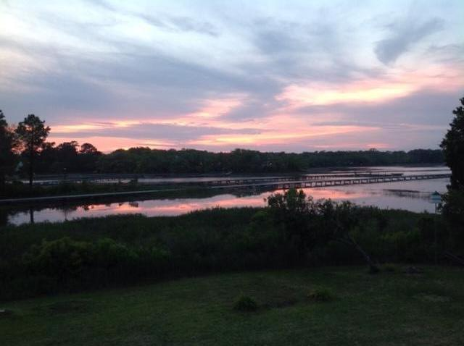
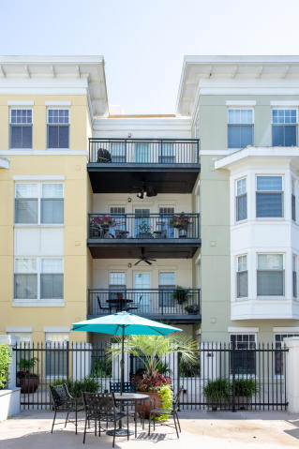
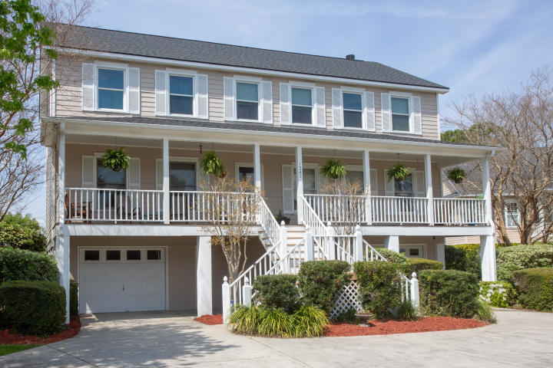
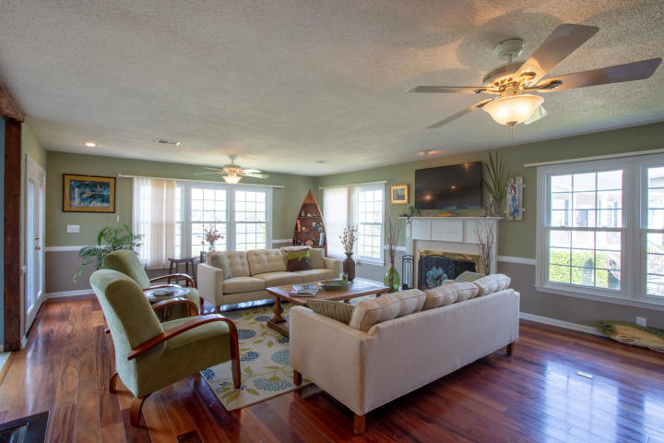
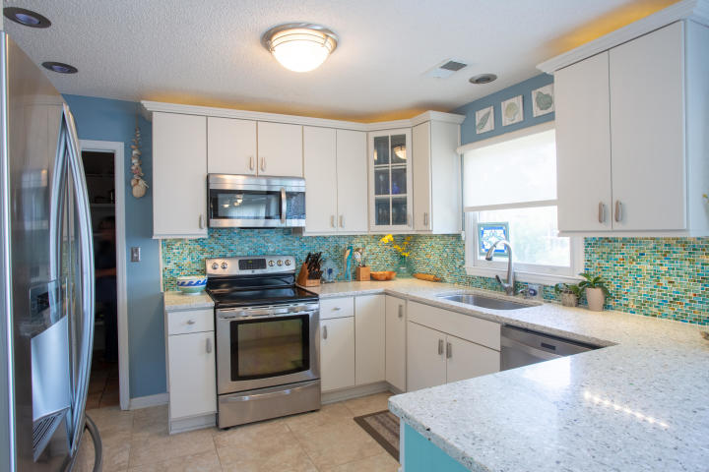
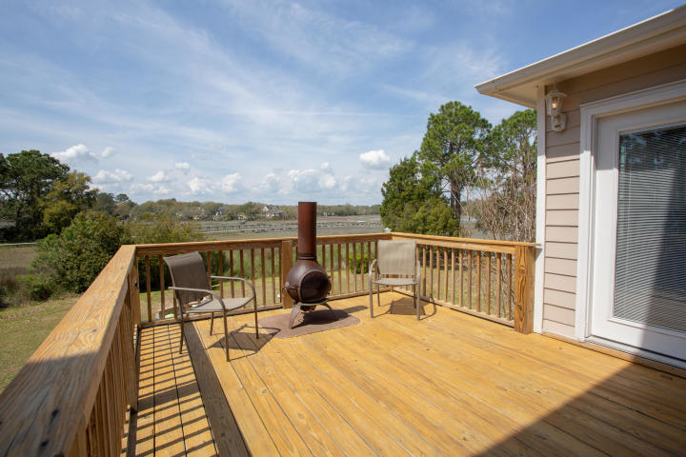
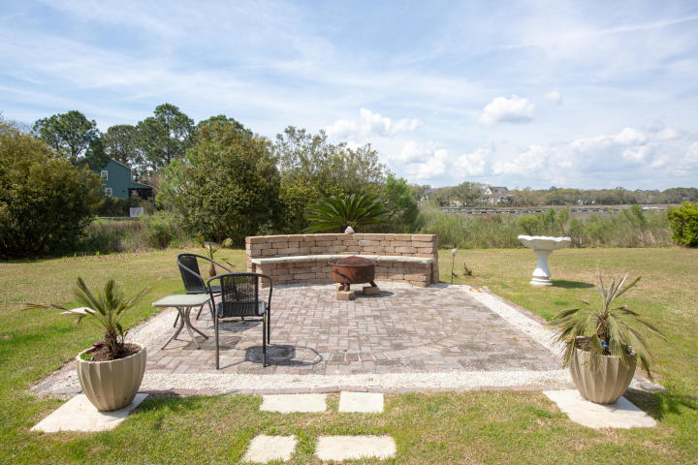


DRAFT
Agent Open House Wednesday 1-3pm
1343 Sea Bass Cove
Seaside Plantation | Charleston, SC 29412 | MLS# 19008923 | $669,000
Stunning waterfront home on a cul-de-sac in Seaside Estates. The first floor has hardwoods, a beautifully renovated kitchen w/ a large pantry, living room w/ expansive views of the Tidal Creek, dining room/TV room, and office. The kitchen has custom oyster shell and sea glass counter-tops, custom slow close cabinetry, and an eat-in area opening up onto the back deck. The living room is great for entertaining w/ a wet bar, beautiful sunset views, doors leading to the back deck, and a wood burning fireplace. The upstairs master has two large closets, windows overlooking the Tidal Creek, and a master bath w/ a soaking tub, walk-in shower, and double vanities. There's another full bath off of the hallway, a laundry room, and another three spacious bedrooms that all get a ton of natural light upstairs. The backyard is one of the larger ones in the neighborhood and has enough space for a pool. There's a back deck and patio w/ a fire-pit overlooking the water. There's an irrigation system that runs on a well. Communal boat ramp in the neighborhood and minutes to Folly Beach. Perfect for a family or retiree looking for the coastal lifestyle.
Greg Gelber
(843) 494-2354
greg.gelber@agentownedrealty.com
AgentOwned Charleston Group | 902 Savannah Hwy | Charleston, SC 29407-7802

