Slide 1


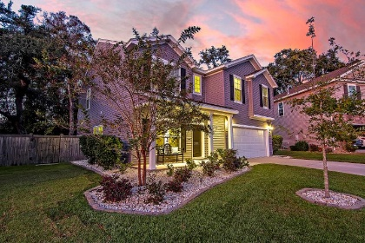
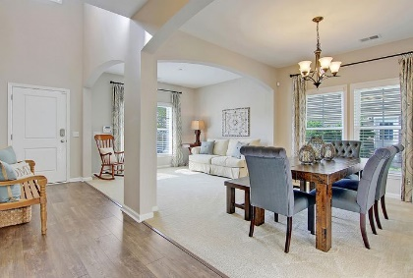
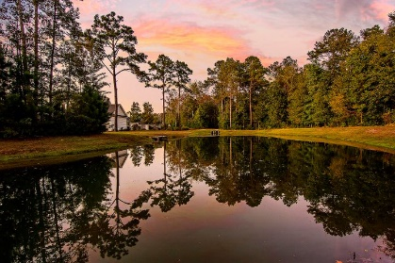
New Year ~ New Price
Same Serenity
1343 Paint Horse Court
Tupelo ~ Mount Pleasant, SC 29429 ~ MLS# 20030275 ~ $439,000
Backing to a pond in Tupelo, this move-in ready home in Mount Pleasant is a must see. You'll be greeted by lovely landscaping, a covered front porch and a two story foyer. A formal living room and dining room are joined by an archway and provide wonderful living areas. The open floor plan boasts an inviting eat-in kitchen with a center island, breakfast bar seating, SS appliances and it opens into the family room which overlooks the spacious fenced-in backyard. Head upstairs to find the owner's suite with a walk-in closet and en-suite bath with dual vanity, garden tub and walk-in shower. Three additional bedrooms, a shared bathroom, and a laundry room complete the second level. The screened-in porch leads to the patio and fenced-in backyard. Behind the fence is a peaceful pond.
This community offers a pool, playground and walking trails through a preserved wetlands area. Come by today!
Christopher Smith 843-267-0735
christopher@mattoneillteam.com
Nate Gainey 843-513-2038
nate@mattoneillteam.com

