Slide 1

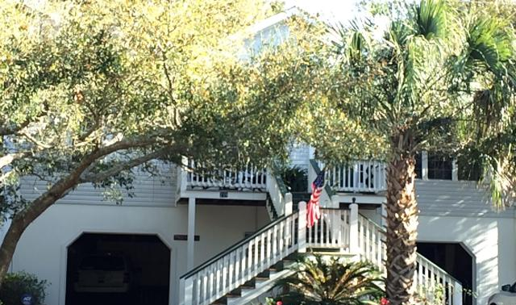
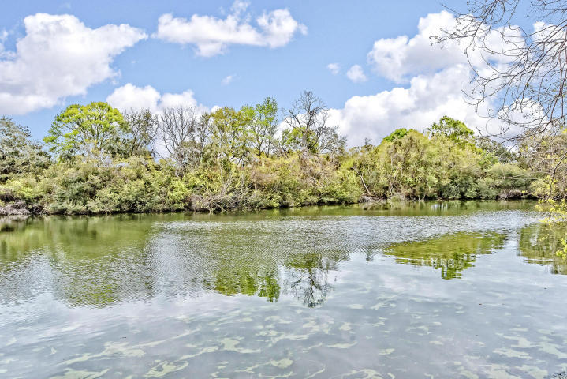
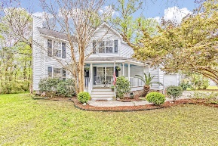
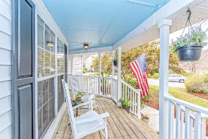
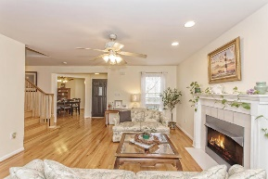
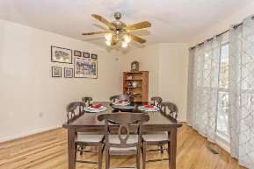
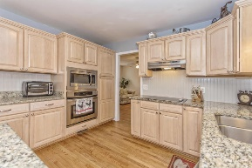
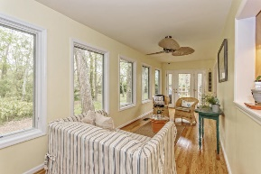
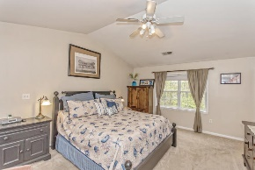
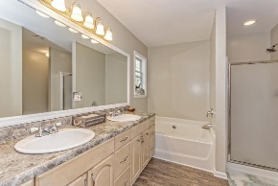
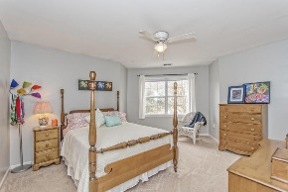
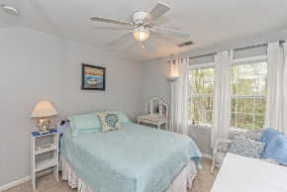
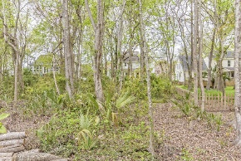
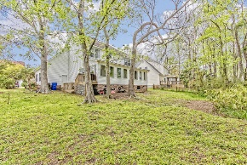

Move-in Ready in Laurel Lakes
Jane Locke, Realtor
M (843) 819-3508
lockejaneb@aol.com
www.century21properties.com
1344 Woodlock Road | Mt Pleasant, SC | MLS# 17008522 | $525,000
DRAFT
This home is move-in ready and is waiting for you. It is in a quiet neighborhood in the middle of Mt. Pleasant - convenient to everything. 10 minutes to beaches, 20 minutes to downtown Charleston, and 20 minutes to airport. Situated on a deep fresh water lake, you can fish, kayak, canoe, paddleboard - all from your own backyard. Downstairs has tile and hardwood floors. Kitchen has energy efficient appliances, plus solar water heater, stainless steel appliances - 2 years old, beadboard walls. Spacious sunroom has energy efficient windows overlooking large backyard which has endless possibilities. Come check out this home for the best in lakefront living. Do not pass up this great home - living on a fresh water lake in the middle of Mt. Pleasant - it just does not get any better!!!!!
Century 21 Properties Plus | 3301 Salterbeck St Suite 100 | Mt. Pleasant, SC 29466

