Slide 1
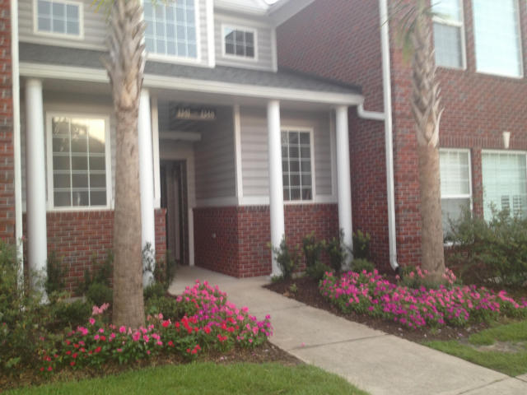
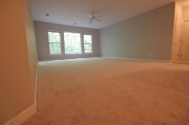
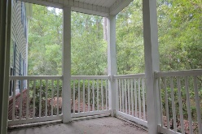

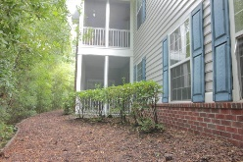
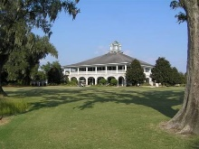


Just Woods and Trees Out This Condo's Windows.
A Feeling of Utter Privacy
1345 Kingsford Ln
Dunes West
Mount Pleasant
MLS# 15019586
$218,900
You won't find a more serene woodsy setting and view. Glance into the lush greenery outside the over-sized windows -- there's a good chance you'll see some wildlife. Situated on the back of the building, away from the parking lot, this first floor flat gives a feeling of solitude and complete privacy. Just painted and re-carpeted throughout, it's in move-in condition and ready to go. The convenience of single floor/first floor; never-deal-with-stairs-at-home living cannot be overstated. Washer, dryer and refrigerator are included. Optional amenities in neighborhood are at extra cost and buyer's discretion: golf, tennis, swimming pools/ water slide, fitness center, boat storage, and more. Taxes shown are for non-owner occupant; taxes would be significantly lower for owner-occupant.
John Crowley
843-819-4951
John.Crowley@AgentOwnedRealty.com
AgentOwned Preferred Group | 1400-G Palm Blvd | Isle Of Palms, SC 29451

