Slide 1
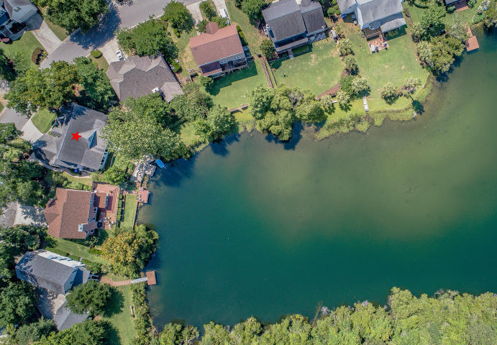
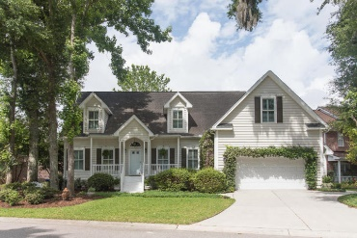
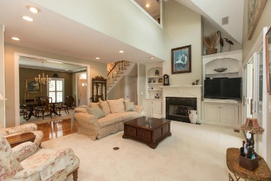
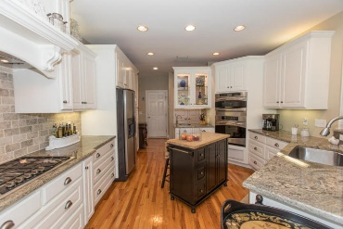
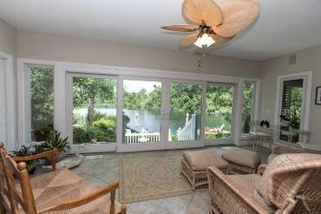
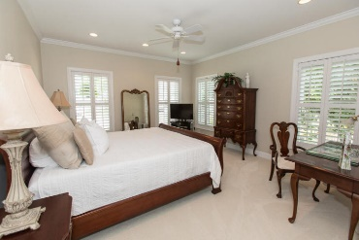
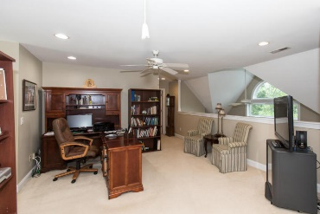
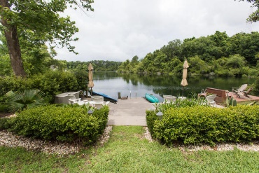
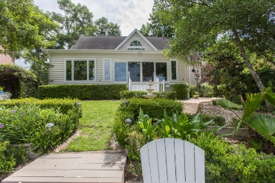
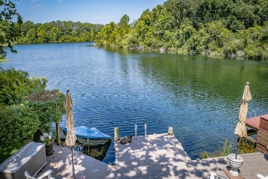


1345 Woodlock Road Laurel Lakes Mount Pleasant, SC 29464 MLS# 18014842 $775,000
Just Reduced to $699,000
Impeccably well maintained home with the most beautiful view of a fresh water lake that will take your breath away. Elegant formal dining room, large family room with gas fire place, sunroom with wonderful view of the lake. "To Die For" gourmet kitchen has new 5 burner gas range top with pot faucet, Spacious granite countertops with breakfast bar & stools, massive kitchen cabinetry and butler pantry. Panoramic & breathtaking view of the lake from the kitchen. Master suite on the first floor with sitting room & walking in dressing room with built ins. Master bath has large newly remodeled glass shower doors & faucets, jacuzzi with glass block windows & double sinks. Second floor has 2 large secondary bedrooms each with its own private bath & a large open area between the bedrooms that could serve as an office, play area or could be converted to a fourth bedroom. Plantation shutters throughout house, security alarm system. Large 2 car garage & extra side parking pad. Extensive landscaping front and back of home with mature low country plantings, arbor, and walkways with 6 zone irrigation system connected to the lake. You have to come inside the house to appreciate this special home with so many extra touches. It is an exceptional home, quality throughout. You will be not disappointed. Thank you for showing.
Cathy Rosenblum
843-817-7869
crosenblum@comcast.net

